Slide 1
UNDP MODEL GOVERNANCE FRAMEWORK FOR DIGITAL LEGAL IDENTITY SYSTEMS
Mogadishu
August 2024

Slide 2
Digital ID has proven an effective enabler for development, but we have still work to do
The potential of digital ID…
…and the work ahead for (digital) identity for everyone
3 - 13% GDP growth
850 Mn people
16% more women than men
could be unlocked in individual countries by 2030 from the implementation of digital ID programs³
do not have any official form of identification, and therefore have limited access to public services and economic mobility¹
don’t have access to ID resulting in limited legal status and access to asset ownership²
(1) World Bank, 850 million people globally don’t have ID, 2023; (2) Biometric Update, Massive gender disparities in digital ID systems persist, 2021; (3) McKinsey, https://www.mckinsey.com/capabilities/mckinsey-digital/our-insights/digital-identification-a-key-to-inclusive-growth, 2019

Slide 3
The value drivers for (digital) identity
Financial inclusion. Reducing fraud. Streamlining government service delivery across government.

Slide 4
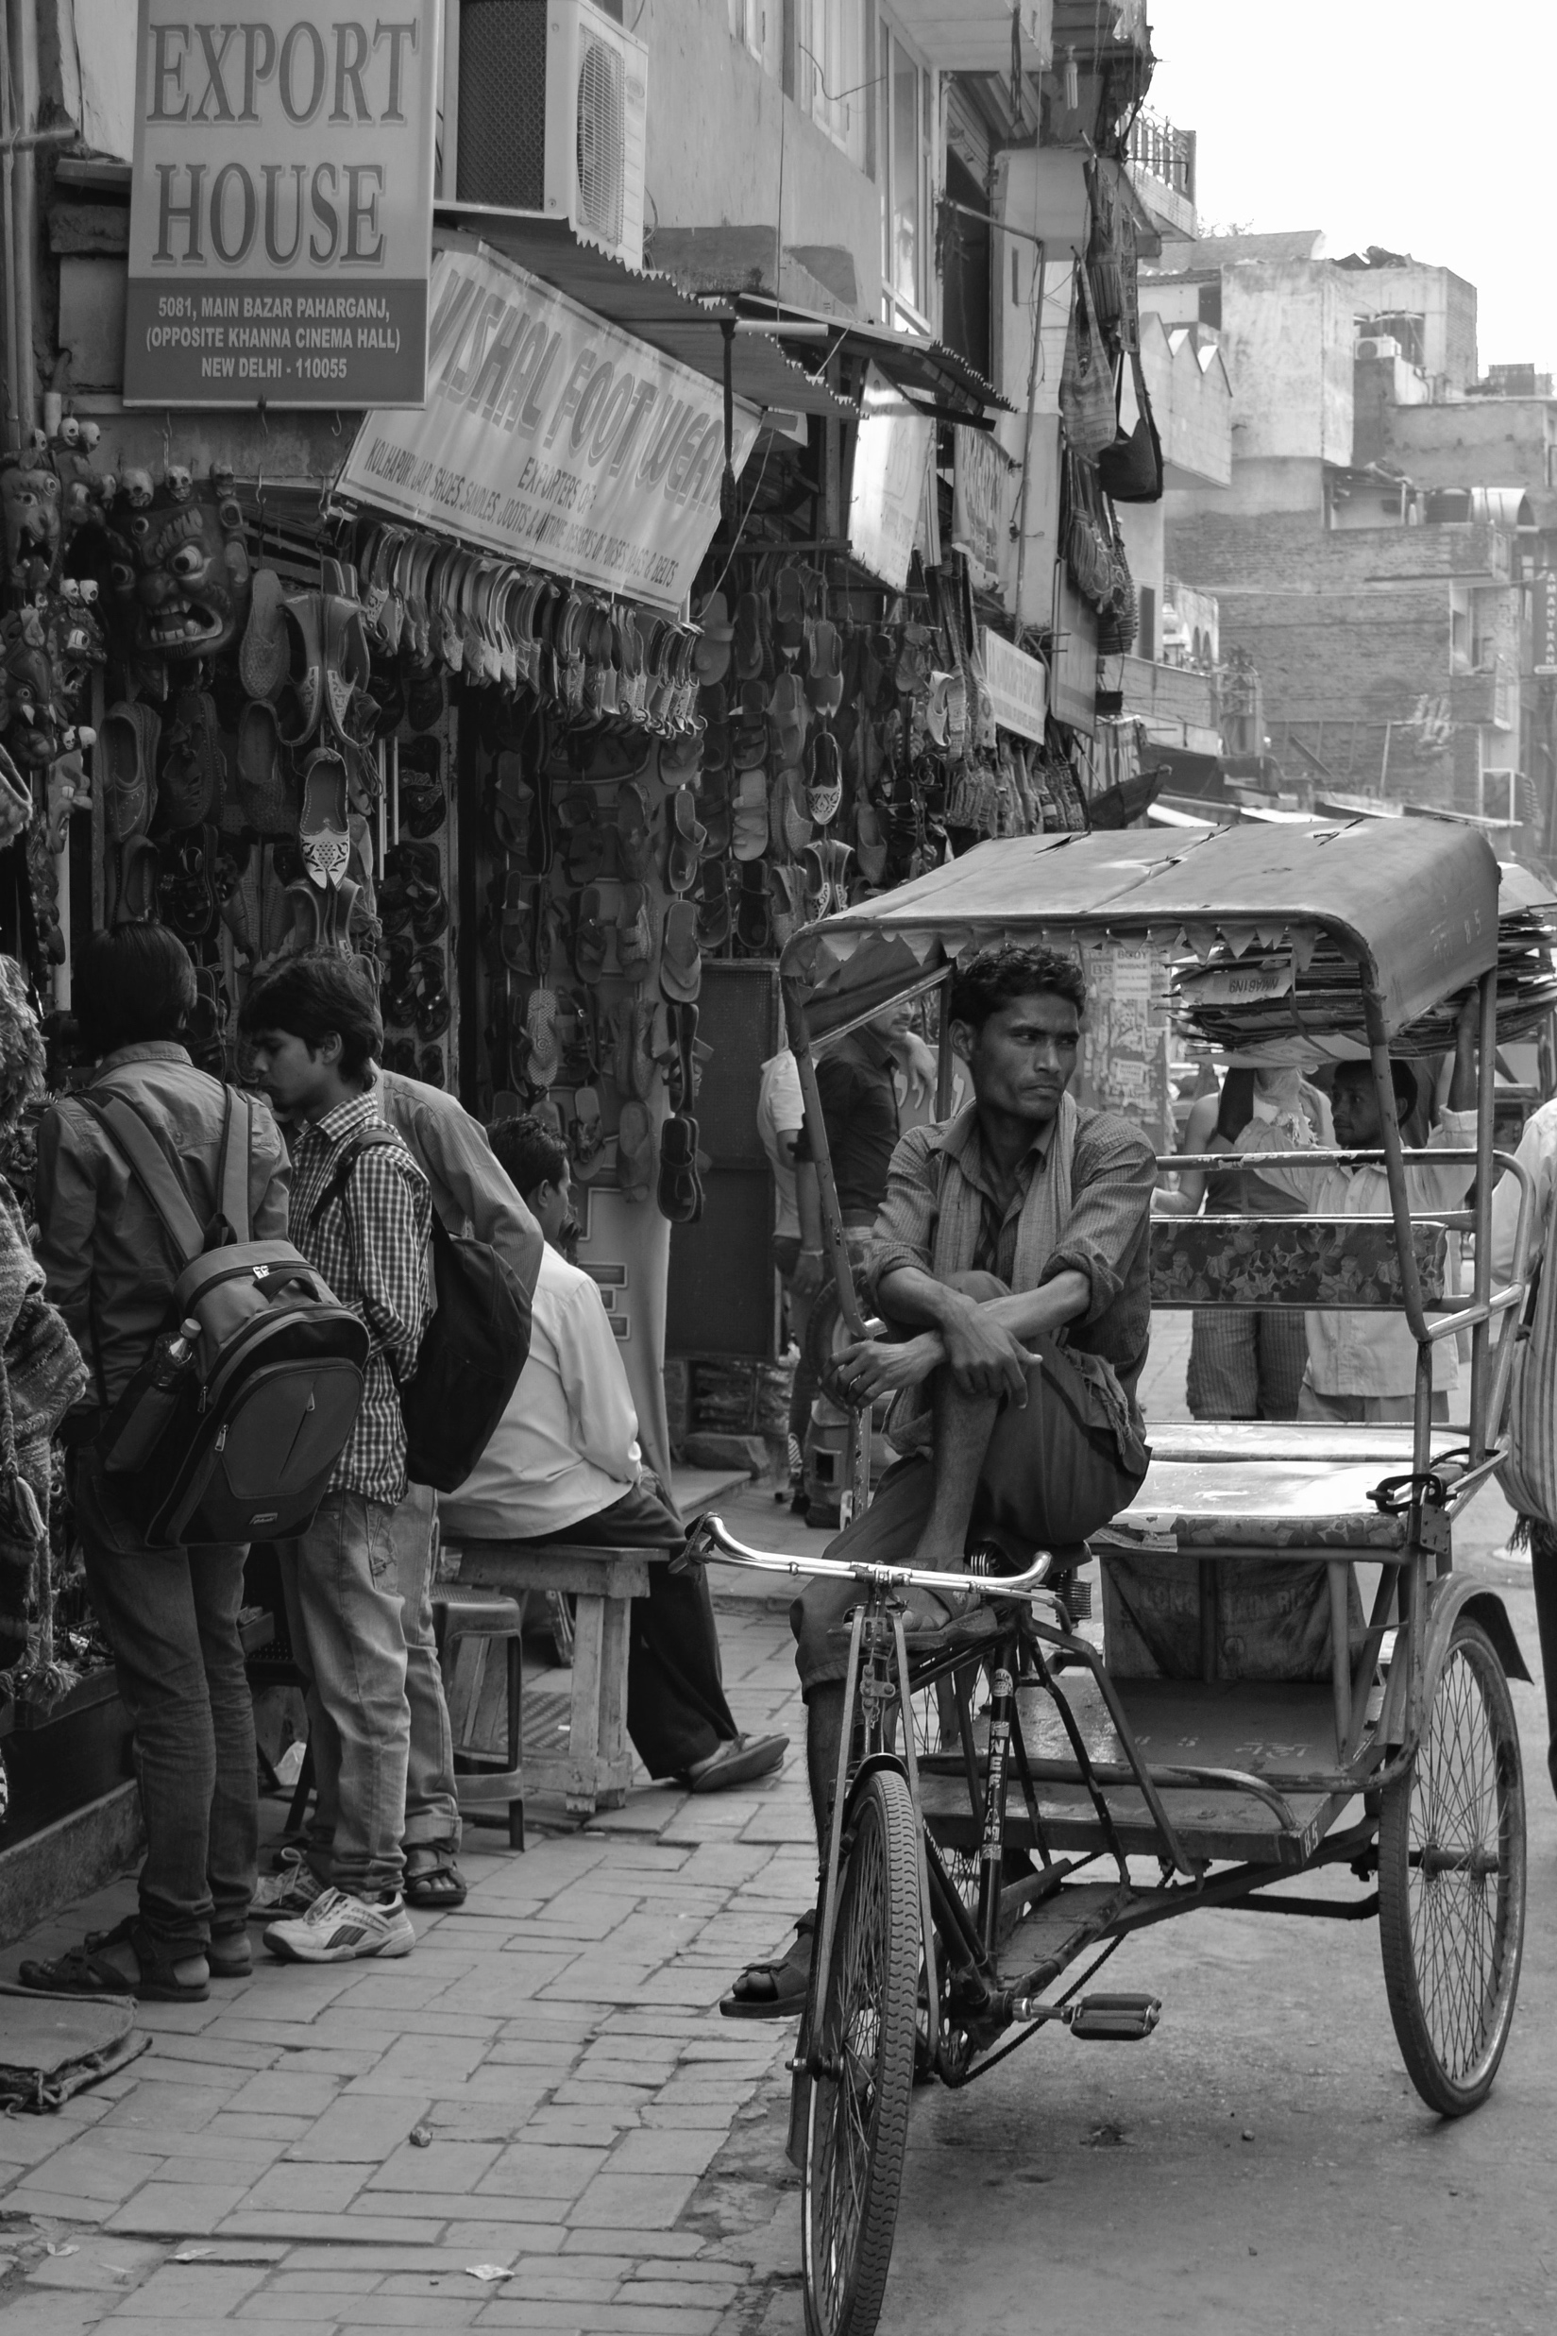
In 2008, India was one of the world’s most unbanked countries
Less than 20% of the population had access to a bank account
Lack of ID
Cost and friction in KYC
Bank branches in cities
Lack of connectivity

Slide 5
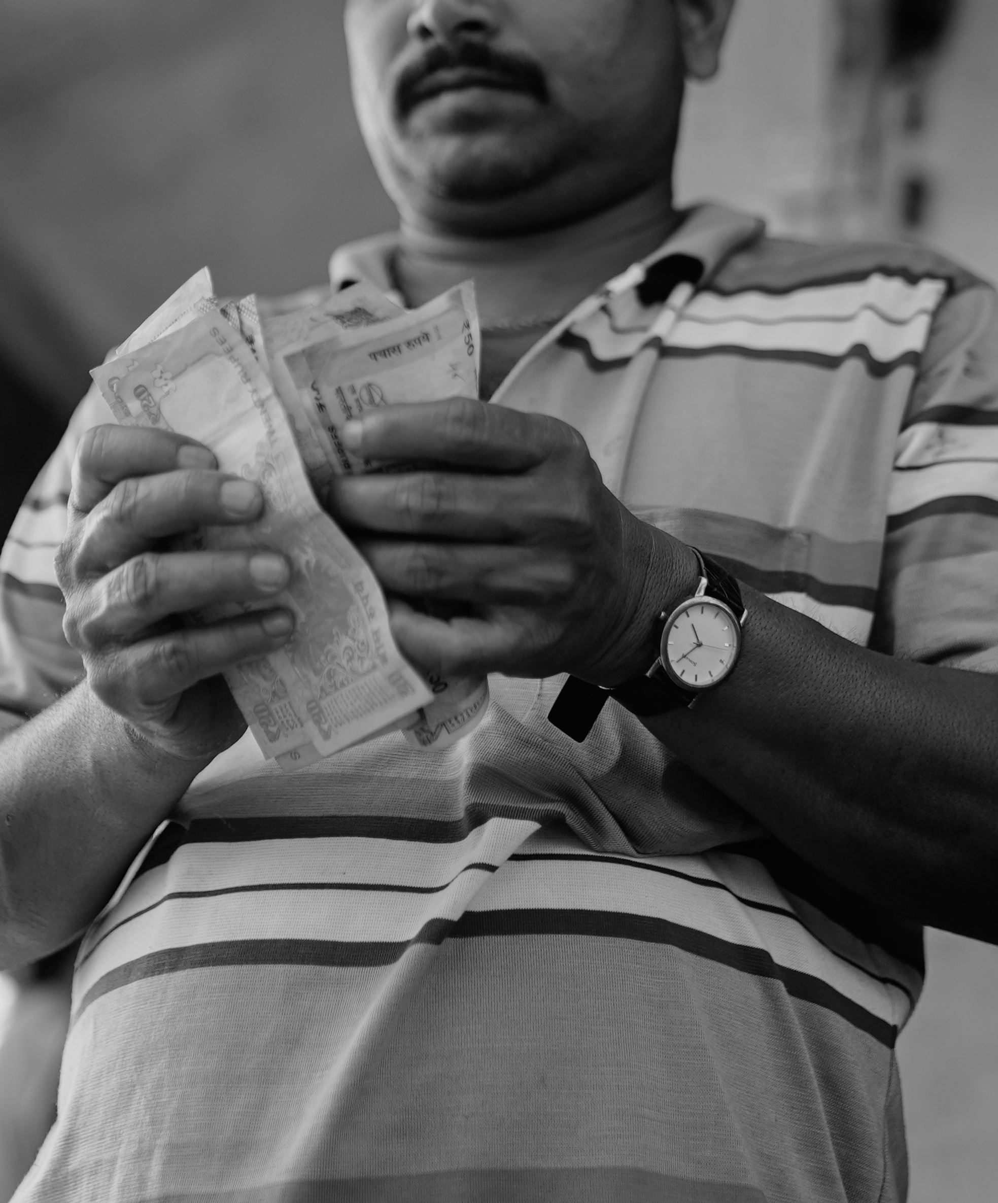
Billions leaked from benefit programmes
More than $50bn leaks per year, equivalent to 20-40% of benefits distributed
Duplicates
Ghost beneficiaries & workers
Physical cash payments
Exclusion of beneficiaries
Lack of reporting and data

Slide 6
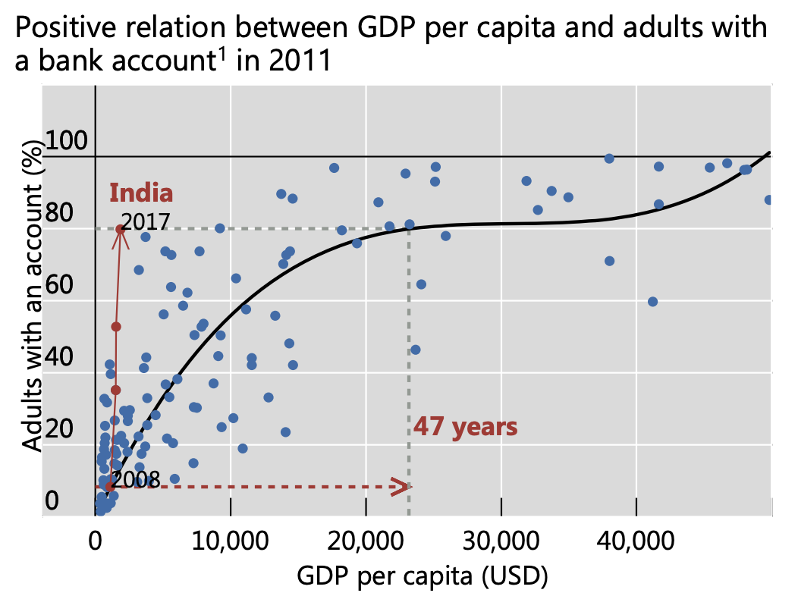
In 9 years, India turned things around, and bank penetration increased to 80%
Following a normal development trajectory, it would have taken India 47 years to reach 80% bank penetration
By “leapfrogging” it only took India 9 years, from 2008 to 2017
In 2008 India had a GDP per capita at 993 USD
Source: Bank of International Settlements (BIS)

Slide 7
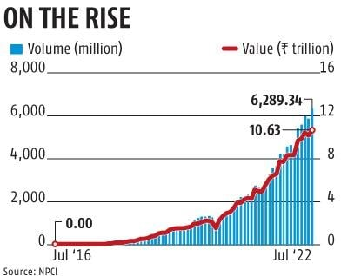
The volume of digital payment transactions is in the 10s of billions each year
The volume and value of digital payment transactions in India grew exponentially from 2016 to 2022
This was made possible largely because of DPI, transforming how business was done

Slide 8
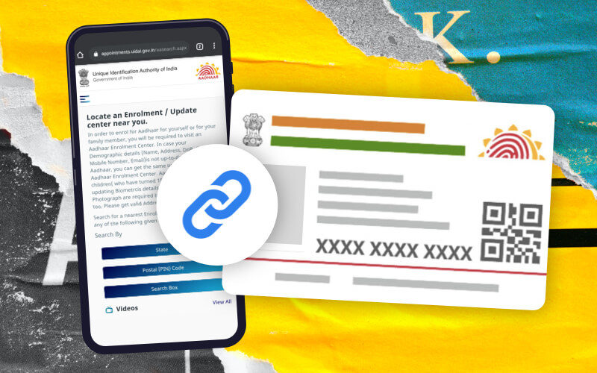
This was made possible by the registration of people through the Adhaar national identity system

Slide 9
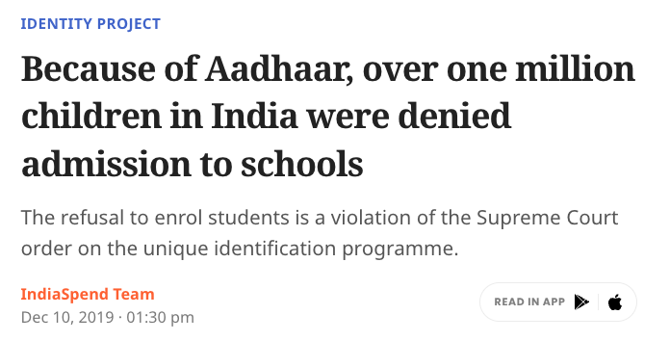
National identity systems are valuable, but challenging to get right
Large scale logistics
Low margin for error
Demand-creation, without excluding
Multiple stakeholders

Slide 10
Ideas of ID: What are we talking about?
Banks
Ministry of Finance
eKYC
Cost
(short term) / Revenue (long term)
Healthcare
Patient verification
Electoral Commission
Voter registration
Telco’s
Sim-card registration
Ministry of Social Affairs
Educational sector
Fraud prevention
Student enrolment
Statistics Bureau
People
Data analysis
Recognition, rights, value, belonging.

Slide 11
In UNDPs experience, the failure of digital identity programmes is rarely because of the IT systems. It is due to the lack of functional, collaborative governance.

Slide 12
Governance The mechanisms, processes, and institutions (formal and informal), through which citizens and groups articulate their interests, exercise their rights, meet their obligations, and mediate their differences.

Slide 13
Governance Governance is not only about government: it is a whole-of-society concept – it is about understanding the way decisions and choices affecting the whole of society or different social groups, are made (key stakeholders include public institutions, the private sector, NGOs, community organizations, etc. at national and/or sub-national/local levels).

Slide 14
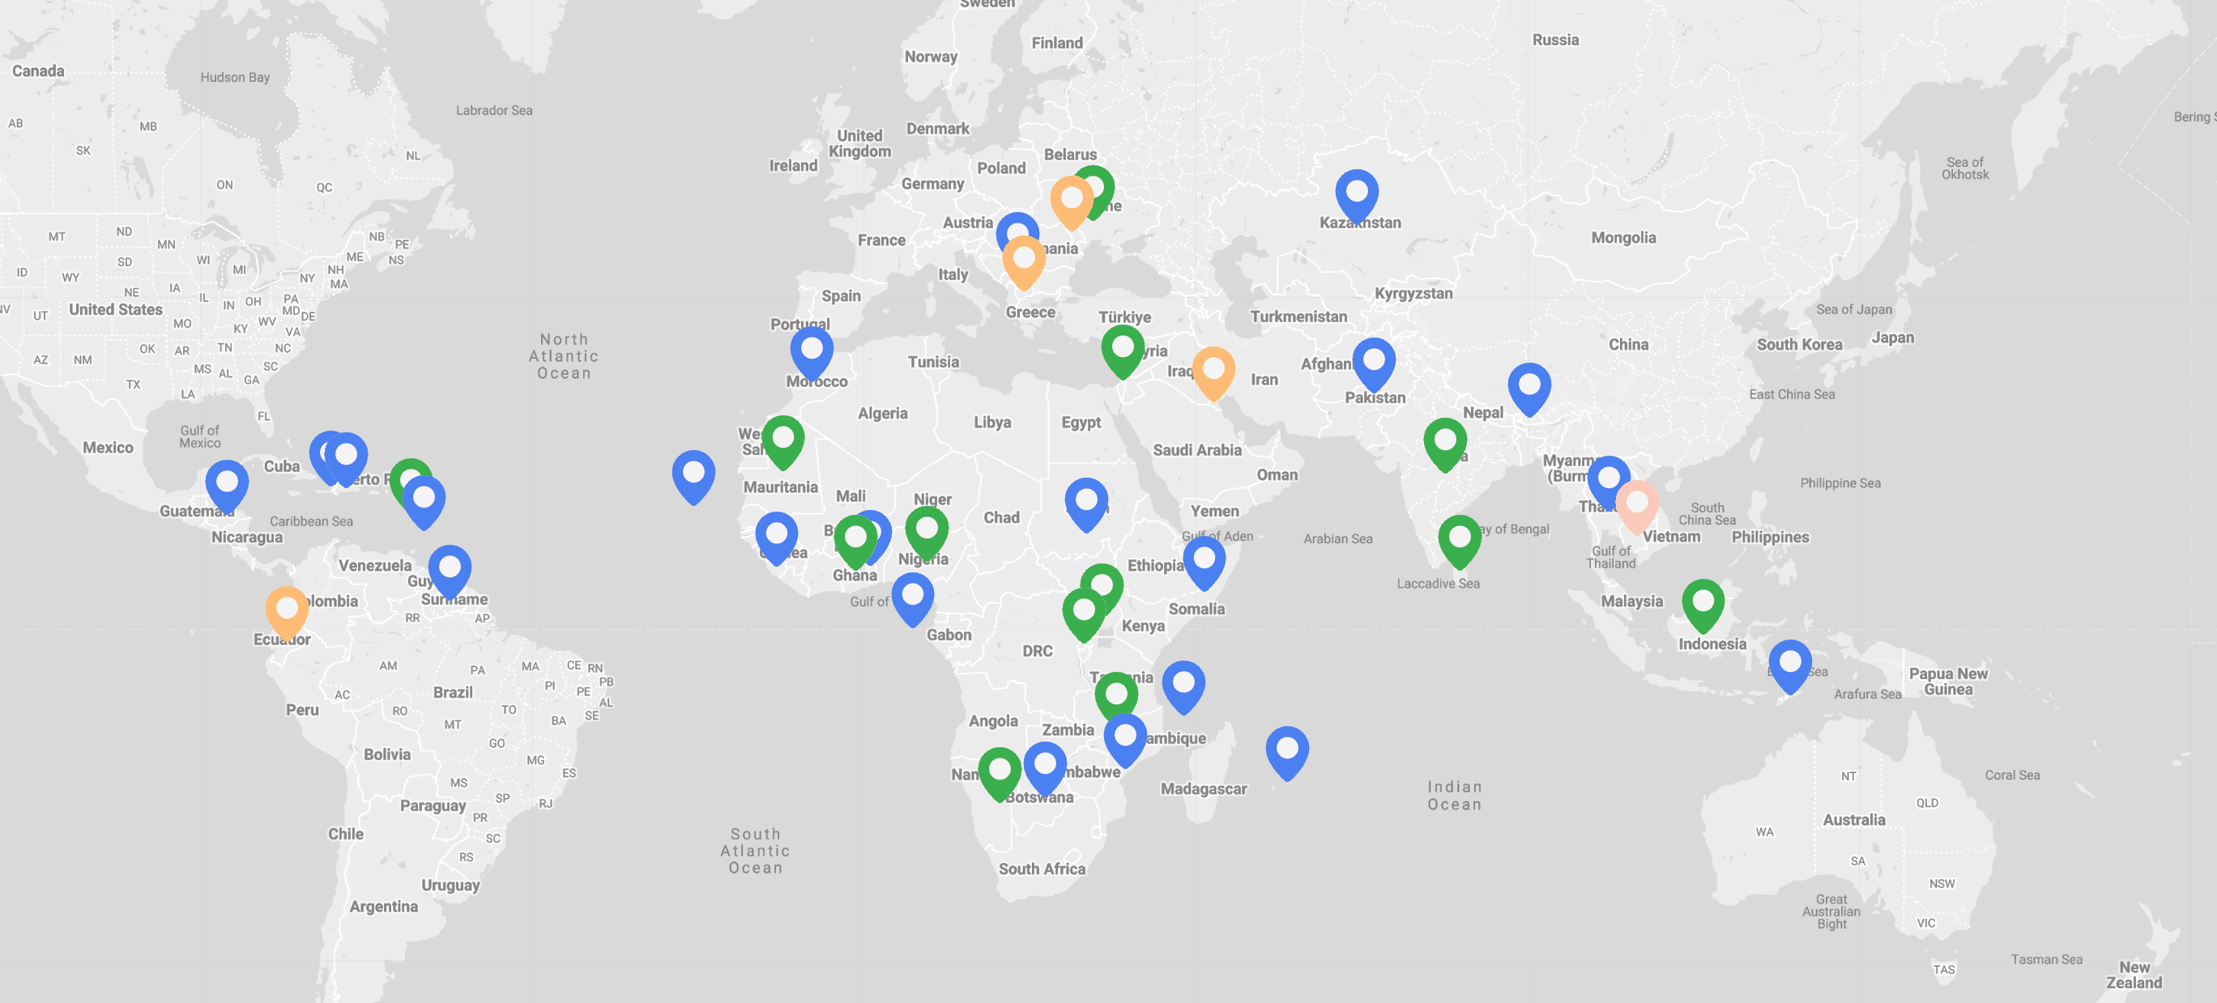
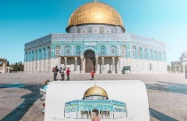
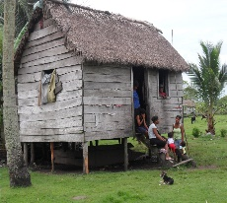
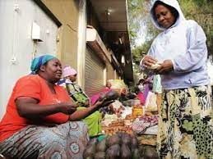
UNDP is supporting over 250 digital projects in +100 countries
Palestine: Access to Justice support through supporting deployment of MIZAN DPG
Mauritania: Completed Readiness Assessment, supporting development of an e-id pilot
Bangladesh: Supported nation-wide A2I programme
LEGEND
Country with on-going or completed digital project Readiness assessment DPI implementation Partnership Support Digital transformation advisory
Honduras: Supported deployment of an ID system to +5 million people
Rwanda: Supported Gov in Cashless acceleration program, trained women and youth in cross-border digital payments
Uganda: Assessed schools and digital skills with Ministry of ICT and Ministry of Education

Slide 15
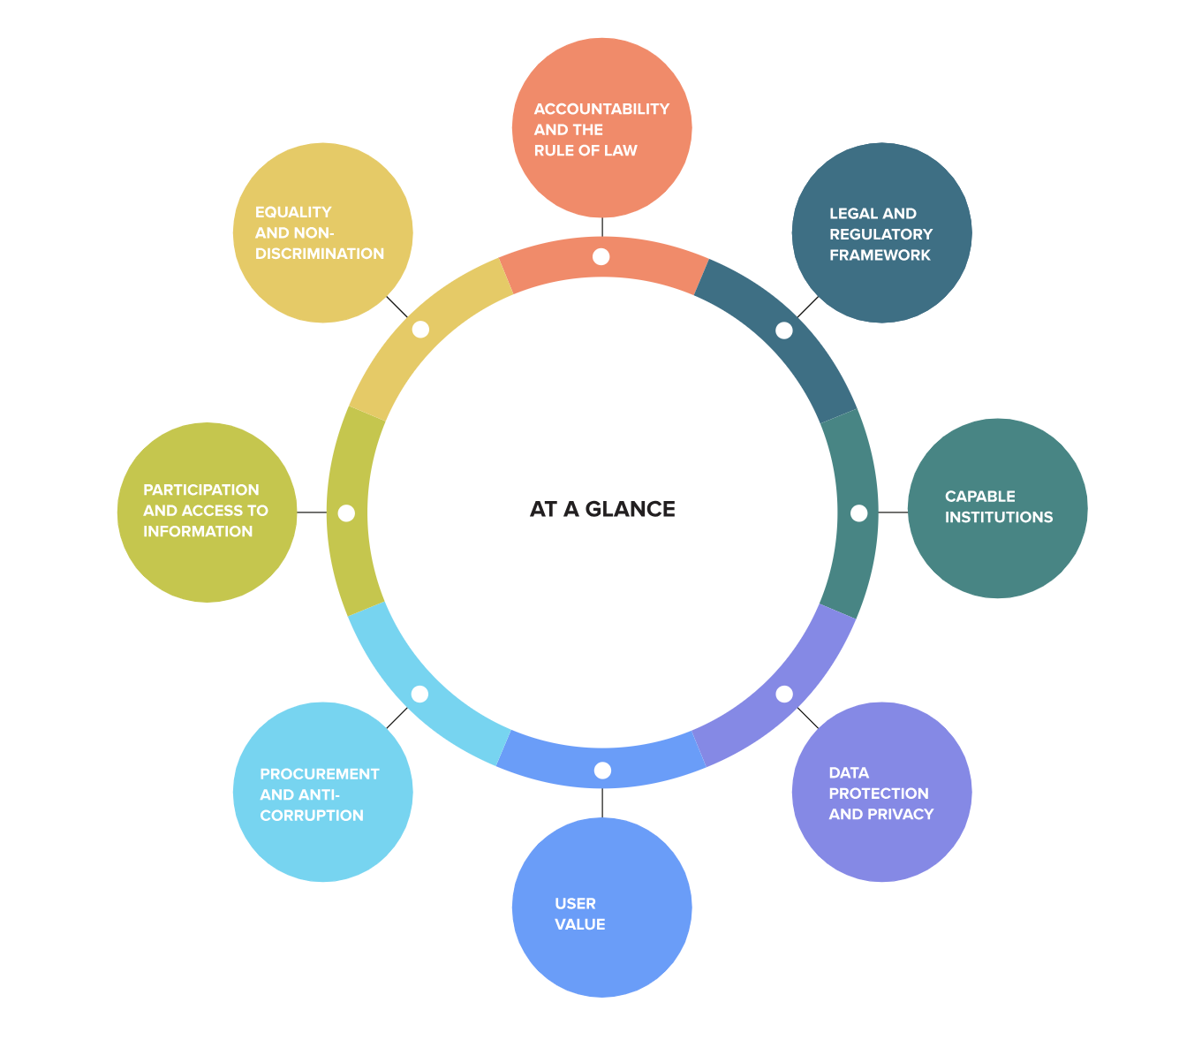
The UNDP Model Governance Framework for Digital Legal Identity Systems
Learn more about the assessment tool at: www.governance4id.org/

Slide 16
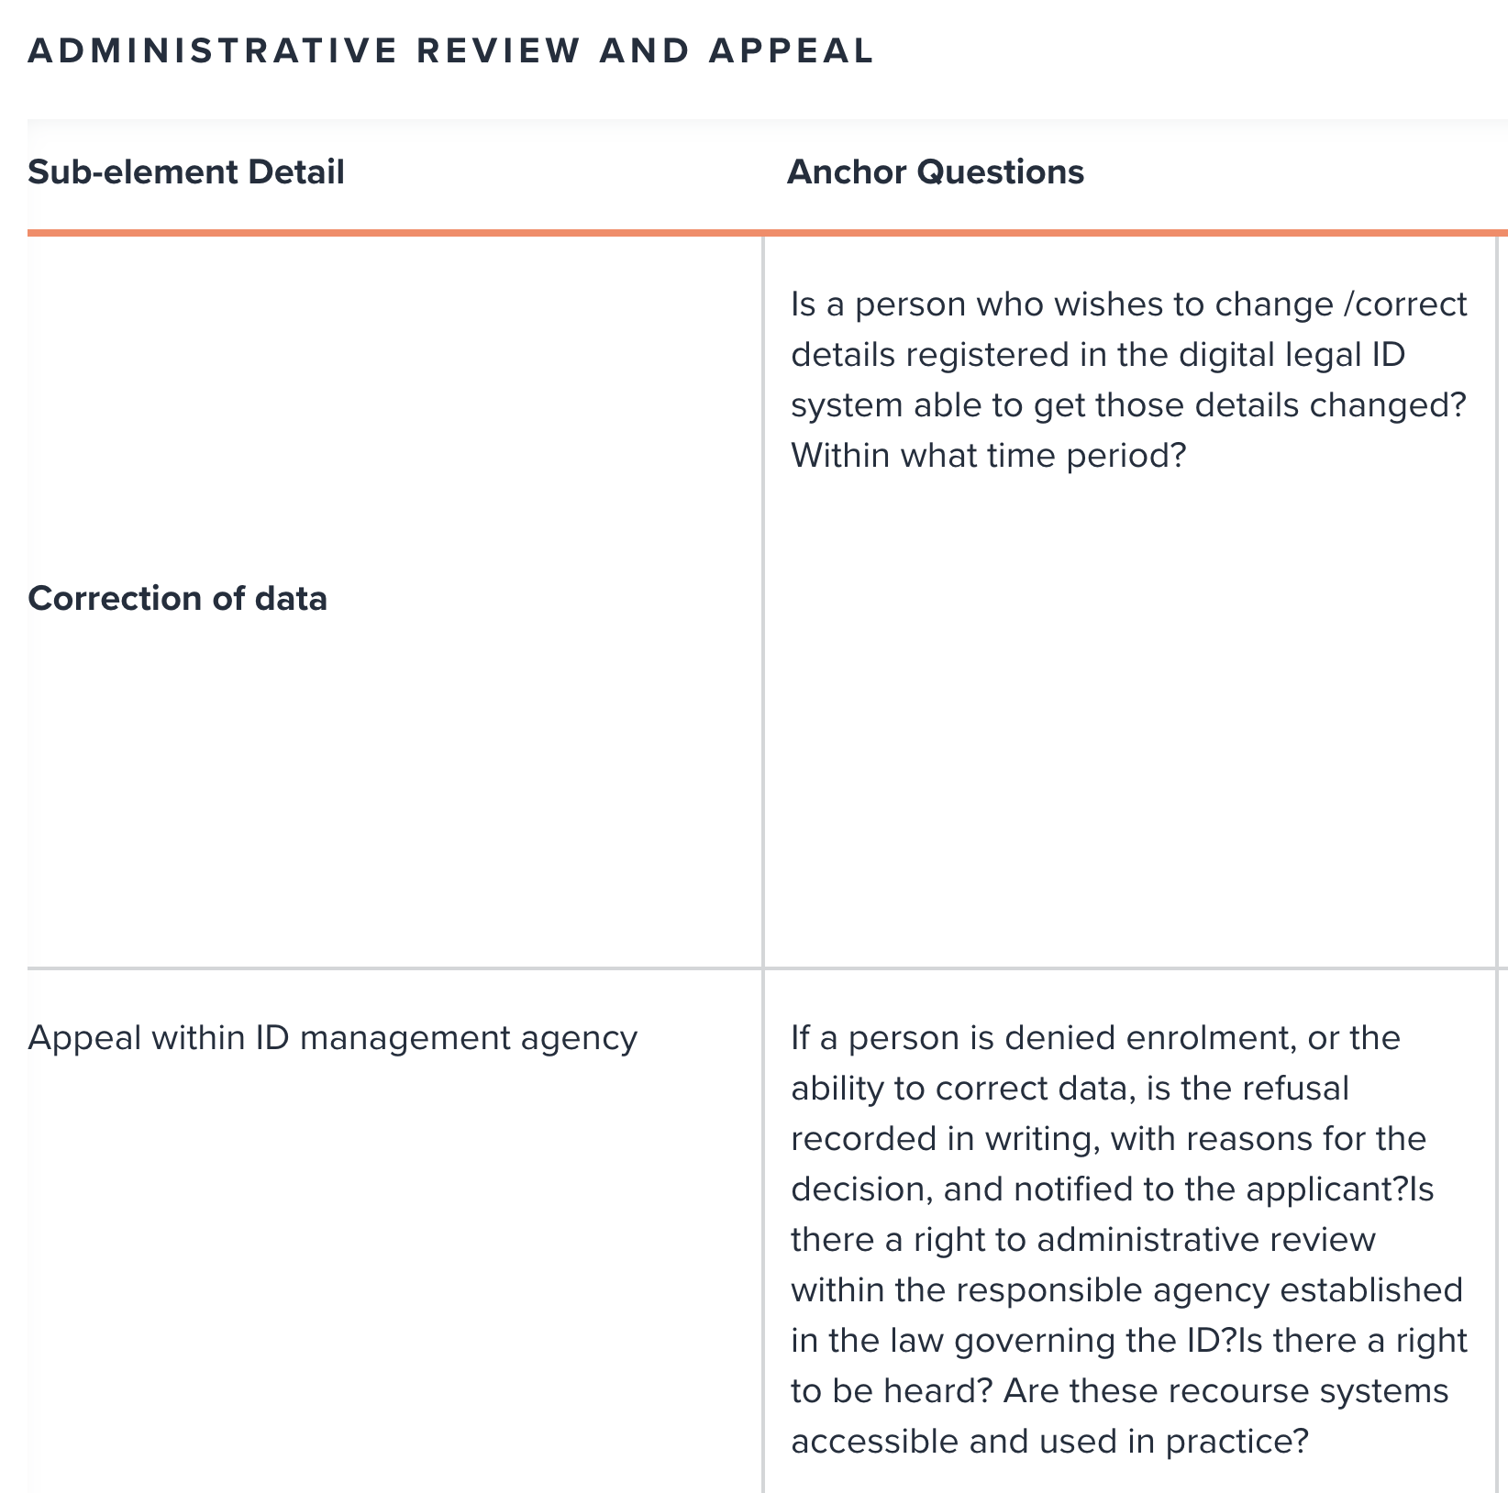
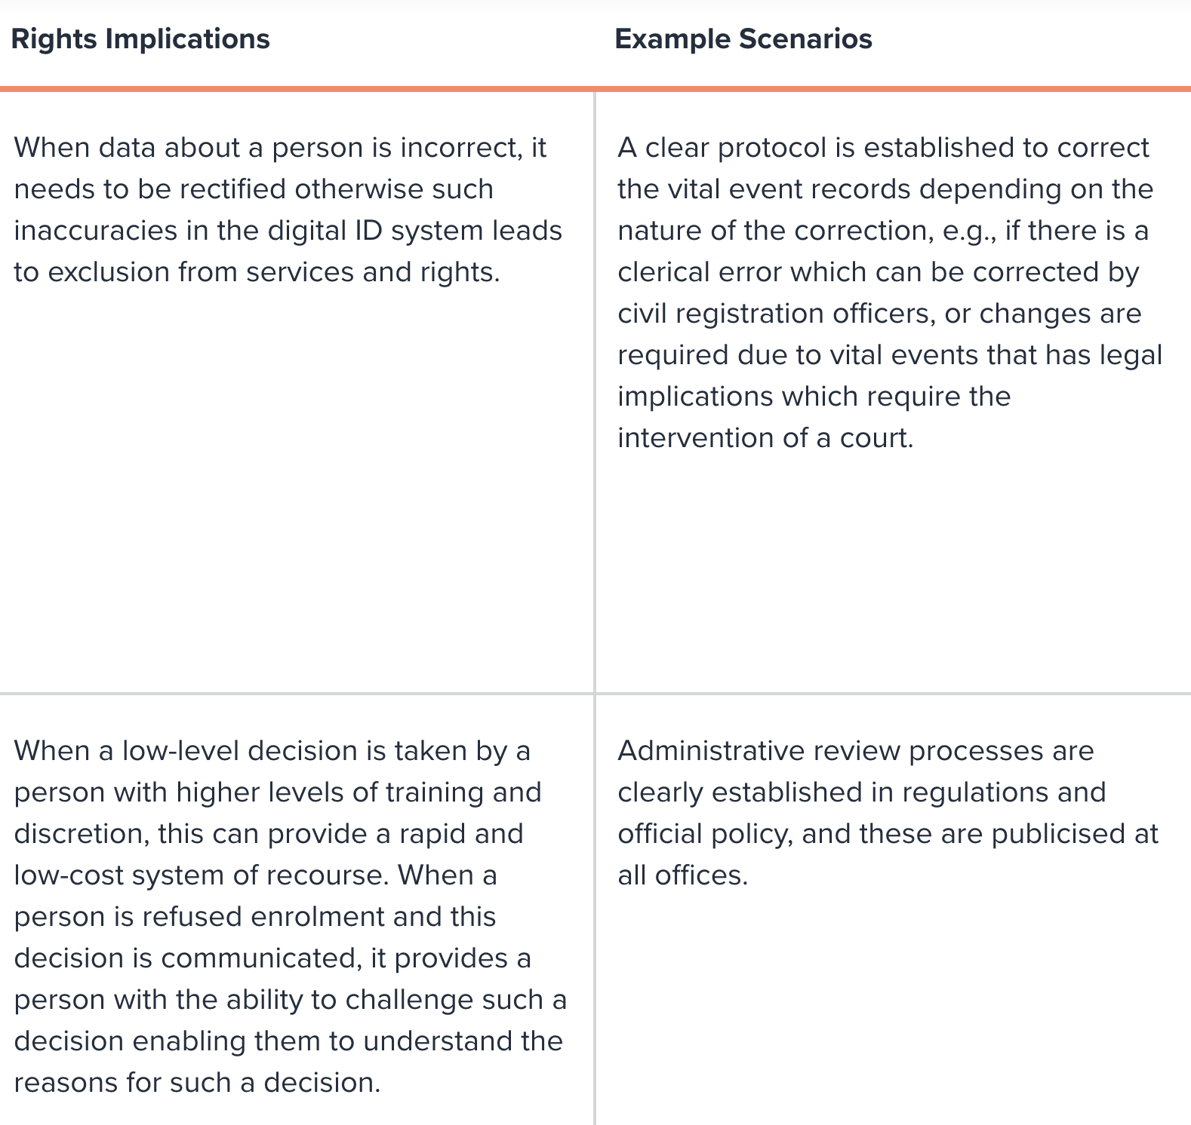
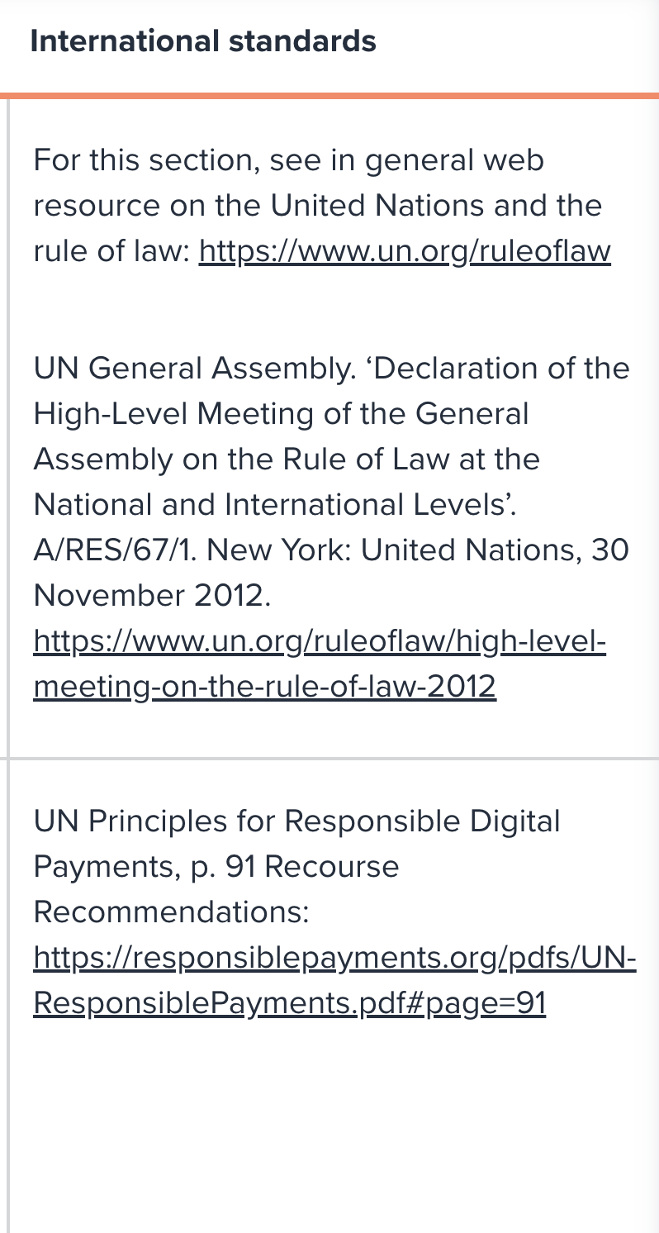
A closer look at the governance framework
Example: The accountability and Rule of Law-element contributes to ensuring that the digital identity system, and its management and impact, are accountable and subject to the rule of law.
Notes:
Independent oversight Judicial oversight Access to legal advice Remedies

Slide 17
Objectives and outcomes
Objectives of the mission
Objectives for the 3 days at Palms Hotel
Assess the governance and capacity of NIRA to deliver on its mandate
Develop an assessment report with actionable recommendations
Develop a presentation with needs to international partners, to improve governance of ID in Somalia
For NIRA to inform stakeholders about achievements and next steps
For stakeholders to inform on work related to ID, and give input to NIRA
Develop and mature valuable use cases for digital identity in Somalia

Slide 18
Team, activities and plan
Mission Team Members
Justin Nettmann, Team Leader
Benjamin Bertelsen, Digital Public Infrastructure, UNDP/Chief Digital Office
Hassan Warsame, Governance advisor
Kifaya Abdulkadir, Legal consultant
Mazen Gharzeddine, Public Sector Innovation, UNDP/Governance
UNDP Country Office & NIRA have been part of the mission throughout: co-creation
Activities to date: Stocktaking & unpacking
Desk Review – key documentation (inc. Legal frameworks; digital transformation strategy; NIRA's operational strategy, secondary research; etc.)
Bilateral meetings
NIRA – Leadership and technical teams (ICT, Legal, Operations, PR & Comms, etc.)
Office of the Prime Minister
Members of Parliament (Upper & Lower Houses)
MOIFAR + CRVS
Central Bank of Somalia
Ministry of Health
Ministry of Communication & Technology

Slide 19
Team, activities and plan
Activities to date (cont.)
Bank Association
Civil Society Organizations (NGOs)
Bureau of Statistics
Data Protection Authority
Auditor General Office
Immigration and Citizenship Agency
Supreme Court
NCA
UNSOM

Slide 20
Team, activities and plan
The Plan Ahead: Moving Forward
Finalize stocktaking – calls/meeting with other stakeholders
Consultation Workshop
Engage with partners in Nairobi: IFIs/World Bank, contributing donors, private sector – inform on key findings, ascertain interest for collaboration
Key Outputs:
Assessment Report: Digital Legal Identity in Somalia
The assessment is then expected to inform the design of a 'Support Programme'
(to present to partners and mobilize and coordinate support)

Slide 21
Day One: 17th August 2024: Introduction to Digital Legal Identity Systems and Governance Challenges
Time | Item | Facilitator
09:00 AM – 09:20 AM | Arrival, introduction, and registration | All
09:20 AM-10:00 AM | Welcome and opening remarks Opening remarks by DG, NIRA Opening remarks by DPS, OPM Opening remarks by Resident Representative, UNDP Somalia Opening remarks by HE Minister MOIFAR -FGS Somali National ID, State-building & the Sustainable Development Goals: Identifying Strategic Linkages (OPM, UNDP) | Facilitation: NIRA team Keynote speakers for the opening session. Hon. Abdirizak Ibrahim DPS, Amjad, Rahmo
10.00AM - 10.15AM | TEA BREAK (15 MINUTES) | All
10.15 AM - 10.45 | Governance of Legal Digital Identity and Objectives of Assessment | Ben Bertelsen, UNDP; Mazen Gharzeddine, UNDP
10.45 - 12.30 | NIRA (part 1) Legal and Regulatory Framework of NIRA (30 min) Operationalization Strategy (30 min) Somali National Identification System (SNID) (30 min)
12:30 AM – 13:30 AM | LUNCH AND PRAYERS (1 HOUR) | All
13.30 - 14.00 | NIRA (part 2) Grievance Redressal Mechanism at NIRA (30 min)
14:00- 14:30 AM | Civil Registration and Vital Science Directorate from MoIFAR
14:30- 15:00 AM | Central Bank of Somalia
15.00AM- 15:30PM | Data Protection Authority
3:30- 4:00 PM | CLOSING OF DAY ONE

Slide 22
GOVERNANCE FOR LEGAL DIGITAL IDENTITY
Thank you

