Slide 1
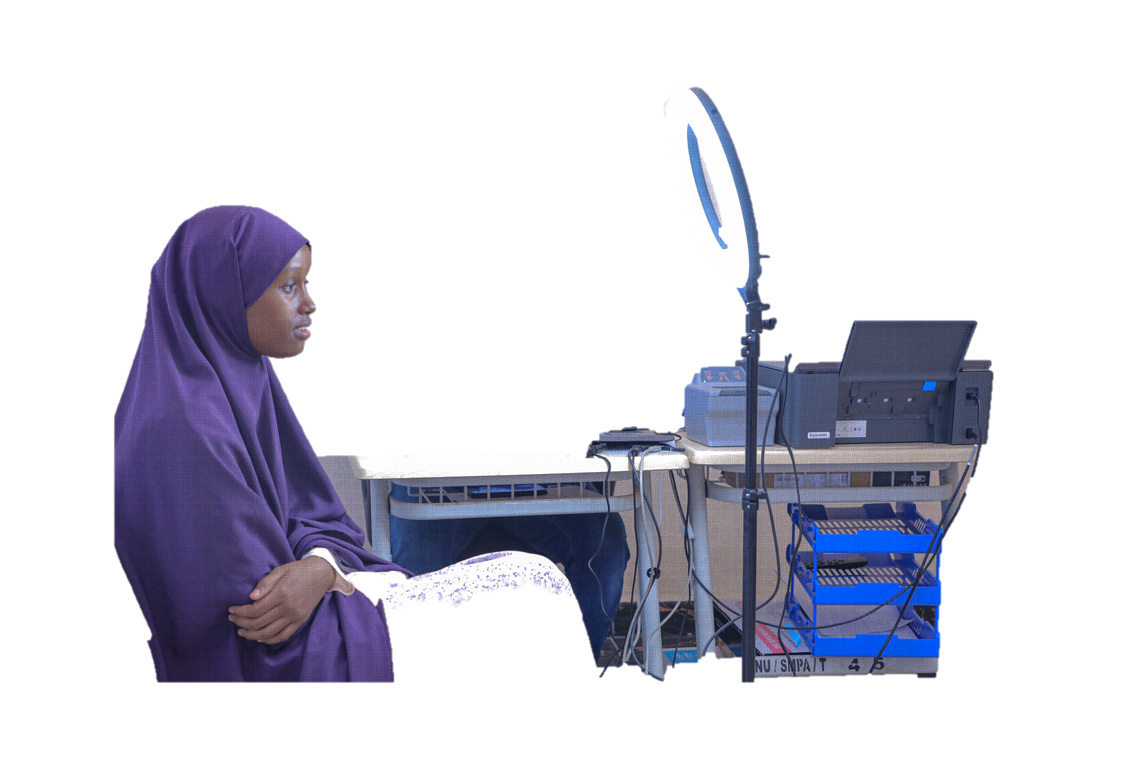
Operationalization Strategy
Your ID, Your Right
NIRA
National Identification And Registration Authority

Slide 2
Introduction
This implementation strategy was developed by the National Identification and Registration Authority (NIRA) to provide a clear direction for efficient and effective roll-out and management of the Somalia National ID and to support inclusive and trusted identity management.
This implementation strategy considers the entire identity lifecycle, starting with registration, during which identity data is collected and proofed, followed by the issuance of identity credentials, and mechanisms for their use (i.e., verification and authentication) at the point of transaction.
NIRA
National Identification And Registration Authority

Slide 3
Principles of the Registration Strategy
Accessibility
Non-discrimination
Flexibility
Privacy
NIRA
National Identification And Registration Authority

Slide 4
Registration Process
The registration officer reviews the application by checking whether it’s correct and complete to proceed and then submits to the MIS
The Applicants fill the application form or NIRA officer assists if they can’t fill
Applicants' Biographic data is entered, and biometrics is captured by the registration officer
Get Queue Ticket
Fill Application Form
Verification & Interview
Data Entry and Biometric Capture
Checking & Consent Sign
Review & Submission
The applicant checks his/her personal information and signs a consent that declares the correctness of the data.
Applicant gets a queue ticket based on the type of registration (New, office mistake, modification, renewal or reprint lost)
•⁠ An officers verifies the supporting documents submitted by the applicant
•⁠ ⁠﻿﻿Asks the applicant some questions to ensure the accuracy of the data and the validity of the supporting documents

Slide 5
Application Process
The system deduplicates the biometrics by comparing the previous biometric data. If it finds duplicate it rejects automatically. If it resembles an adjudication officers decide by checking a certain threshold and the biographic data
The printed Certificates is delivered to the registration sites and issued to the applicants
The supervisor approves the application if it meets the registration requirements or rejects of it is not
Verification
Approval/
rejection
Text Deduplication
ABIS
Printing Credentials
Issue Credentials
After deduplication, the NIN is generated
National ID certificate is printed to complete the process for now.
Then the physical ID cards will be printed
The system checks the completeness of the submitted application
After approval, The system deduplicates the biographic data by comparing the completed applications in the data center. If it finds duplicate information it rejects automatically, if it is suspicious, an adjudication officers check and decide it.

Slide 6
Deduplication Process
Demographic De-Duplication
Full Name
Date of Birth
place of birth
sex &
Mother’s name
Biometrics Deduplication
Facial-image matching
Fingerprint matching
Manual Adjudication
Notes:
xog-horraada & xog-dhalyada

Slide 7
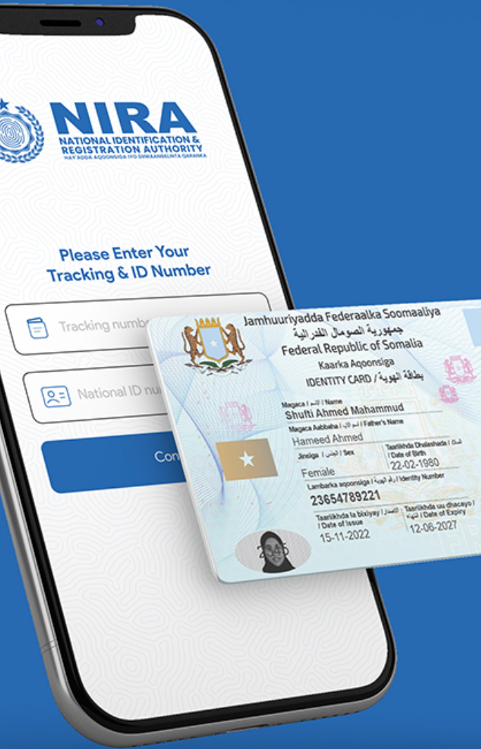
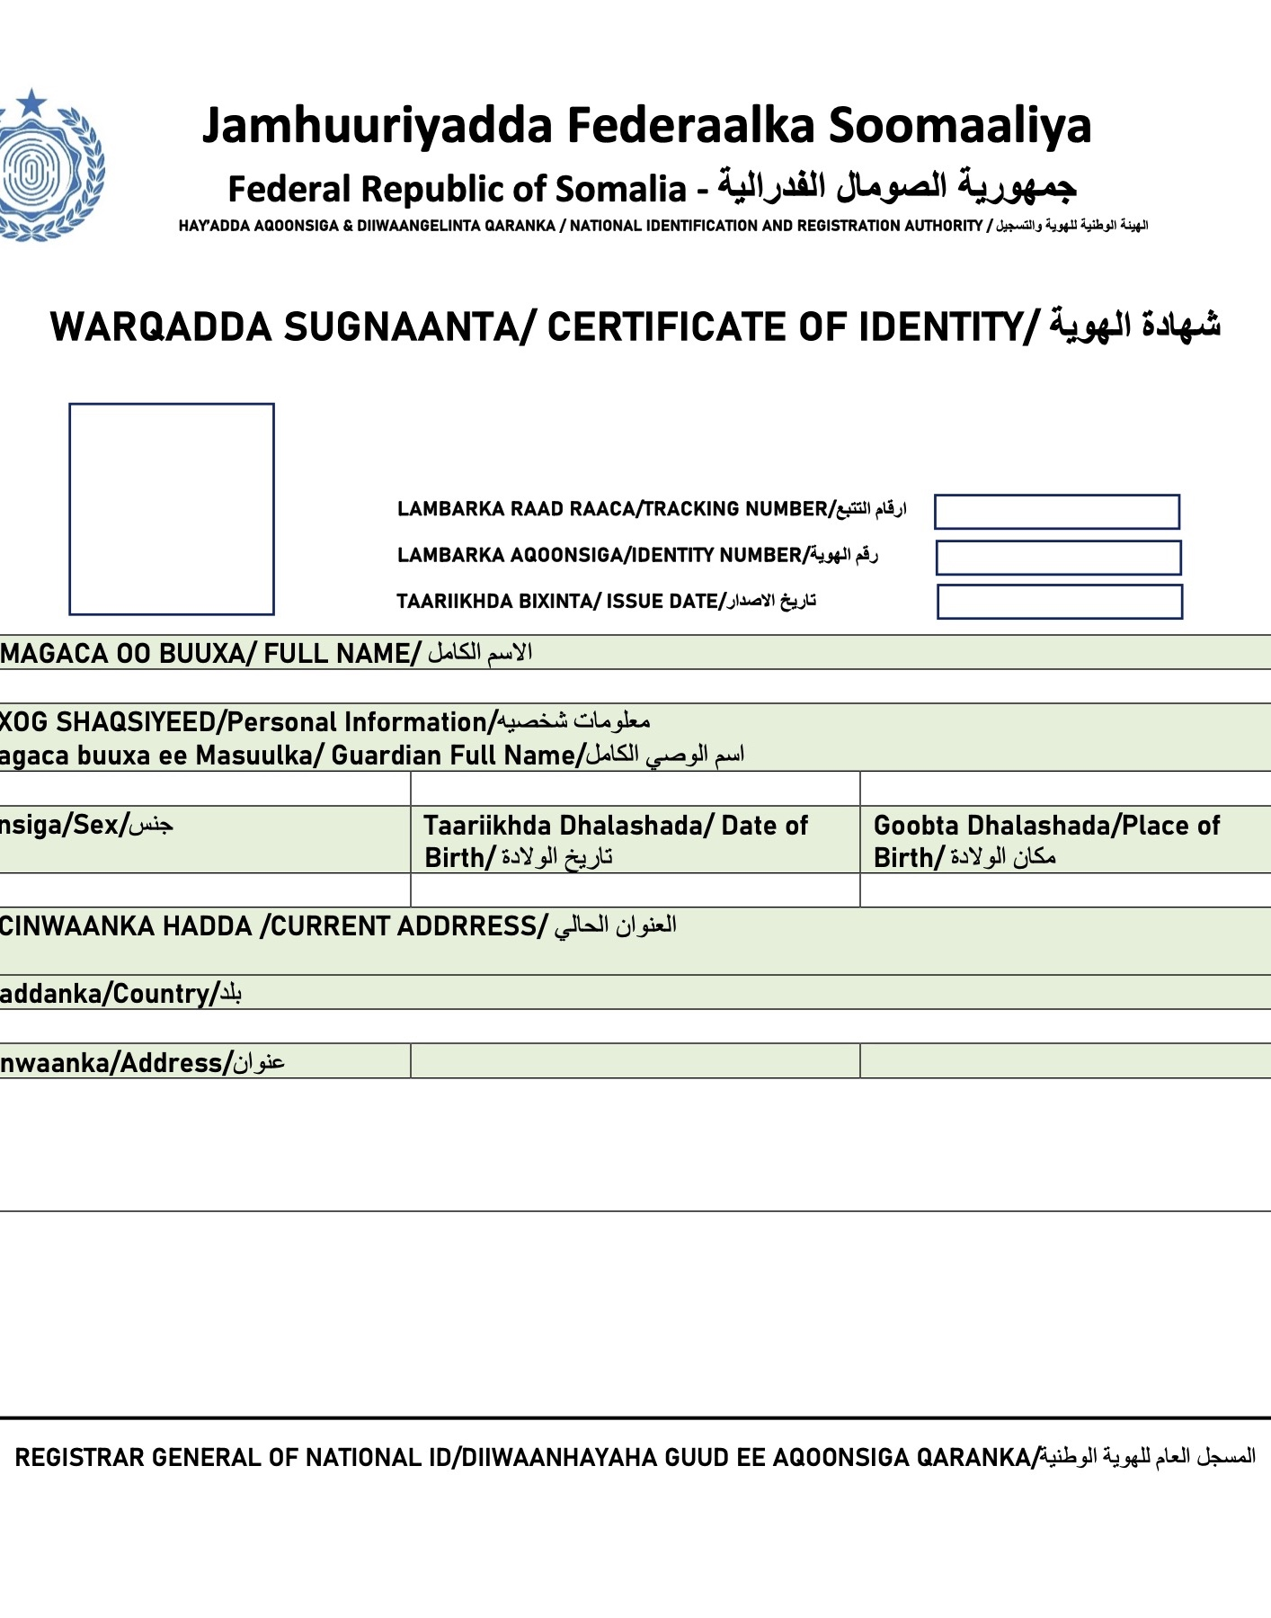
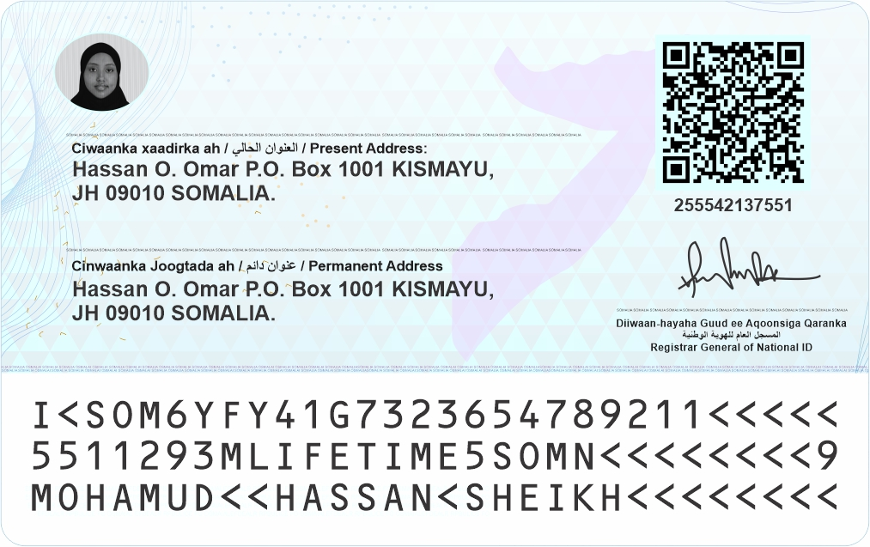
Credentials
eAqoonsi Digital ID
Certificate of Identity
National ID Card
2
1
3
27 Security Features
NIRA Mobile App is Somalia's go-to for digital identity
for both online and offline verification.
Lifetime Unique ID number
12345678961

Slide 8
Coverage/Target Registration
2023
Pilot
2024
5 M
2025
5 M
2026
5 M

Slide 9
Registration Centers & Mobile Teams Plan
2023
2024
2025
2026
10
80
30
30
5
10
20
15

Slide 10
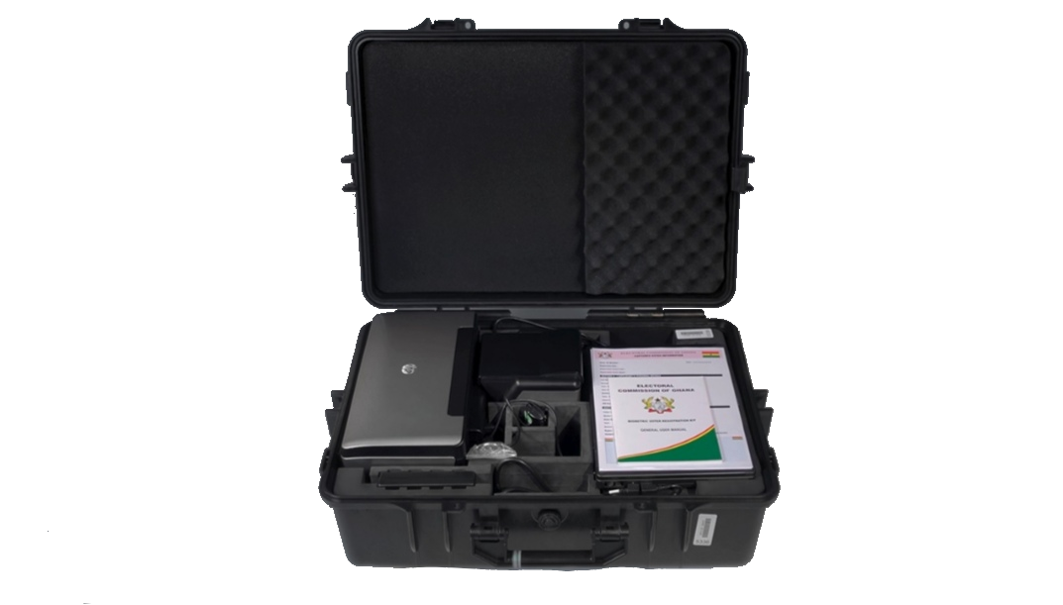
Registration Kits and Registration Staff Plan
 | 2023 | 2024 | 2025 | 2026
Registration Kits | 35 | 750 | 1050 | 1050
Registration Staff | 92 | 1200 | 1530 | 1530

Slide 11
Active Registration Centers in the Benadir Region
Yaqshid Center
Wadajir Center
Shingani Center
Howlwadag Center
HQ Center

Slide 12
Upcoming Registration Centers in FMS
 | State | Under Process Registration Center
 | Southwest State | Baydhabo
 | Galmudug State | Dhusamareb
 | Hirshabelle State | Jowhar
 | Jubbaland State | Kismayo
 | Puntland | Garowe
 | SSC Khatumo | Laascaanoold

Slide 13
Human Resources and capacity Building
The National Identification and Registration Authority (NIRA) is going to recruit and mobilize more than 1k staff to carry out a mass National ID registration campaign all over the country.
Therefore, NIRA is dedicated to fostering employee growth and development through a structured training framework.

Slide 14
Current Training Programs offered by NIRA
1
Human Resource Policies Training
2
Somali National ID System
3
Communication Skills
4
Registration Processes and Procedures

Slide 15
Critical Success Factors
04
Branding and positioning as a development initiative
03
Technology readiness
05
Private sector friendly policies
02
Legal Framework
01
06
Somali Led Initiative
Sound operationalization strategy

Slide 16
The Existing Main Challenges
1
Institutional Challenges
2
Use of Identification
3
Insufficient Funding
4
Insufficient Workforce
5
Security Challenge

Slide 17
Thank you

