Slide 1
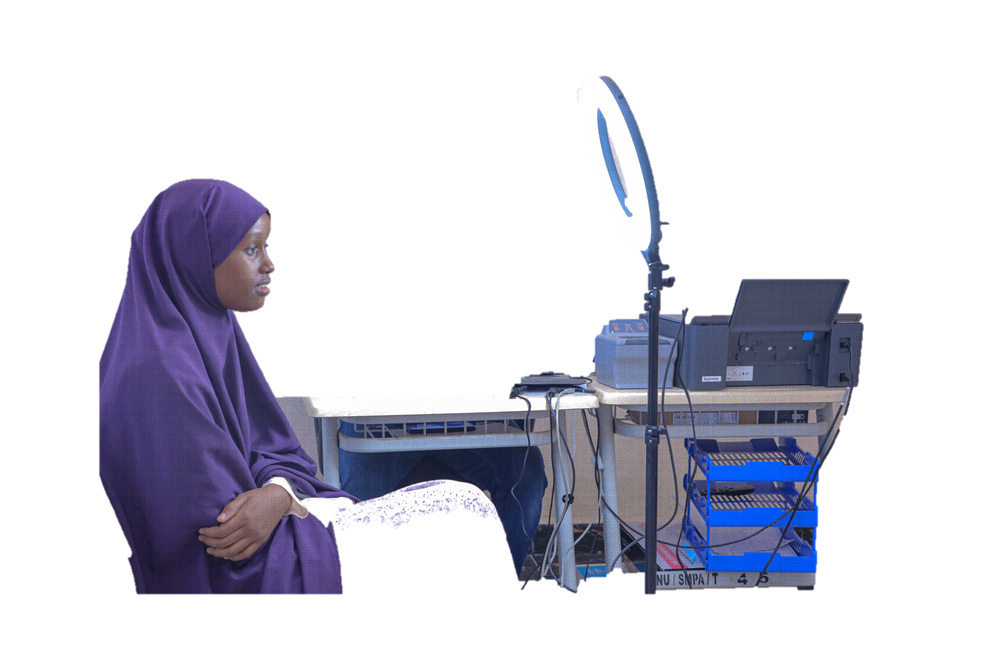
Information Technology
Your ID, Your Right
NIRA
National Identification And Registration Authority

Slide 2
Converged infrastructure
Compute
Storage
Network
Virtualization
Applications
NIRA
National Identification And Registration Authority

Slide 3
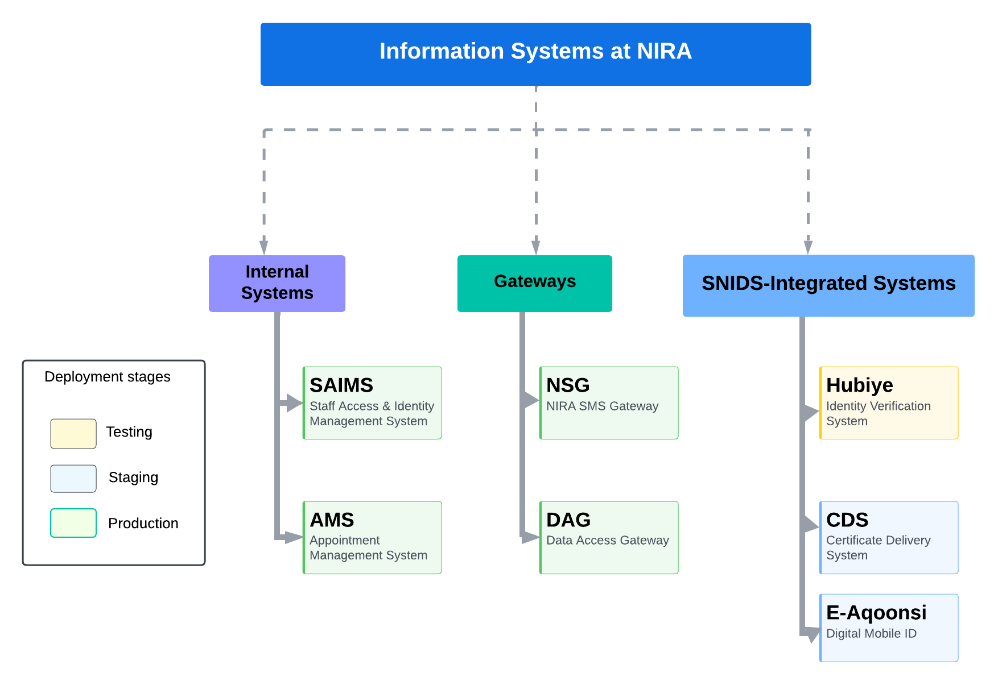
Information System
NIRA
National Identification And Registration Authority

Slide 4
Somalia National Identification System
Facilitates data capturing of individuals in a distributed environment using encrypted SQL-Lite database
Offline data capture allows for registrations even where network is not available
Data is synchronized with central postgres database once user machine is online
Incremental library synchronization ensures that updates at center are downloaded efficiently on registration machines
1
2
3
4

Slide 5
Somalia National Identification System
1
Messaging Queue enabled data transfer ensures asynchronous communication to increase system reliability, flexibility and scalability. The Producer/Consumer model ensures that records can be added to the queue without waiting for them to be consumed.
Use of two-way encryption ensures secure communication with the center
Microservices based architecture facilitates availability of services and separation of concerns
2
3

Slide 6
Somalia National Identification System
Backend data-processing is managed by asynchronous processes that run separately to carry out their own respective functions
Stage controller process manages routing of the application between processes depending on the stage of the application. This ensures central management of all threads from one place
Elastic search has been used to efficiently index required application parameters and search data already enrolled for text-deduplication
AFIS engine uses highly efficient in-memory matching algorithms to facilitate biometric de-duplication

Slide 7
Data Access Gateway (DAG)
(DAG) serves as the central backbone for facilitating communication between all NIRA Backend Services and the Somali National ID Database.
The system is designed based on a microservice architecture, promoting modularity and scalability.

Slide 9
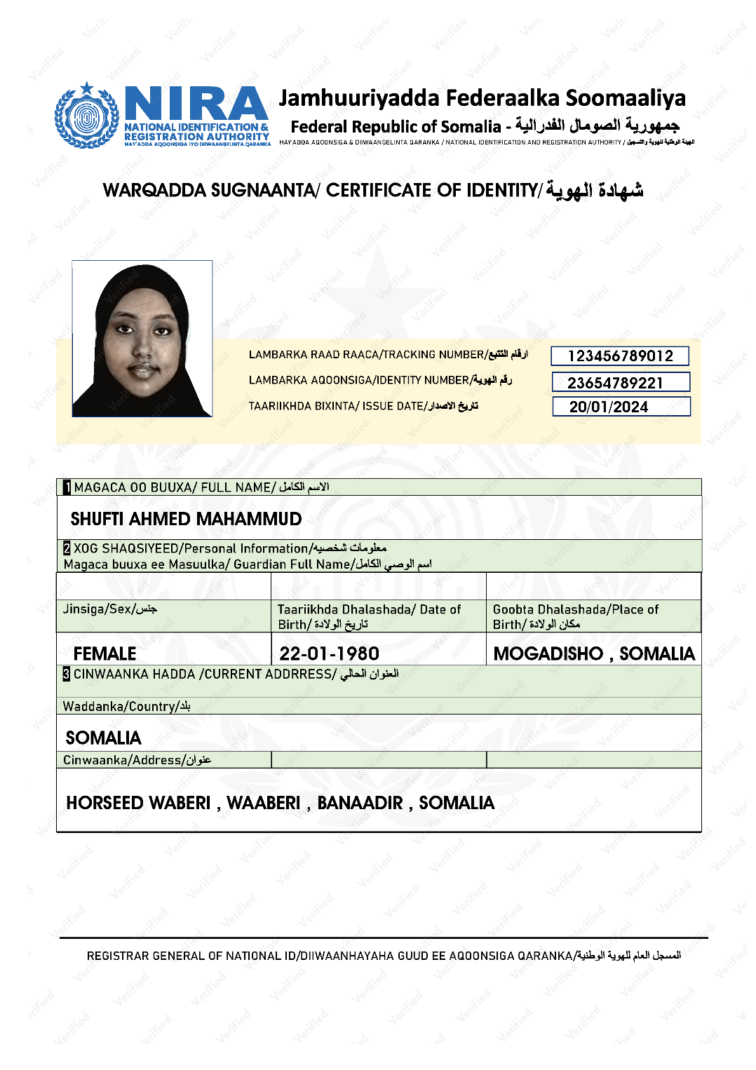
Certificate Delivery System (CDS)
The Certificate Delivery System is a pioneering platform designed to modernize and accelerate the distribution of certificates upon the final confirmation of registering the national identity.
It transforms conventional methods by offering immediate digital access to certificates, thereby eliminating delays and enhancing the overall experience for both administrators and recipients.

Slide 11
Hubiye Platform

Slide 12
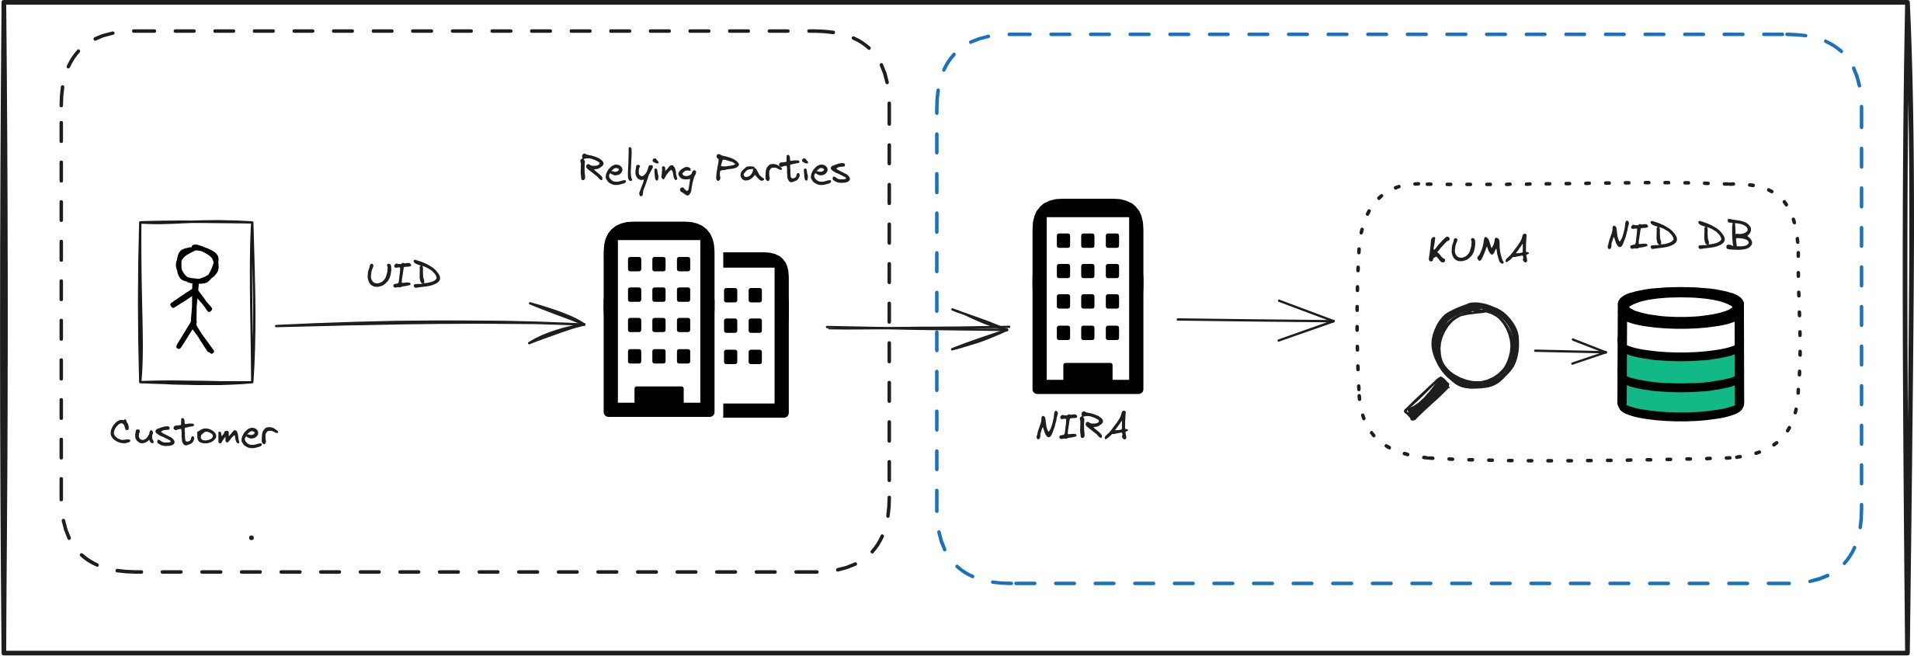
ID Verification Use-case

Slide 13
Verification Process

Slide 14
Hubiye Platform

Slide 15
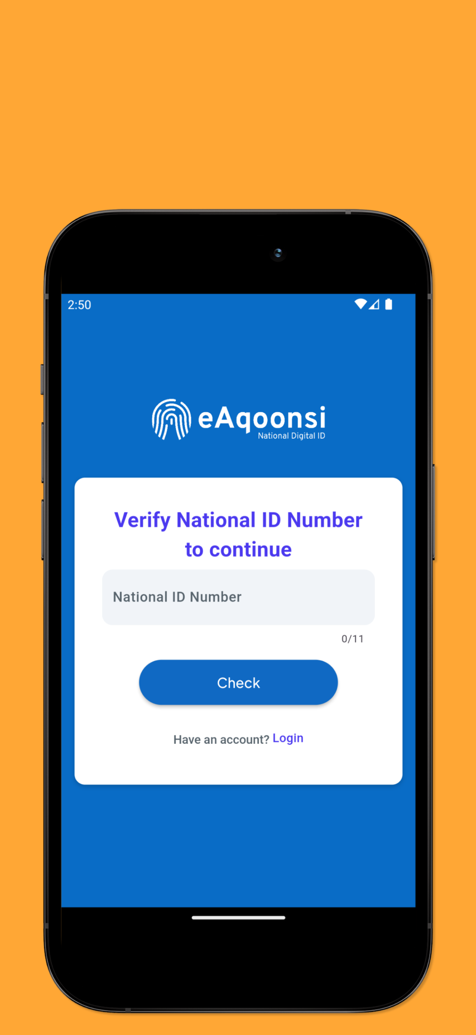
eAqoonsi is Somalia's innovative approach to digital identity, providing a secure and convenient mobile ID as one of three essential credentials offered by the National Identification and Registration Authority of Somalia (NIRA).
This mobile ID facilitates a modern, digital way for citizens to prove their identity, enhancing access to services and personal verification with ease.
eAqoonsi stands as a testament to Somalia's commitment to advancing its foundational ID infrastructure, offering a forward-thinking alternative to traditional identification methods.

Slide 16
Data Protection by Design (DPbD)
Data Protection by Design (DPbD) is a fundamental principle that integrates data protection measures into the development and operation of digital systems from the outset.
For Digital Identification and Registration Authorities, DPbD ensures that privacy and data protection are embedded into every aspect of the identification, registration, and management processes, safeguarding personal data from misuse, unauthorized access, or breaches.

Slide 17
Data Protection by Design (DPbD)
Minimization of Data Collection
Purpose Limitation
Data Integrity and Confidentiality
User Control and Transparency
Security Measures
Regular Audits and Impact Assessments
User Education and Awareness
Resilience Against Threats
Legal Framework
Data Classification

Slide 18
Thank You

