Slide 1
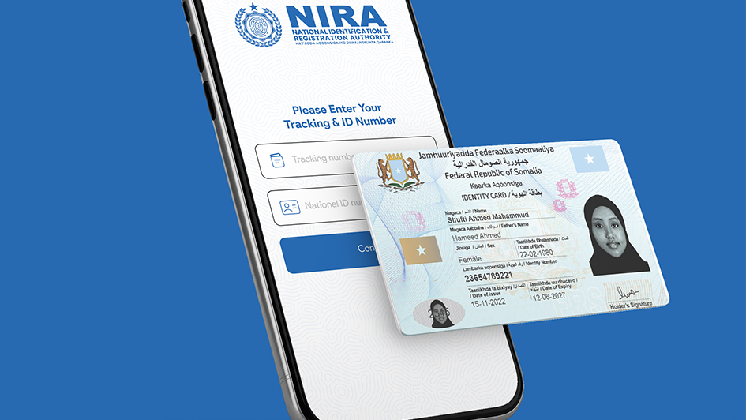
LEGAL & REGULATORY FRAMEWORK OF NIRA

Slide 2
Foundational legal framework
Constitution of Somalia
The National Identification and Registration Law
Articles 2 (3):
“Every citizen also has the right to obtain a Somali passport, national identification documents, registration documents, and any other identification issued by the government to its citizens”.
The National Identification and Registration Law is the primary legislative instrument governing public identity and national ID matters in Somalia.
Pg / 04

Slide 3

Approved NIRA’s Regulations
01
Emblem Regulation
Establishes NIRA emblem brand, its use.
NIRA's legal framework has been significantly strengthened through the ratification of several key regulations, including an emblem regulation, the Registration Regulation, national ID fee regulations, and the drafting of the Data Protection Regulation.
02
Public Registration and Identification Regulation
Registration processes, identification credentials, corrections and data sharing, etc.
03
National ID Fees Regulation
Determines applicable fees to the national ID services
04
NIRA BoD Regulation
Internal rules and procedures
Pg / 18

Slide 4
Internal Procedures & Bylaws
01
Fee Waiver Procedures for IDPs
In addition to the foundational Identification and Registration of Persons Act No. 009, which was passed by Parliament and signed into law by the President, NIRA has secured the approval and completion of several critical supporting procedures from various government authorities
02
Code of Conduct for NIRA Staff
03
Registration Process for Children and Individuals Without Legal Authority
04
Procedures for Correcting Errors and Amending Public Data
04
NIRA Complaint procedure of National Identity
Pg / 18

Slide 5
Planned Regulations
& procedures
Apart from the regulations that have been approved or completed, NIRA plans to initiate the following regulations
01
Draft Data protection Regulation
02
Registration Process for Persons Living Abroad
03
Incomplete Biometric Data Registration
Pg / 18

Slide 6
Core principles
01
INCLUSION
(UNIVERSAL COVERAGE AND ACCESSIBILITY)
02
DESIGN
(ROBUST, SECURE, RESPONSIVE AND SUSTAINABLE)
03
Privacy and Data Protection
(BUILDING TRUST BY PROTECTING PRIVACY AND USER RIGHTS)
Pg / 04

Slide 7
Relevant Laws & Regulations
01
03
Data Protection Law
Citizenship Law
This empowers individuals with rights over their personal data collected by NIRA in the national ID system.
This law specifies the criteria and processes that NIRA must follow when registering citizens for national ID cards.
02
04
Proposed Civil Registration and Vital Statistics
Cybersecurity Regulations
These rules mandate the security standards and protocols that NIRA's IT systems and databases must adhere to.
This law governs how NIRA can integrate and utilize the civil registry data (births, deaths, marriages, etc.)
04

