Slide 1

Civil Registration in
Somalia
Mohamed Mohamud
Ministry of Interior, Federal Affairs and Reconciliation (MOIFAR)

Slide 2

Contents
Background
Status of Civil Registration in Somalia
Key Achievements since 2021
eCRVS Demo
National CRVS Policy – an Overview
The UN LIA Holistic Approach Model
Linkages between the CRVS system & the Digital ID system
Next Steps: What can be done?

Slide 3
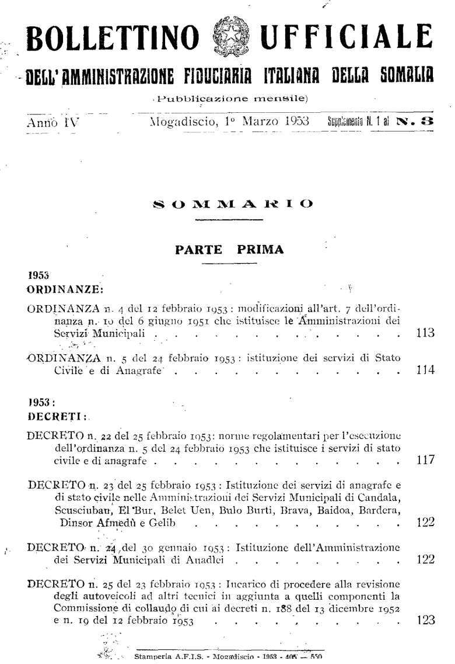
Background
  Prior to the government collapse in 1991, all districts in the country offered registration services for births, deaths, marriages, and divorces
  The CRVS system ceased functioning post-1991, with almost no remaining records or traces
  The existing CRVS legal framework in Somalia was fragmented, became outdated and is not functioning effectively with the country’s current federated government structure
  It does not also adequately address the digital technological advances made in CRVS services over the past 30 years.

Slide 4
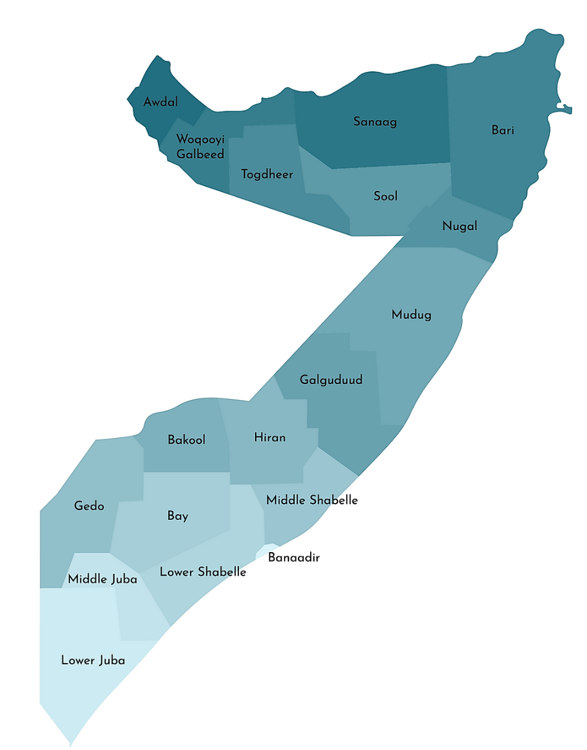
Status of Civil Registration in Somalia
Current CRVS processes are bureaucratic and fragmented, coordinated nationally and administered by local governments without contributing to national statistics
A total of 33 districts and Mogadishu Municipality provide birth certifications on demand
Hospitals nationwide record live births and deaths, most confined to individual hospital registers and not integrated into a national database
There are no official estimates on the completeness of vital events registration in Somalia.

Slide 5
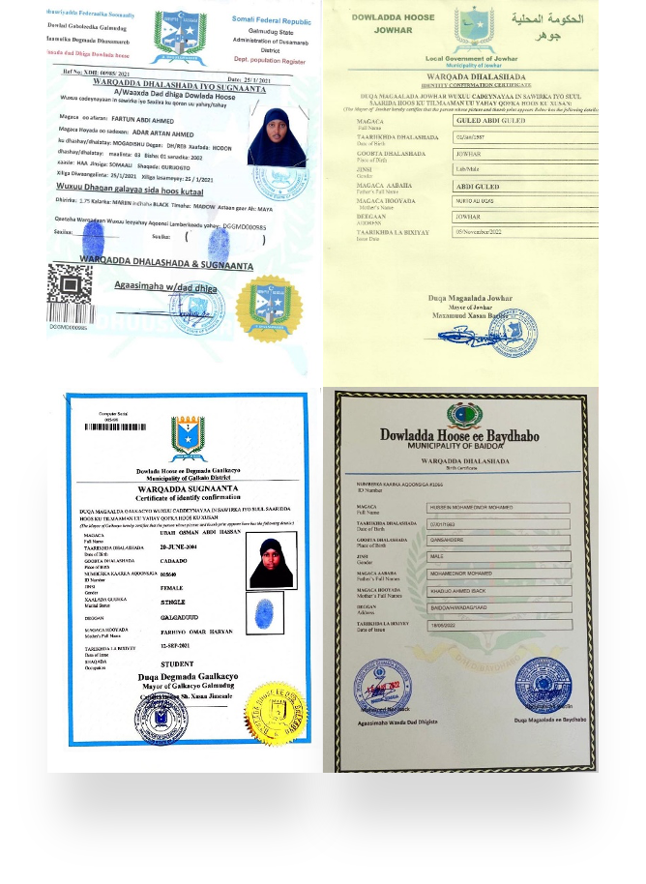
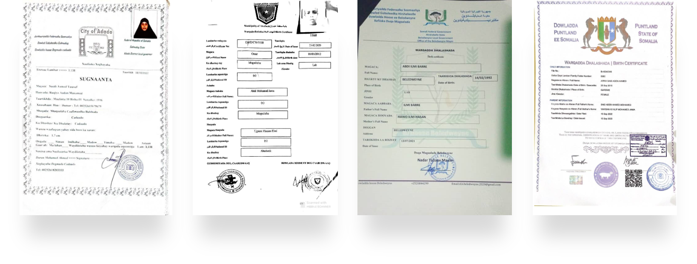
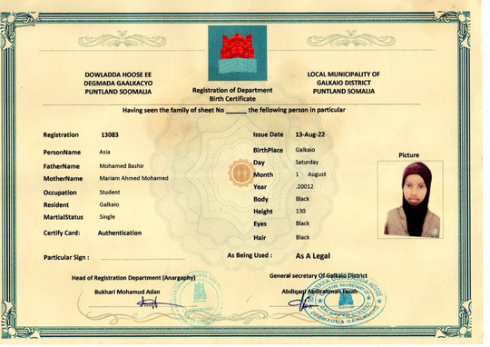
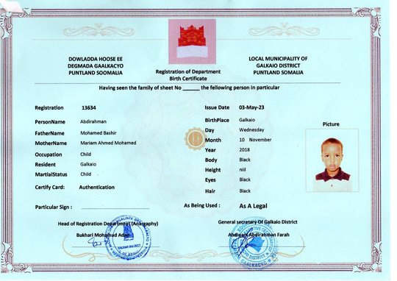
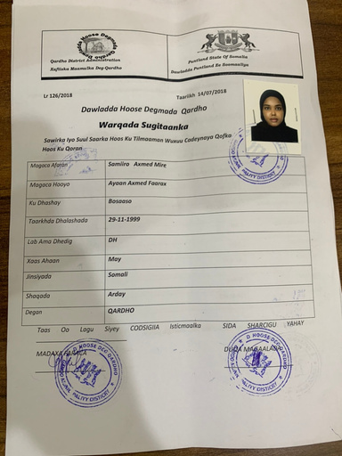
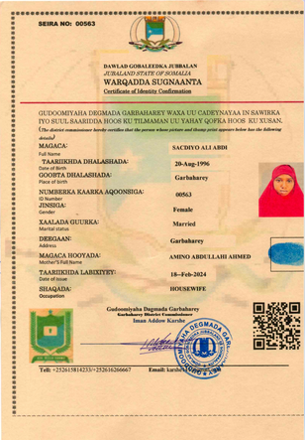
Birth Certificates in Different Administrations

Slide 6
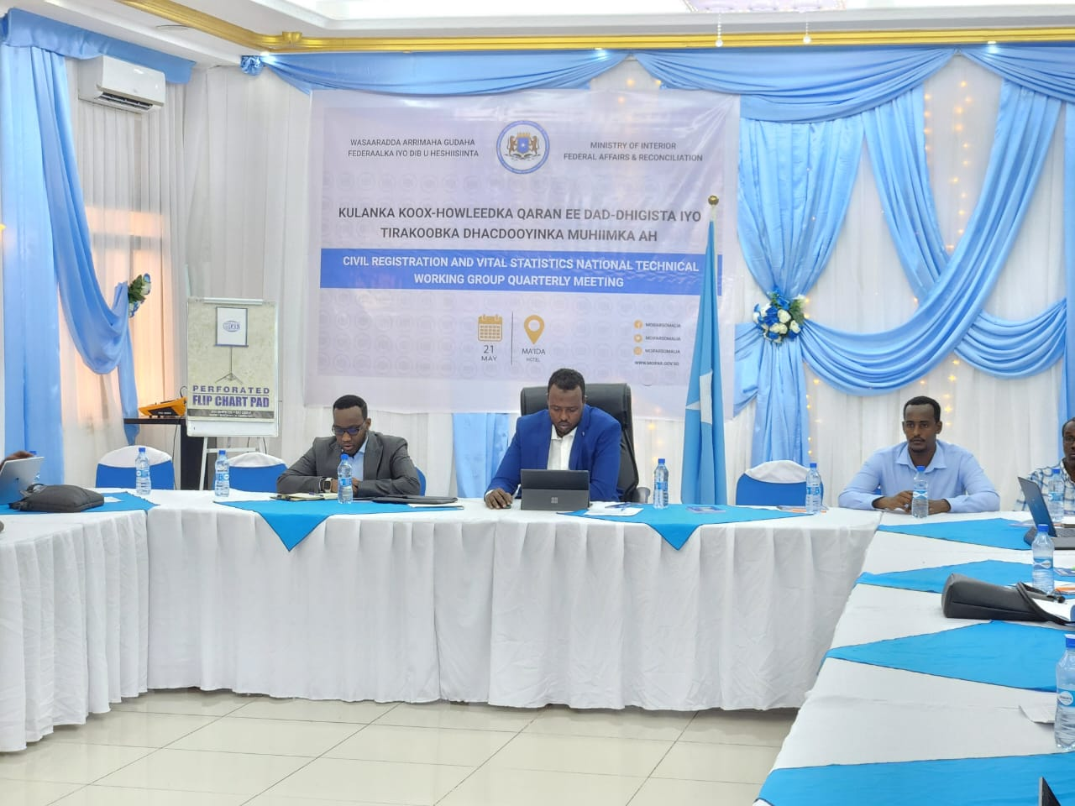
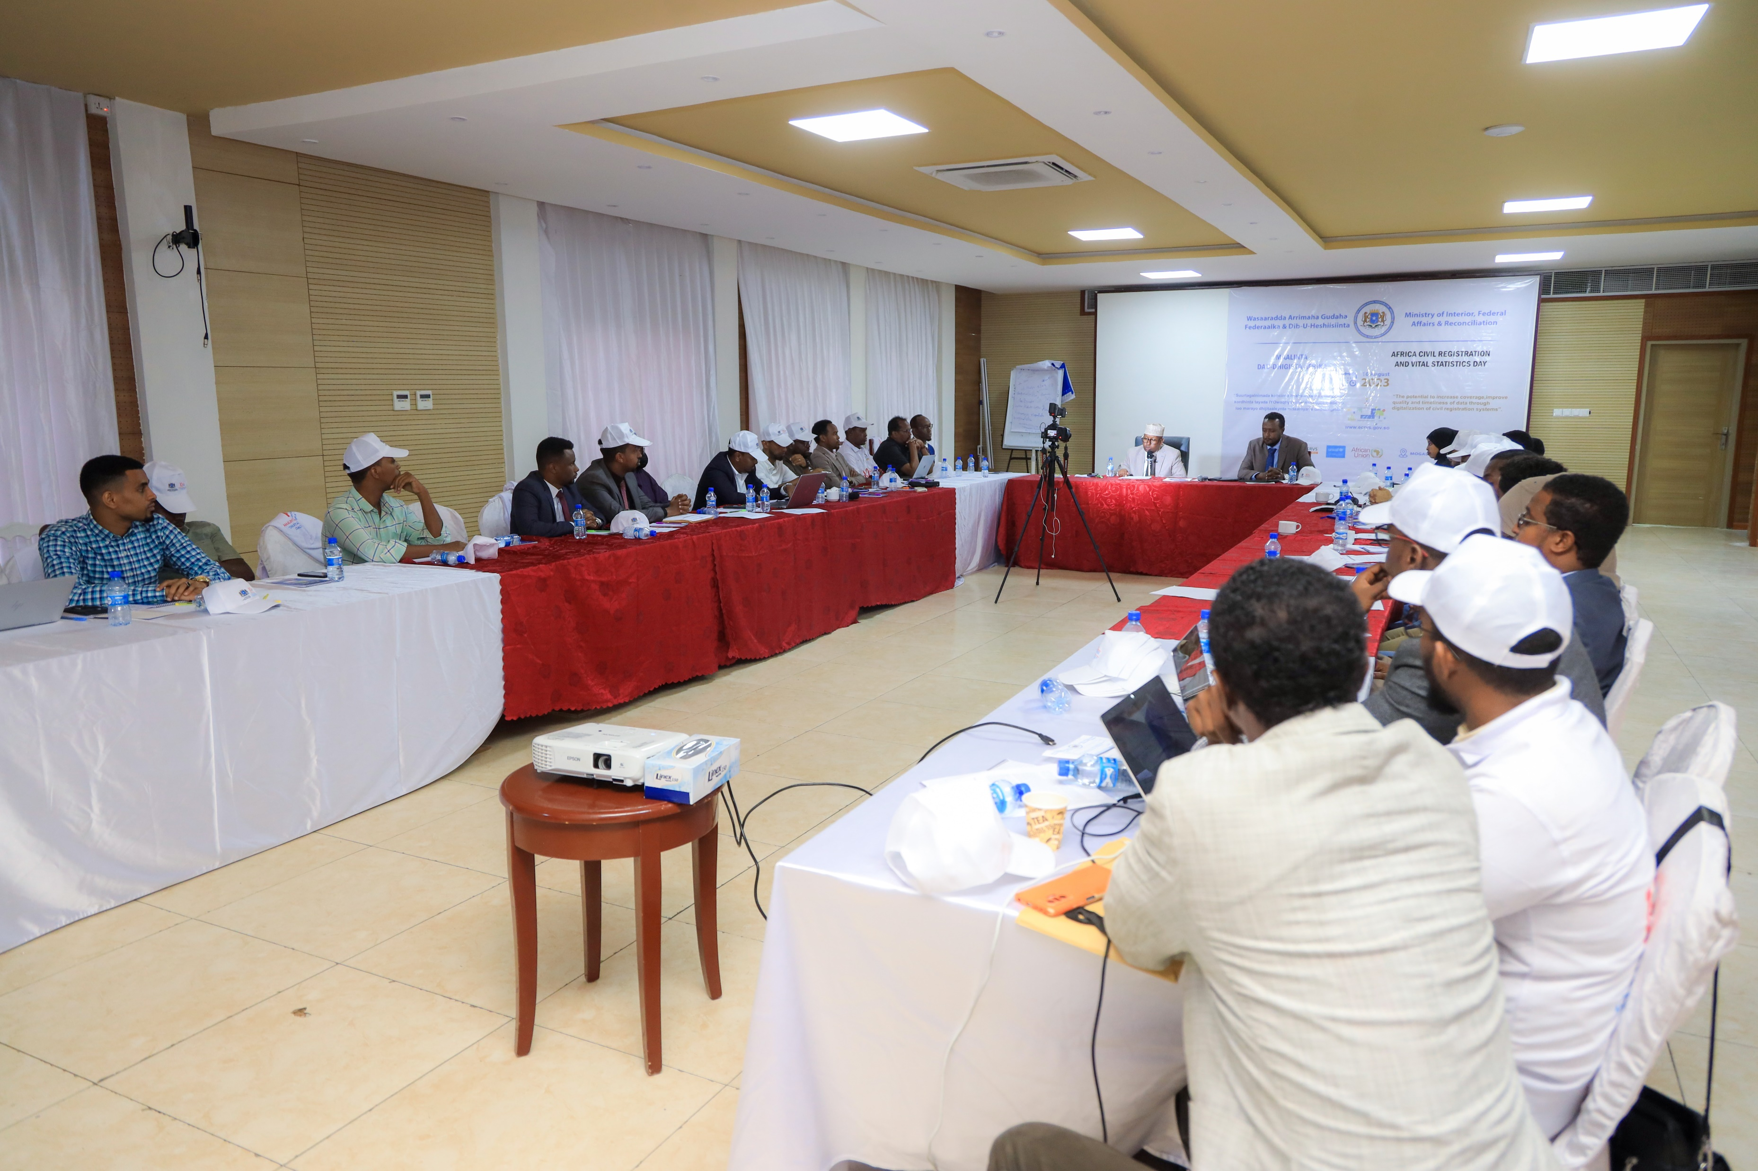
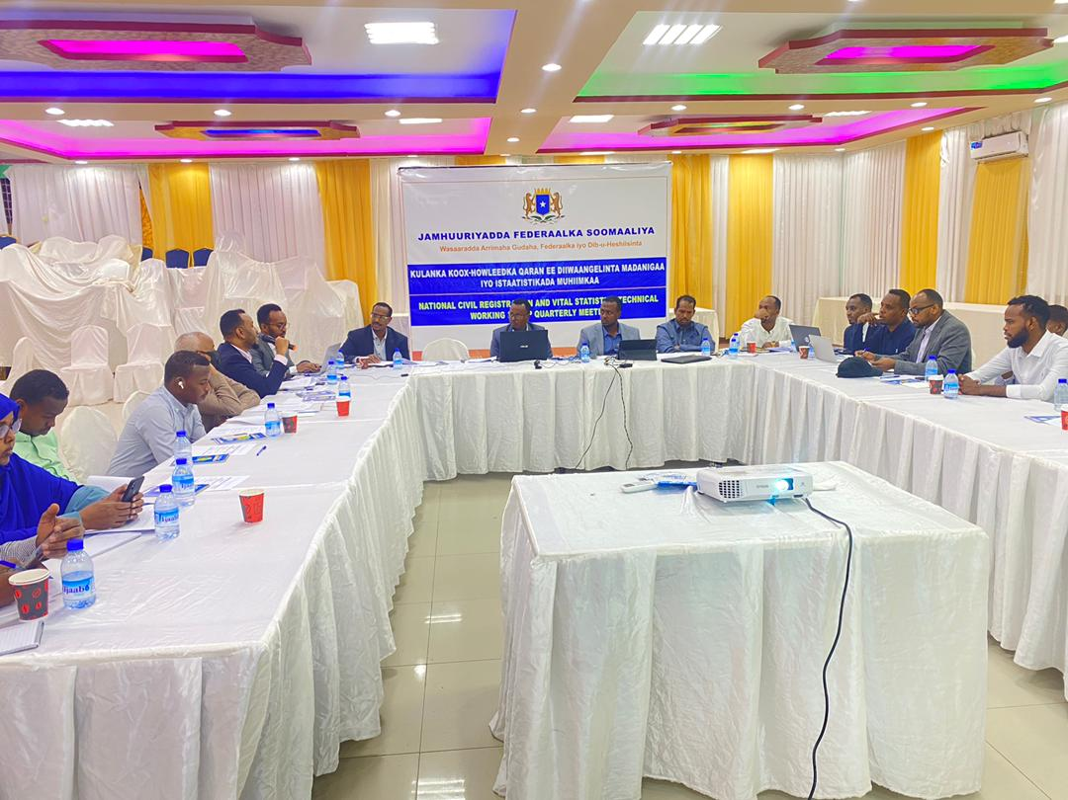
Key Achievements since 2021
The TWG, comprising representatives from the Federal & State-level relevant Institutions, has convened quarterly since the last quarter of 2021.

Slide 7
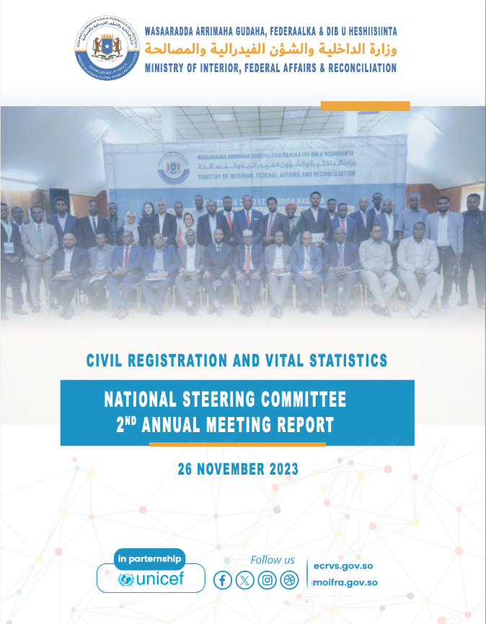
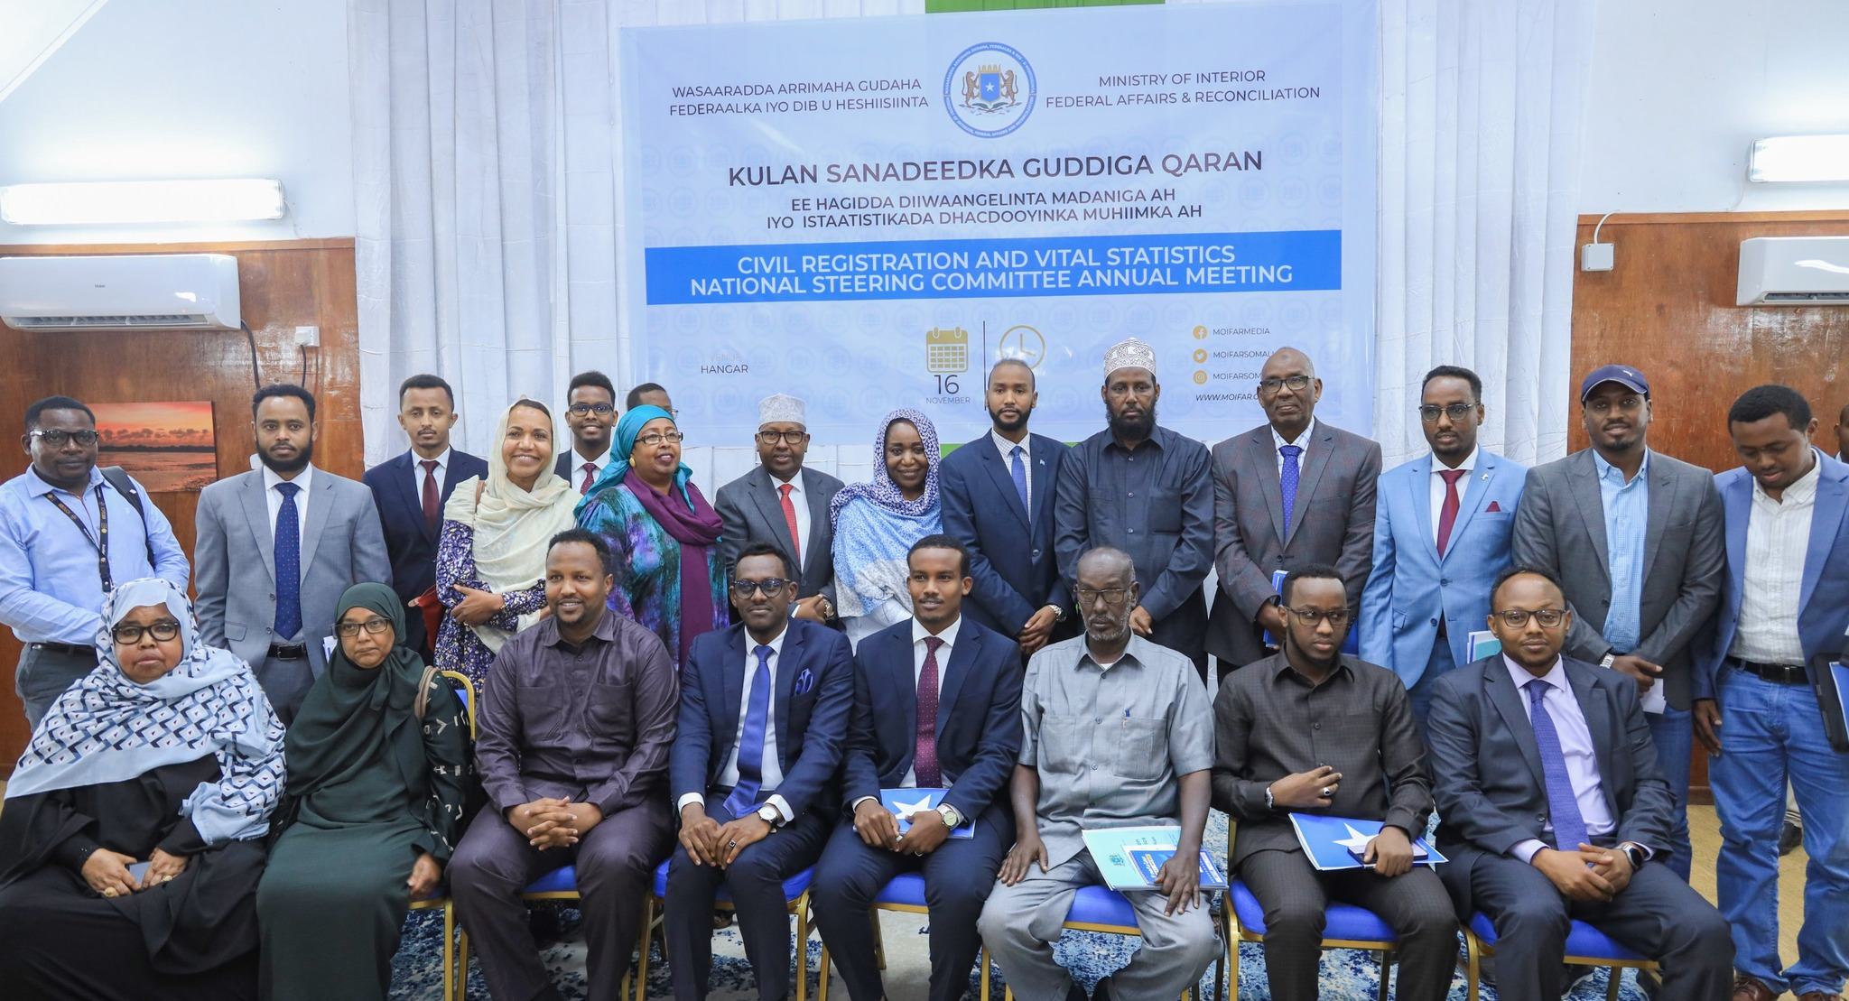
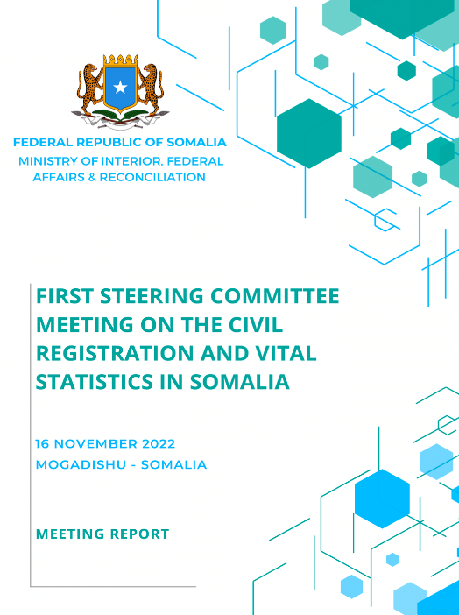
Key Achievements since 2021
The Third National Steering Committee annual meeting is set to take place in September 2024.

Slide 8
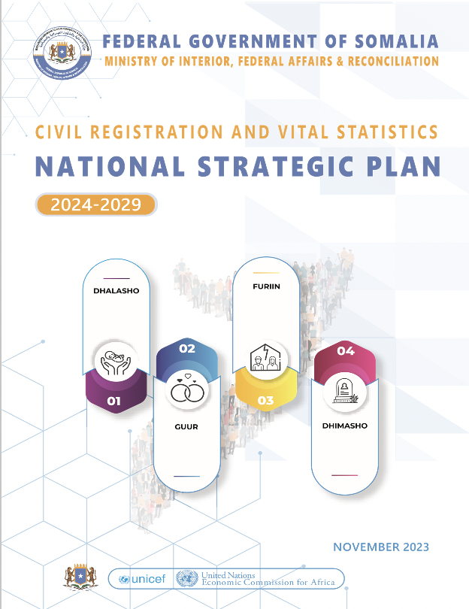
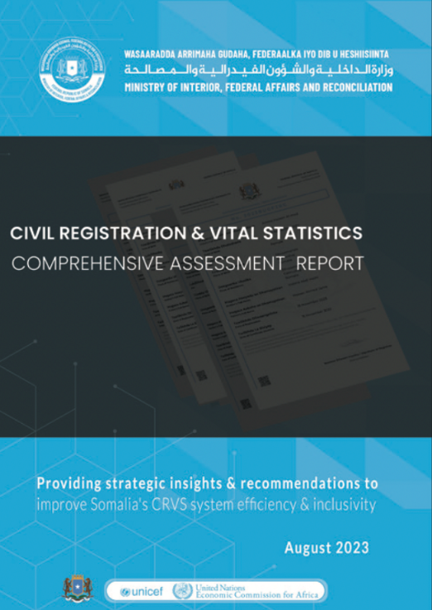

Key Achievements since 2021
.
The CRVS Department has been elevated to a General Directorate within the Ministry of Interior as of 2024
The Ministries of Interior at FMS level established Civil Registration Service Offices
The CR directorate trained stakeholders both domestically and internationally, and equipped state coordination offices and 21 district registrar offices
It also established strong stakeholder coordination, particularly with NIRA, MOH, SNBS, and FMS MOIs
As outlined in the National CRVS Strategic Plan, Somalia aims to produce its first Vital Statistics report by 2029.
Vision: “To have a universal and complete registration of vital events in Somalia”

Slide 9
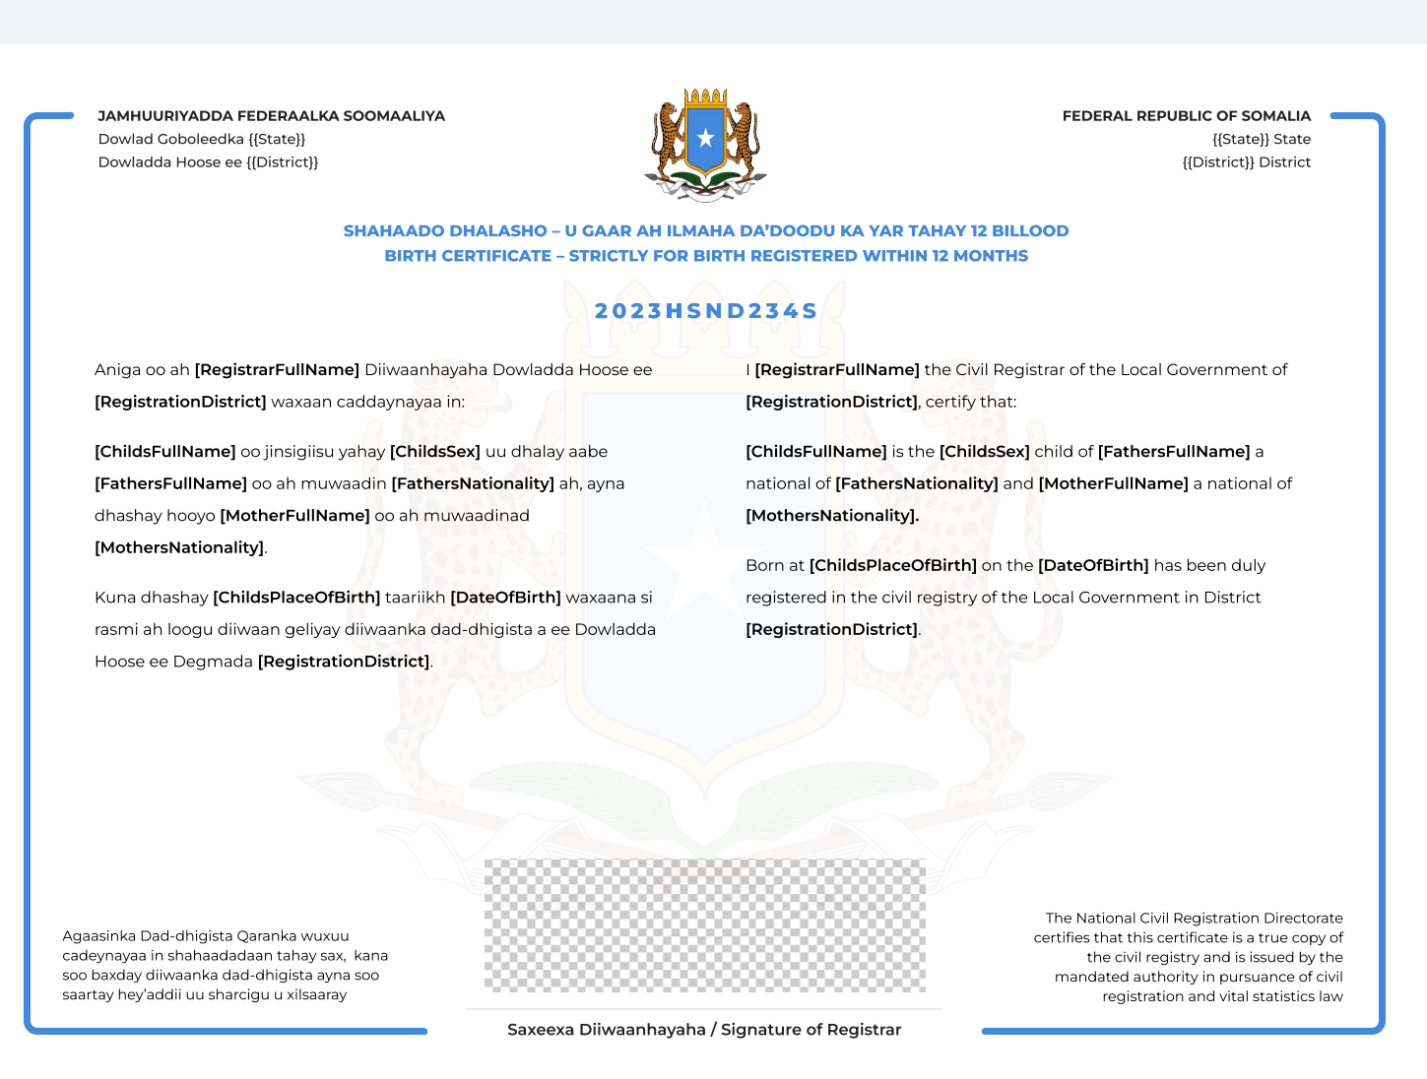
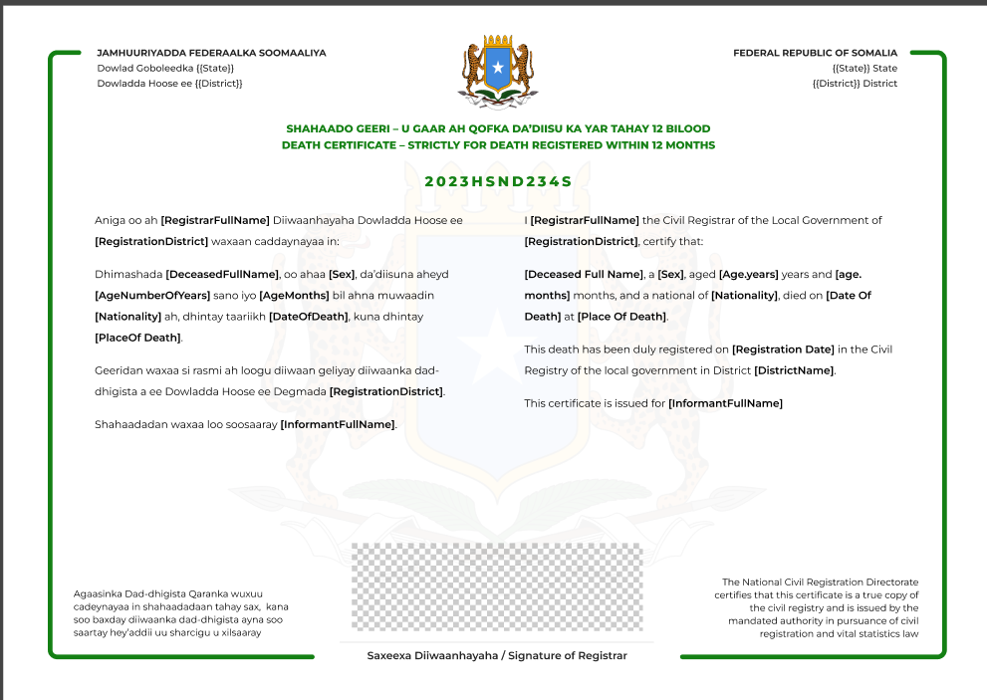
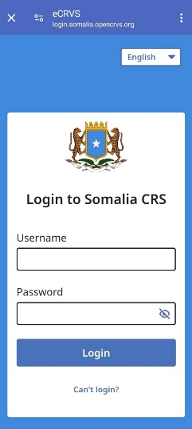
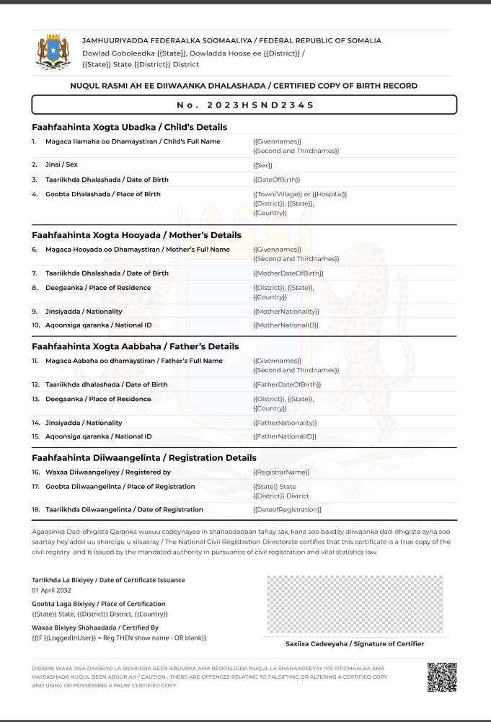
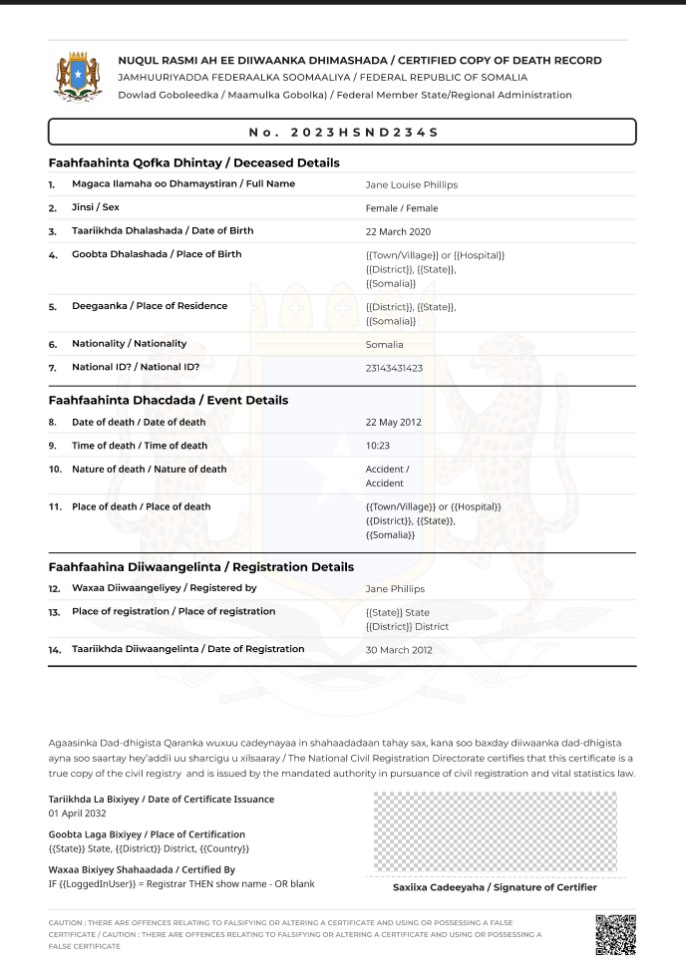
eCRVS - Digital First Approach
Digital Somalia eCRVS platform has been developed
The birth and death registration systems have been completed and are ready for piloting in 21 Districts across the country.

Slide 10
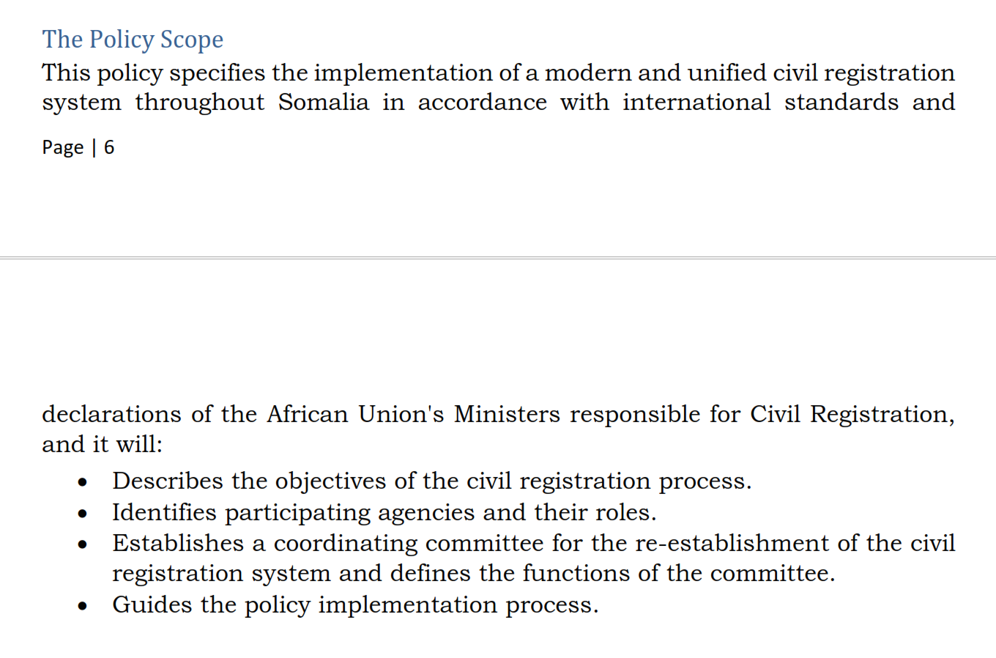
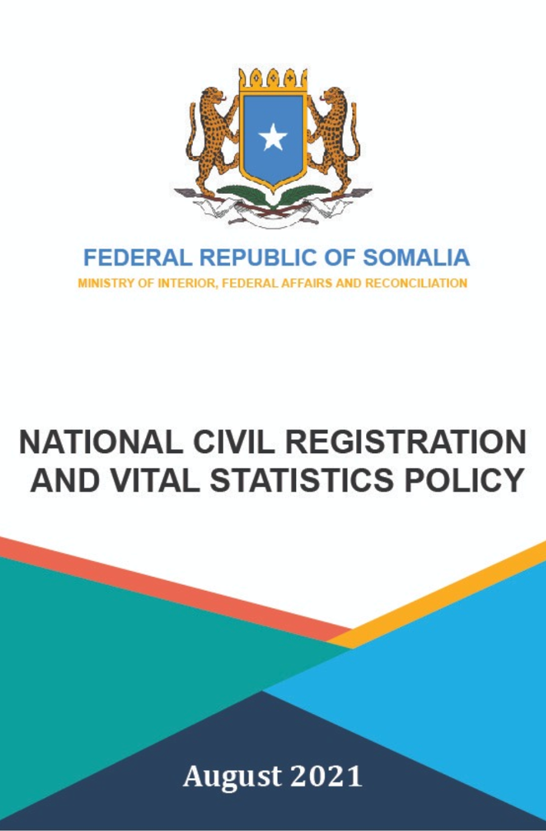
The National CRVS Policy - an Overview
Approved by the FGS Cabinet in August 2021

Slide 11
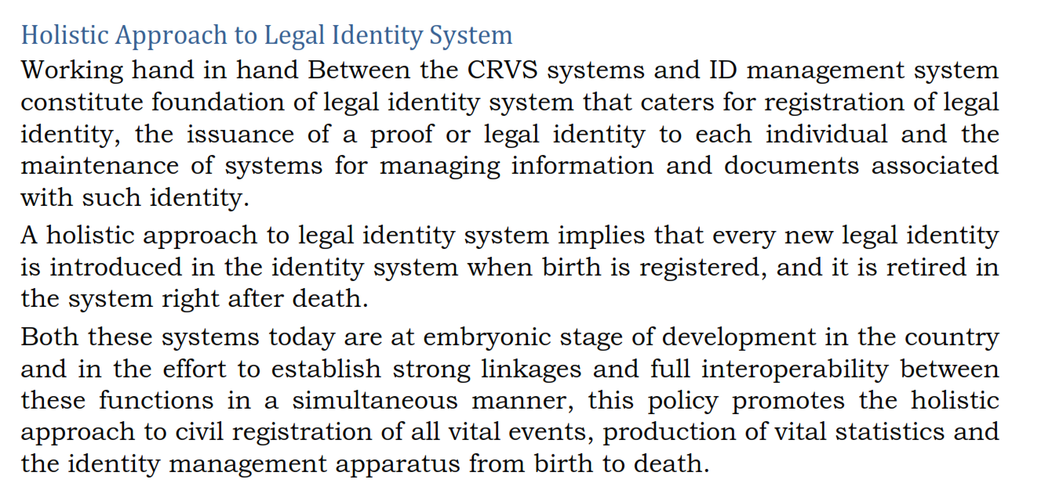
The National CRVS Policy - an Overview
Approved by the FGS Cabinet in August 2021

Slide 12
Recommended UN LIA Holistic Approach Model
UNECA.ORG
Notes:
Presented by: Violet

Slide 13
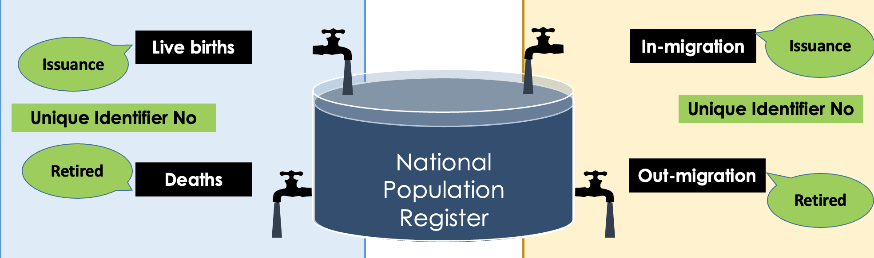
What’s Legal Identity?
Legal identity is defined as the basic characteristics of an individual’s identity, e.g. name, sex, place and date of birth conferred through registration and the issuance of a certificate by an authorized civil registration authority following the occurrence of birth. In the absence of birth registration, legal identity may be conferred by a legally-recognized identification authority; this system should be linked to the civil registration system to ensure a holistic approach to legal identity from birth to death. (UN LIEG)
Definition

Slide 14

Linkages between the CRVS system & the Digital ID system
The CRVS system serves as foundational source for the digital ID system
Linking digital identity data to vital records can help prevent identity fraud
The CRVS and the digital ID systems provides a more comprehensive approach to identity management, spanning the full life cycle of an individual (from birth to death)
The interoperability of CRVS and digital ID systems can enhance overall governance and accountability
The two systems can be complementary and mutually reinforcing as strengthening linkages will improve overall coverage, accuracy and reliability of data & records.

Slide 15

Next Steps: What Can Be Done?
Facilitate close collaboration between the government agencies responsible for CRVS and digital ID systems
Develop clear governance structures and decision-making processes to strengthen linkages of the two systems
Ensure strengthening the interoperability of CRVS and Digital ID Systems (each system should be designed to support and connect with the other)
Enable Late Birth Registration during Digital ID Enrolment (the digital ID enrolment process should provide an opportunity for late birth registration)
Enable seamless data exchange between the CRVS and digital ID systems while ensuring data privacy, security & integrity.

Slide 16


