Slide 1
Somalia Country Assessment Workshop on Digital Legal Identity and Digital Public Infrastructure
Somalia National Bureau of Statistics Presentation
Government issued Identifications
17 August, 2024
Mogadishu

Slide 2
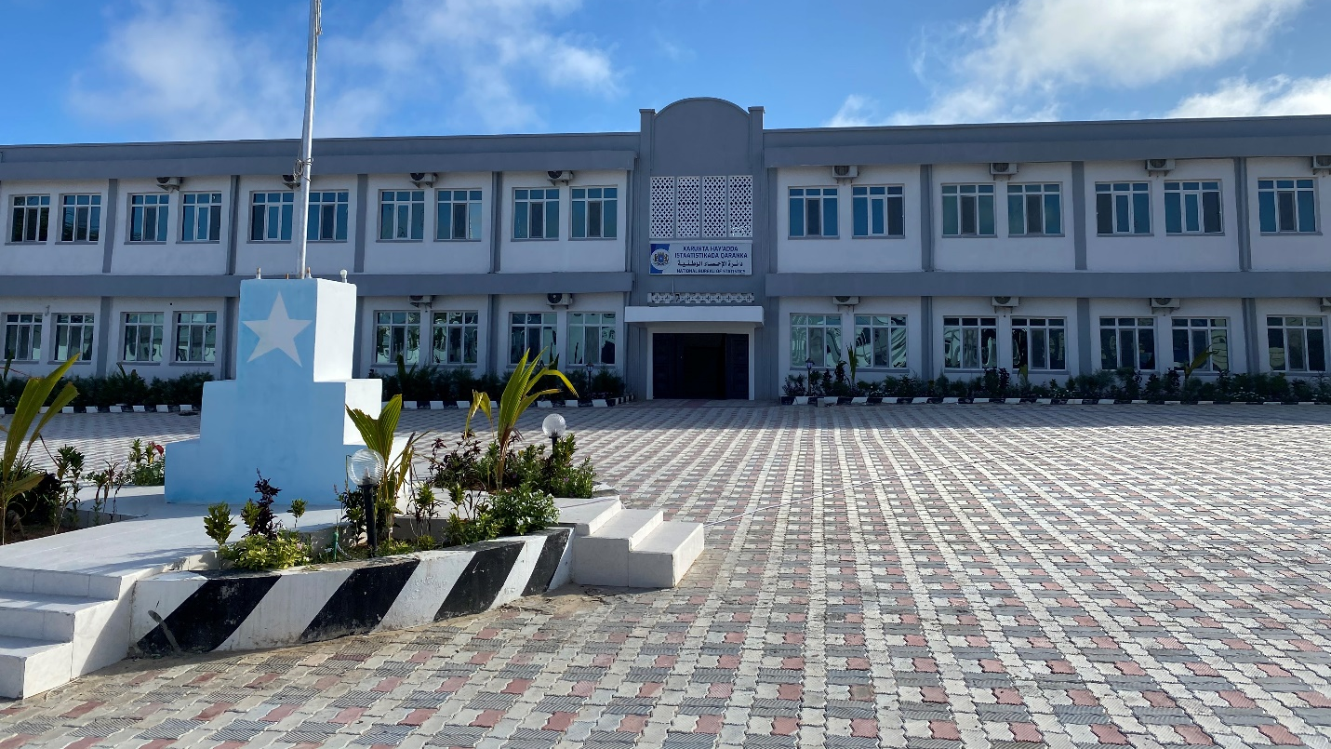
Somalia National Bureau of Statistics

Slide 3
Outline
Background
Data Source
Results

Slide 4
Background
The Somalia Statistical System collapsed in 1991 which led to the erosion of the capacity and Somali statistical infrastructure resulting in large gaps in the statistical information for national development.
The Directorate of National Statistics (DNS) was established in 2014 and began the process of rebuilding, however, most recently the DNS has been restructured and transformed from a Department of Statistics within the Ministry of Planning to an independent Somalia National Bureau of Statistics (SNBS).
The president signed the Somali Statistical Act into law on February 24, 2020.
What does this change?
The SNBS is an autonomous government agency that is exclusively mandated to collect collate analyze verify approve administer publish and regularly disseminate all official economic social environment and demographic statistics as well as the formulation of policies and the establishment of internal regulations priorities standards and criteria for all censuses and surveys to be carried out across Somalia

Slide 5
Directorate’s Data Production
Surveys and census
Population Estimation Survey for Somalia (PESS 2014)
Somali Health and Demographic Survey (SHDS2020)
Somali Integrated Household Budget Survey (SIHBS 2022)
Multiple Indicator Cluster Surveys (MICS2025)
Population & Housing Census

Slide 6
Data Source
The Somalia Integrated Household Budget Survey (SIHBS2022) is a nationally representative survey
SIHBS 2022 is representative both at regional level and for urban, rural and nomadic areas at the national level.
A total of 7,212 households were selected from 601 Enumeration Areas (EAs) distributed across Somalia. About 35 EAs were sampled in each of the 17 covered regions, with 12 HHs interviewed per EA, adding up to about 420 HHs per region

Slide 7
Legal Identity and the Sustainable Development Goals
The 2030 Agenda for Sustainable Development” (UN 2015) explained the agenda in 17 SDGs and 169 targets, including topics such as health, education, and gender quality. The importance of improving identity management systems is recognized in the following SDG targets and indicator:
Target 16.9. By 2030, provide legal identity for all, including birth registration.
Indicator 17.19.2b. Proportion of countries that have achieved 100 percent birth registration and 80 per cent death registration.

Slide 8
Government issued ID ownership by sex
Sex | No ID | Passport | Any other form of ID
Male | 84.7 | 4.9 | 10.4
Female | 86.5 | 2.9 | 10.7
Total | 85.5 | 3.9 | 10.6

Slide 9
Government issued ID ownership by place of residence
Place of Residence | No ID | Passport | Any other form of ID
Rural | 88.6 | 1.3 | 10.1
Urban | 83.1 | 5.3 | 11.5
Nomadic | 93.8 | 0.2 | 6
Total | 85.5 | 3.9 | 10.6

Slide 10
Government issued ID ownership by age group
Age group | No ID | Passport | Any other form of ID
15-19 | 92.5 | 1.5 | 6.1
20-24 | 85.2 | 3.2 | 11.7
25-29 | 83.3 | 4.7 | 12
30-34 | 82.9 | 4 | 13.1
35-39 | 84.6 | 3.9 | 11.4
40-44 | 83.6 | 3.9 | 12.5
45 - 49 | 80.9 | 6.2 | 12.9
50 - 54 | 81.3 | 6.1 | 12.6
55 -59 | 80.3 | 7.1 | 12.6
60 -64 | 82 | 6.2 | 11.8
65 - 69 | 83.7 | 7.5 | 8.8
70 - 74 | 84.1 | 6 | 9.9
75 -79 | 87.7 | 10.8 | 1.5
80+ | 86.7 | 6.2 | 7.2
Total | 85.5 | 3.9 | 10.6

Slide 11
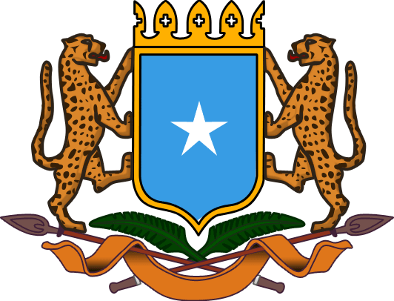
Mahadsanidiin

