Slide 1


THE DIGITAL PUBLIC INFRASTRUCTURE (DPI) APPROACH AND SOMALIA
Mogadishu
August 2024

Slide 2
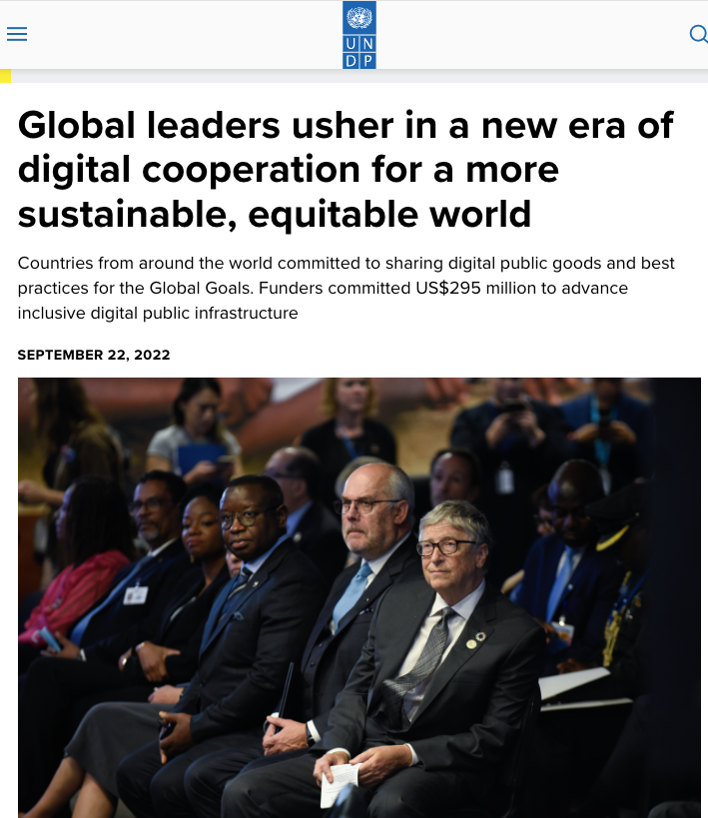
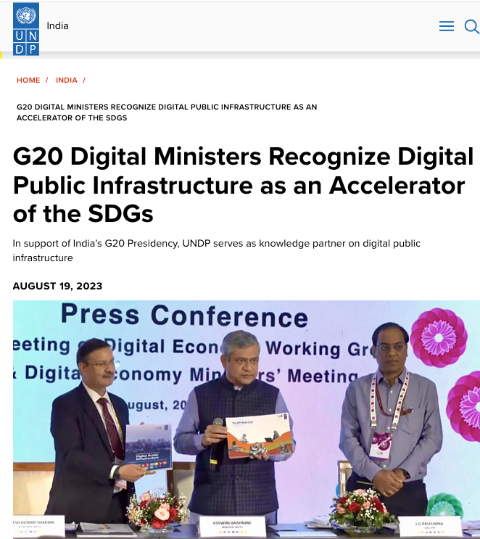
UNDP has advocated for a DPI approach
Notes:
UN General Assembly 2022

Slide 3
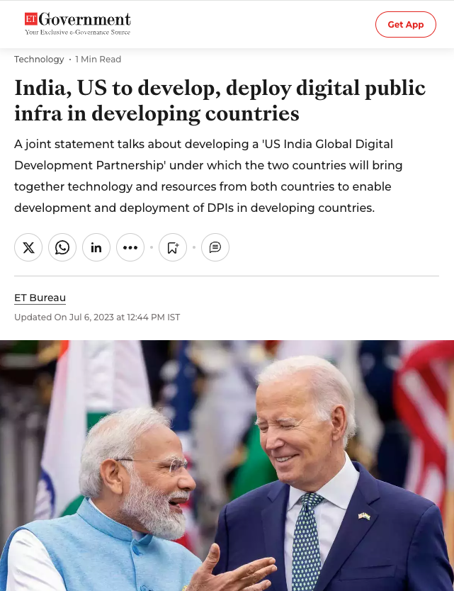
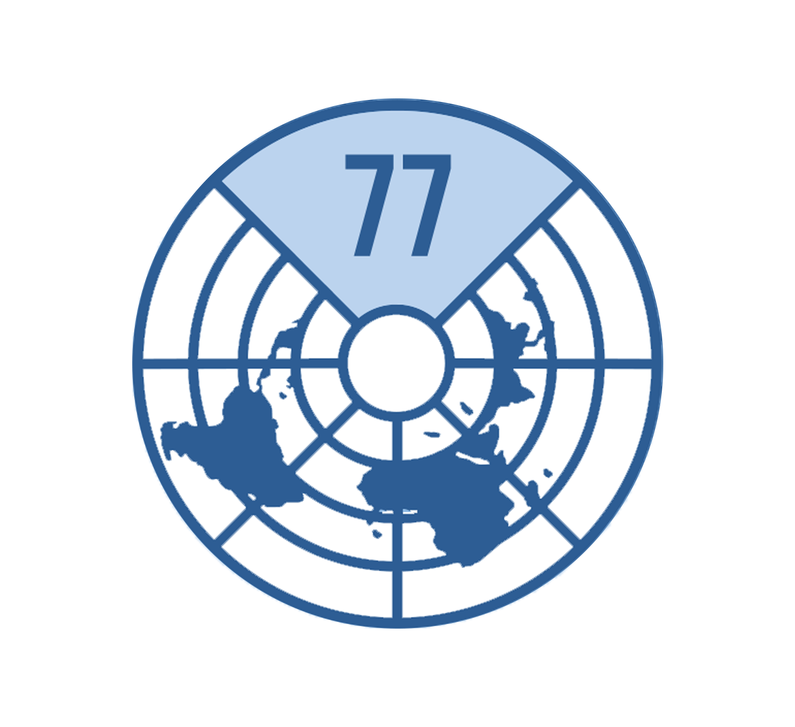


Global leaders have recognized DPI too
The Compact should call for resilient, affordable, and accessible digital infrastructure, including minimum digital public infrastructure for digital inclusion and connectivity for all.
G77-submission to the Global Digital Compact
50-in-5 is an UN-supported global DPI Advocacy Campaign that has +10 countries advocating for inclusive DPI
India Stack is probably the greatest contribution that India can make to the world.
Satya Nadella, CEO, Microsoft
Notes:
UN General Assembly 2022

Slide 4
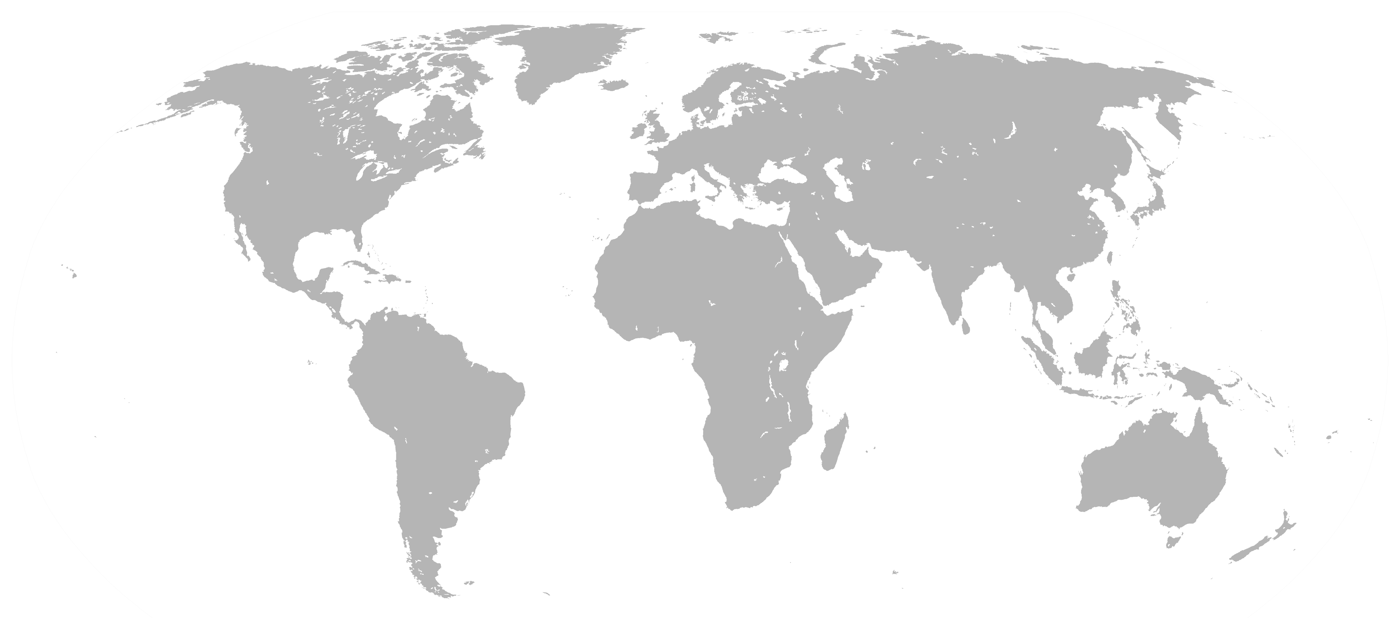





















Countries have been doing DPI for a while with strong results
Example of countries
Tools and technologies used
Notes:
In different places, countries have delivered digital public services, and enabled an eco-system of business to innovate, developing...
on principles of open, re-usable, technical software components, I like to use the analogy of Lego-blocks
encouraging, and sometimes mandating, that these components are interoperable, meaning they allow for information to flow easily between systems
and fostering uniformity in data standards, specifying the technical format, semantics and meaning of that information that shared

Slide 5
Why a need for a new approach?
3 challenges holding back digital transformation in government
Inadequate
governance
(and exclusion)
High project failure rate
High cost of ICT
Notes:
What we see is that there are some countries that have taken an untraditional way of dealing with this risk.

Slide 6

High failure rate
Percent of government digital transformation initiatives to reform that do not fully meet expectations
80%
Source: McKinsey & Company, 2018
Notes:
What we see is that there are some countries that have taken an untraditional way of dealing with this risk.

Slide 7


Cost
#DigitalUNDP
The Global Government IT Spend in 2022 was $683 bn, of which 90% was spent in N America, W Europe, China, Mature Asia.
If the Rest of the World would want to raise to the same level (per capita), it would need an additional $1297 bn
© Photo credit

Slide 8

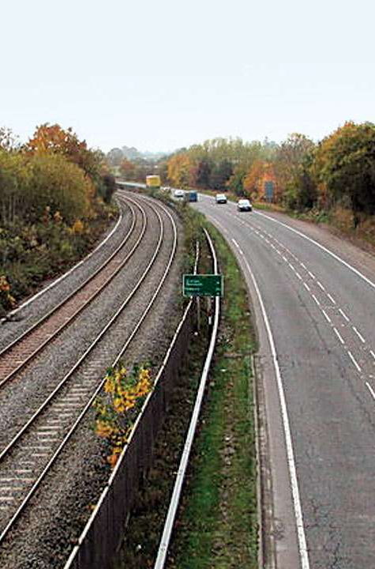

Insufficient governance
What if we governed digital more like we govern physical infrastructure?

Slide 9
Deliberate government investment, policy and coordination to increase public welfare and private sector growth

Slide 10




Infrastructure: A shared means to many ends
Gov
Ministry of Education
Ministry of Health
National tax/ revenue authority
Department of Agriculture
Infra
…but this is not how digital usually works in government

Slide 11
However, government ICT is generally siloed
Ministry of Education
Ministry of Health
National tax/ revenue authority
…
Public services
(Use cases)
Applications
Databases
Credits: David Eaves, University College London
Notes:
…these applications are your…

Slide 12
However, government ICT is generally siloed
Government institutions
Ministry of Education
Ministry of Health
National tax/ revenue authority
Public services
(Use cases)
Applications
Databases
System duplication, little standardization, different user experiences
Credits: David Eaves, University College London
Notes:
…there is vertical accountability in each part of government. So the boss know who to go to when things down work, which department, which unit, typically down to which IT vendor eventually needs to get to work.
However, what this results in is a lot of system duplication, lack of common standards and different user experiences.

Slide 13
DPI introduces shared layers of digital “building blocks”
Ministry of Education
Ministry of Health
National tax/ revenue authority
Government institutions
Public services
Digital ID
Shared digital “building blocks”
Digital payments
Data exchange
Data

Slide 14
Let’s consider an example of emerging digital public infrastructure in Somalia
Notes:
What we see is that there are some countries that have taken an untraditional way of dealing with this risk.

Slide 15
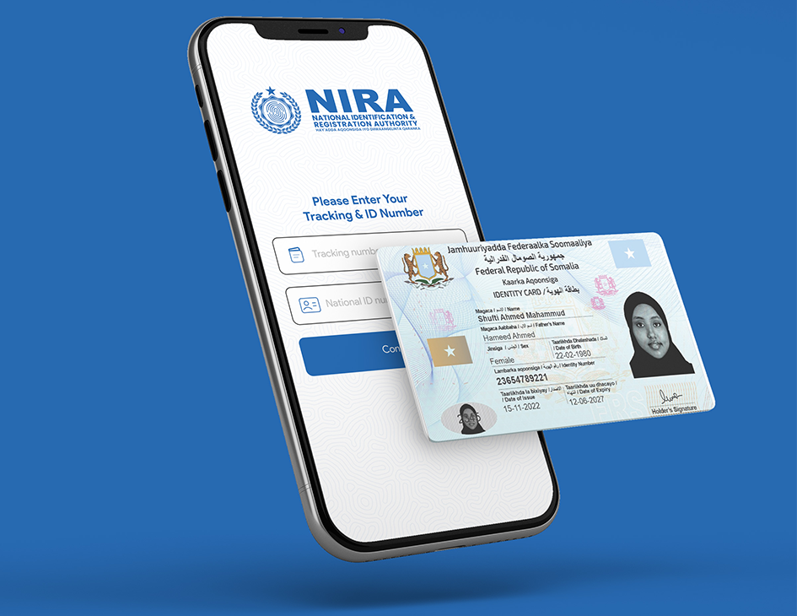
NIRA
Scenario: A user attempts to log into an online banking service.
To verify their identity, the bank sends a one-time password (OTP) to the persons registered NIRA mobile phone app.
The user logs in using their own password, then enter the one-time password, to gain access to their online bank account.
How many “building blocks” are there in this scenario?
Notes:
There is naturally a tech-component to this. In other words how country architect and design country-wide systems to work together. And to work with private sector. Dr. Pramod Varma is going to talk more about that.
The other key elements are governance and inclusion. I will focus on these two, because we would argue, that the technology is not the hard part. The tech is out there.
Countries have different levels of digital capacity to work with the tech, but at the minimum it can be procured by India, Estonia, Ukraine, Bangladesh or elsewhere.
Governance, or the lack of governance, is where we see countries stumble.
And inclusivity is key, we are developing systems for the future, and that future belongs to all of us, also those that are not connected or illerate, so we need actions to bring them along.

Slide 16
A set of building blocks as part of DPI
Account mapper
eLocker
National population registry
Birth/death e-notification
eKYC
eSignature
OTP
Secure push notifications
QRs
IDs
Mobile ID
…
Notes:
There is naturally a tech-component to this. In other words how country architect and design country-wide systems to work together. And to work with private sector. Dr. Pramod Varma is going to talk more about that.
The other key elements are governance and inclusion. I will focus on these two, because we would argue, that the technology is not the hard part. The tech is out there.
Countries have different levels of digital capacity to work with the tech, but at the minimum it can be procured by India, Estonia, Ukraine, Bangladesh or elsewhere.
Governance, or the lack of governance, is where we see countries stumble.
And inclusivity is key, we are developing systems for the future, and that future belongs to all of us, also those that are not connected or illerate, so we need actions to bring them along.

Slide 17


Digital Public Infrastructure (DPI)
A set of digital building blocks (platforms/ protocols/ networks) which are interoperable, driven by open standards/specifications, enable access to public and private services at societal scale, and are governed by enabling rules to drive innovation, inclusion, and competition
Definition adopted by G20 countries
Notes:
...so DPI can be considered as a...
...
now, there are a few things to unpack for this definition. As a UNDP development professional working with digital, the key elements we take away are...

Slide 18


Openness and interoperability in digital identity (as part of DPI)
Identity solutions as free and open source software (FOSS)
Standards-development to make portability more seamless
Notes:
There is naturally a tech-component to this. In other words how country architect and design country-wide systems to work together. And to work with private sector. Dr. Pramod Varma is going to talk more about that.
The other key elements are governance and inclusion. I will focus on these two, because we would argue, that the technology is not the hard part. The tech is out there.
Countries have different levels of digital capacity to work with the tech, but at the minimum it can be procured by India, Estonia, Ukraine, Bangladesh or elsewhere.
Governance, or the lack of governance, is where we see countries stumble.
And inclusivity is key, we are developing systems for the future, and that future belongs to all of us, also those that are not connected or illerate, so we need actions to bring them along.

Slide 19
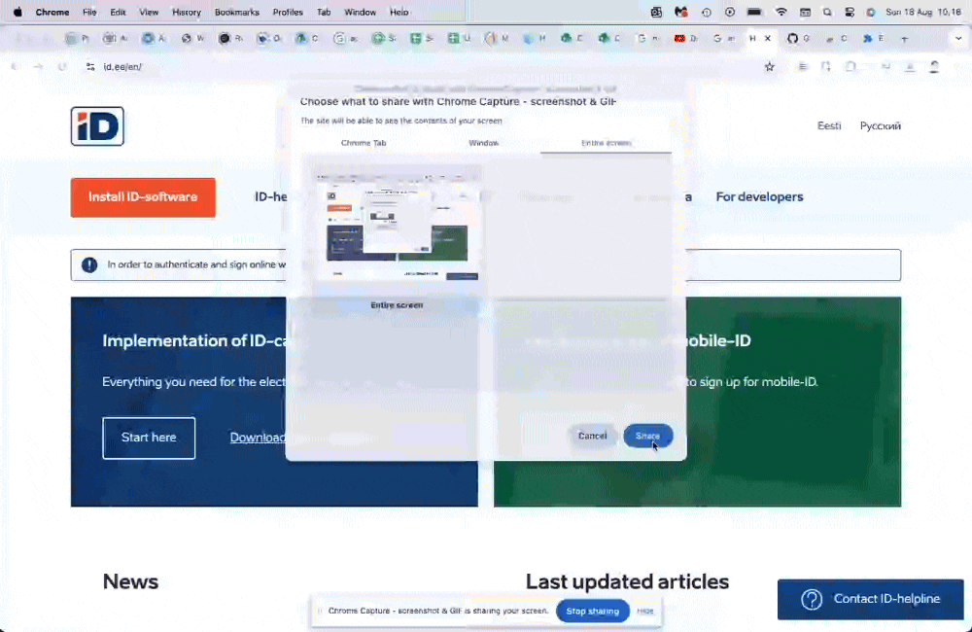

Openness in DPI
Making government identity software freely and openly available for all
Kick-starting local innovation in public and private sector
Notes:
There is naturally a tech-component to this. In other words how country architect and design country-wide systems to work together. And to work with private sector. Dr. Pramod Varma is going to talk more about that.
The other key elements are governance and inclusion. I will focus on these two, because we would argue, that the technology is not the hard part. The tech is out there.
Countries have different levels of digital capacity to work with the tech, but at the minimum it can be procured by India, Estonia, Ukraine, Bangladesh or elsewhere.
Governance, or the lack of governance, is where we see countries stumble.
And inclusivity is key, we are developing systems for the future, and that future belongs to all of us, also those that are not connected or illerate, so we need actions to bring them along.

Slide 20
DPI as governed by enabling rules: Figuring out the hard question when digital is shared infrastructure
Who operates and maintains?
Who pays?
How is data privacy ensured?
What steps are taken to ensure inclusion?
How is remediation handled?
Notes:
…and because it’s infrastructure, it’s sticky. Once in place and organisations begin to use the standards and systems laid down. It’s hard to change, it’s path dependent. So the importance for us to get it right becomes magnified.

Slide 21
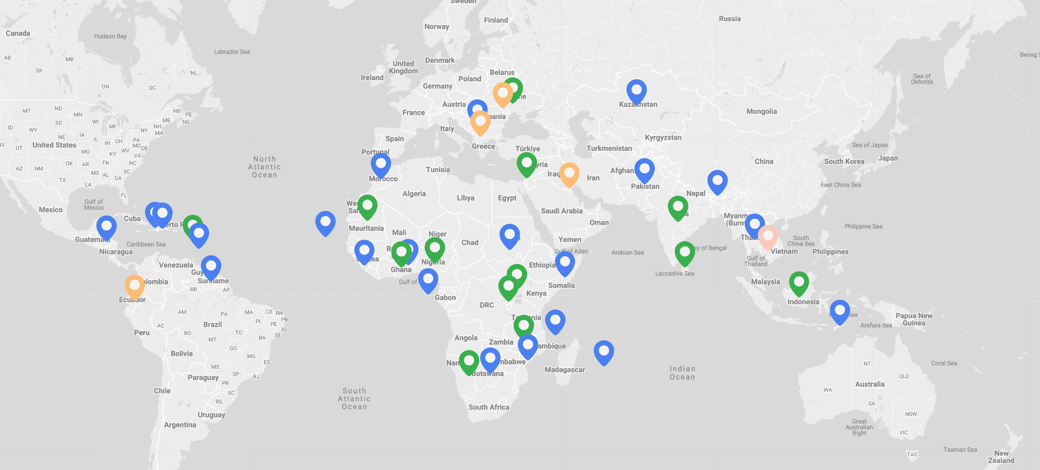
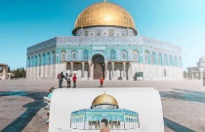
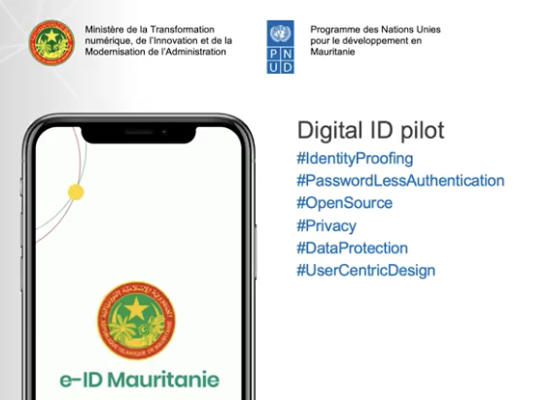

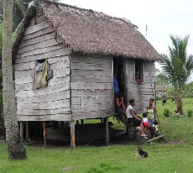
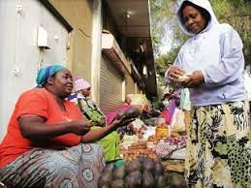
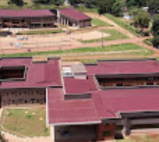






UNDP is supporting over 250 digital projects in +100 countries
Palestine: Access to Justice support through supporting deployment of MIZAN DPG
Mauritania: Completed Readiness Assessment, supporting development of an e-id pilot
Bangladesh: Supported nation-wide A2I programme
LEGEND
Country with on-going or completed digital project
Readiness assessment
DPI implementation
Partnership Support
Digital transformation advisory
Honduras: Supported deployment of an ID system to +5 million people
Rwanda: Supported Gov in Cashless acceleration program, trained women and youth in cross-border digital payments
Uganda: Assessed schools and digital skills with Ministry of ICT and Ministry of Education

Slide 22
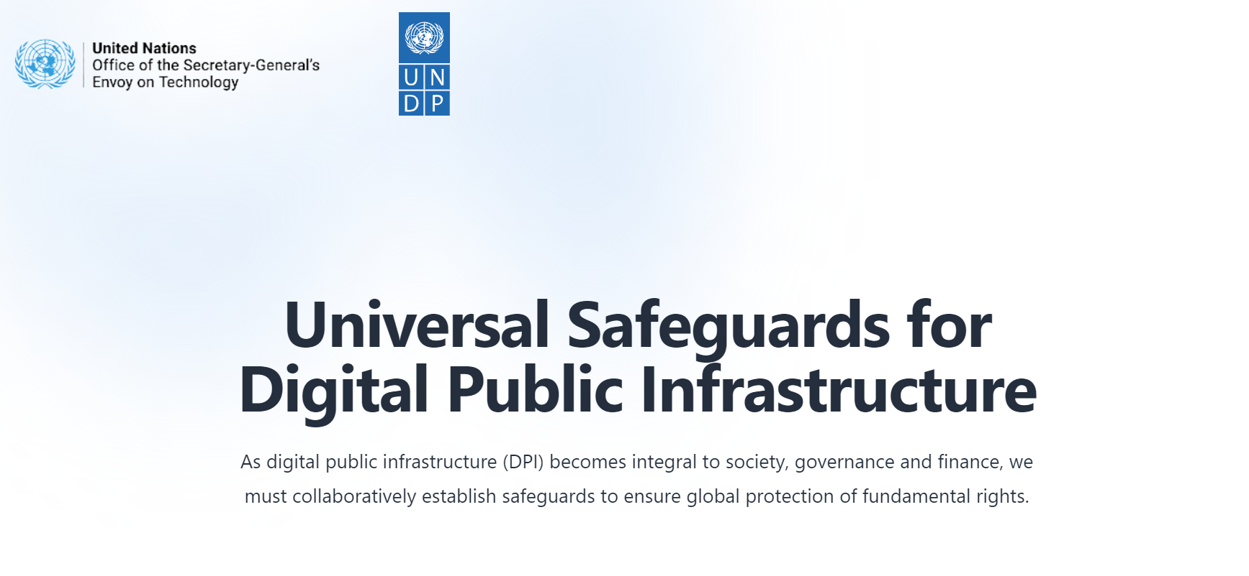
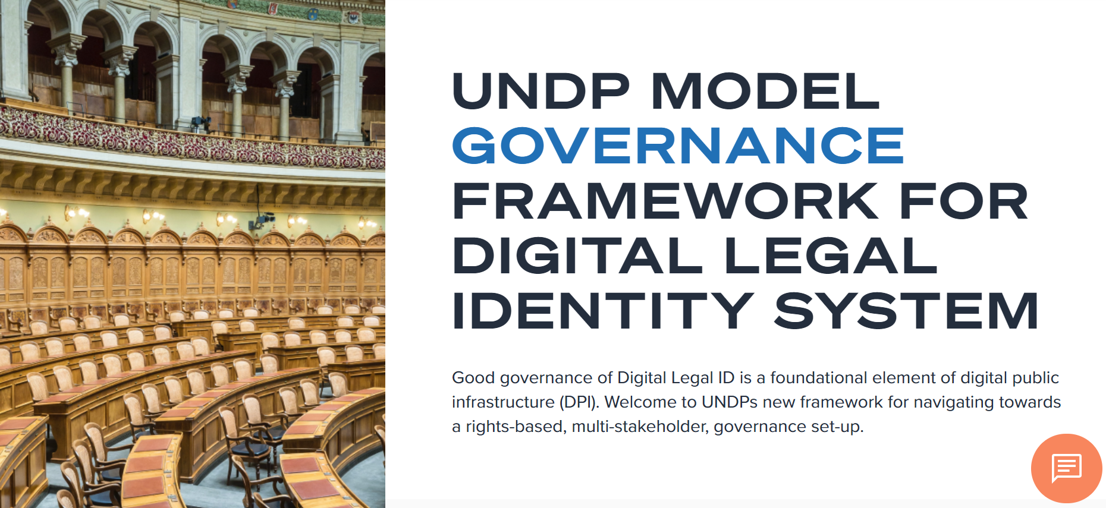
UNDP works to strengthen governance of DPIs to ensure safe, responsible, and inclusive use
Universal Safeguards for Digital Public Infrastructure
UNDP Model Governance Framework for Digital Legal ID System

Slide 23
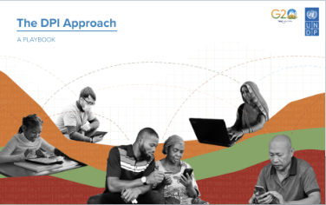



In summary
The DPI Approach: A Playbook
DPI is an approach that includes on technology, governance and inclusivity
UNDP has a particular focus on governance and inclusion, we usually partner with others on tech
UNDP has been a knowledge partner for India’s G20 on DPI, and we have a team to support countries
Digital Public Goods for the SDGs-Case Studies
The Human and Economic Impact of Digital Public Infrastructure
Accelerating The SDGs Through DPI: A Compendium of The Potential of DPI

Slide 24
Thank you
Ben Bertelsen, DPI Manager
August 2024

