Slide 1
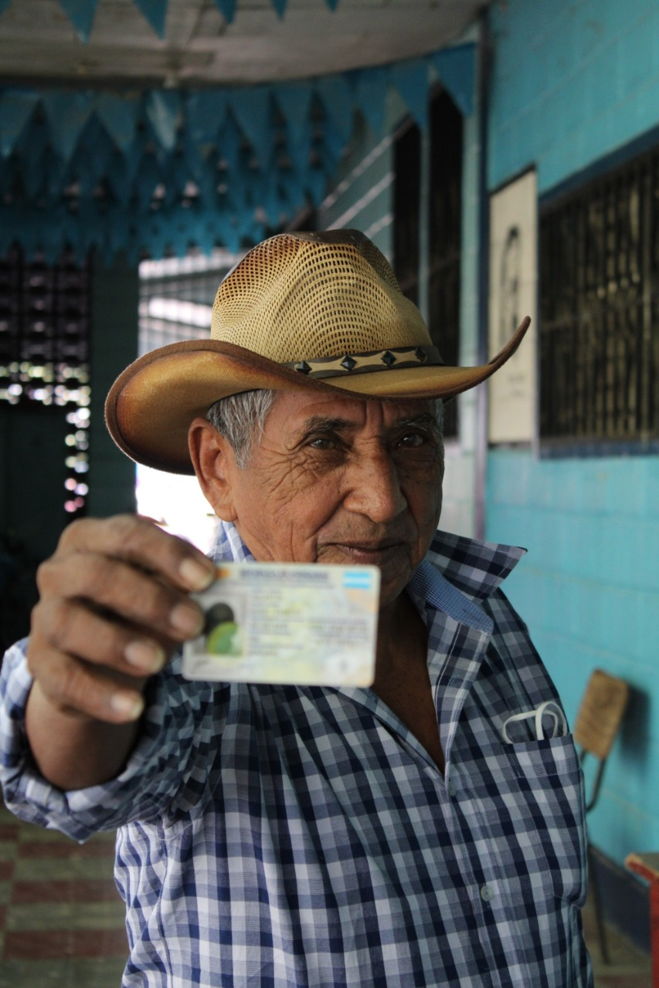
HONDURAS
THE ROLE OF DIGITAL IDENTITY IN BUILDING CITIZEN TRUST
Alessandra Rossi
UNDP
Chief Technical Advisor

Slide 2


Slide 3

Goals
Digital Biometric Registration
Updated citizen database
Centralized database to transform public administration
provides guarantees and strengthens confidence in public institutions and processes.
New ID
card
Knowledge Transfer
to RNP
with high levels of security.

Slide 4
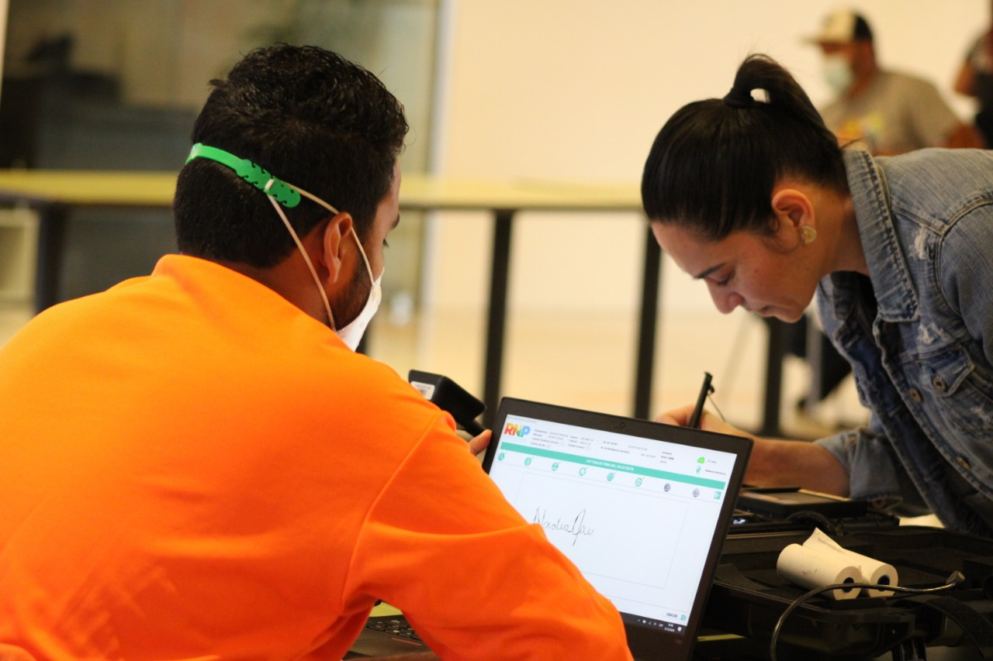
CONTRIBUTION OF THE NATIONAL IDENTIFICATION PROCESS TO THE SOCIAL DEVELOPMENT OF THE COUNTRY

Slide 5
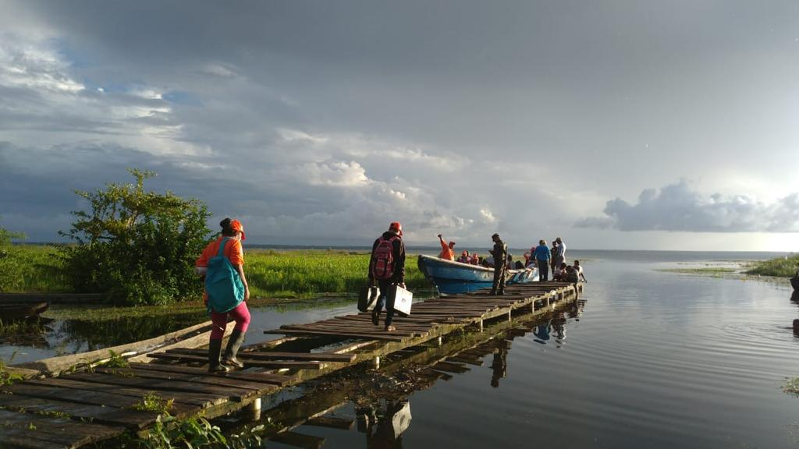
RNP PERSONNEL TRAVELED AROUND THE COUNTRY

Slide 6
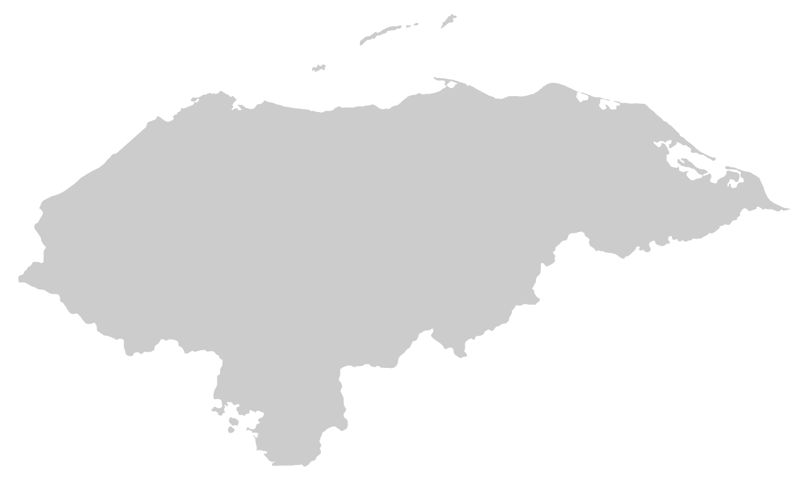






Implementation at the National Level
Field operation throughout the country
2020- 2021 (COVID and tropical storms ETA and IOTA)
Logistical support
3,700
Enrollers
1,400
Kits
65
trainers
431
supervisors
56
coordinators
The project successfully carried out the mass enrollment of more than 5.5 million citizens ( from 18 years old): 2.6 million men and 2.9 million women in less than 1 year. Population is 9- 10 million.

Slide 7
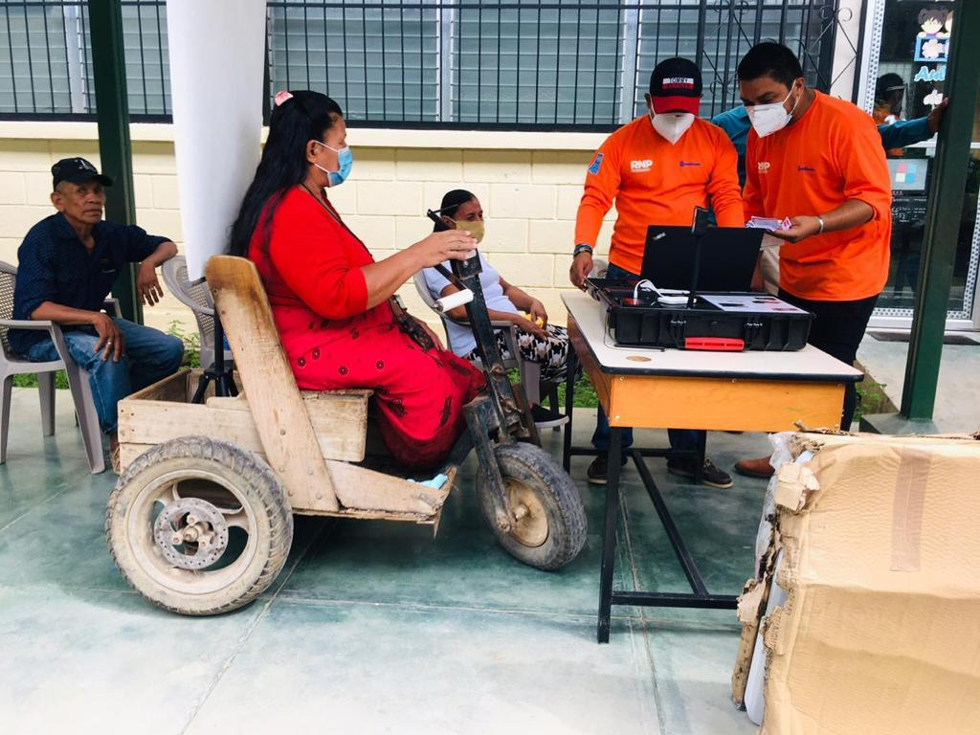
ATTENTION TO VULNERABLE SEGMENTS OF THE POPULATION

Slide 8
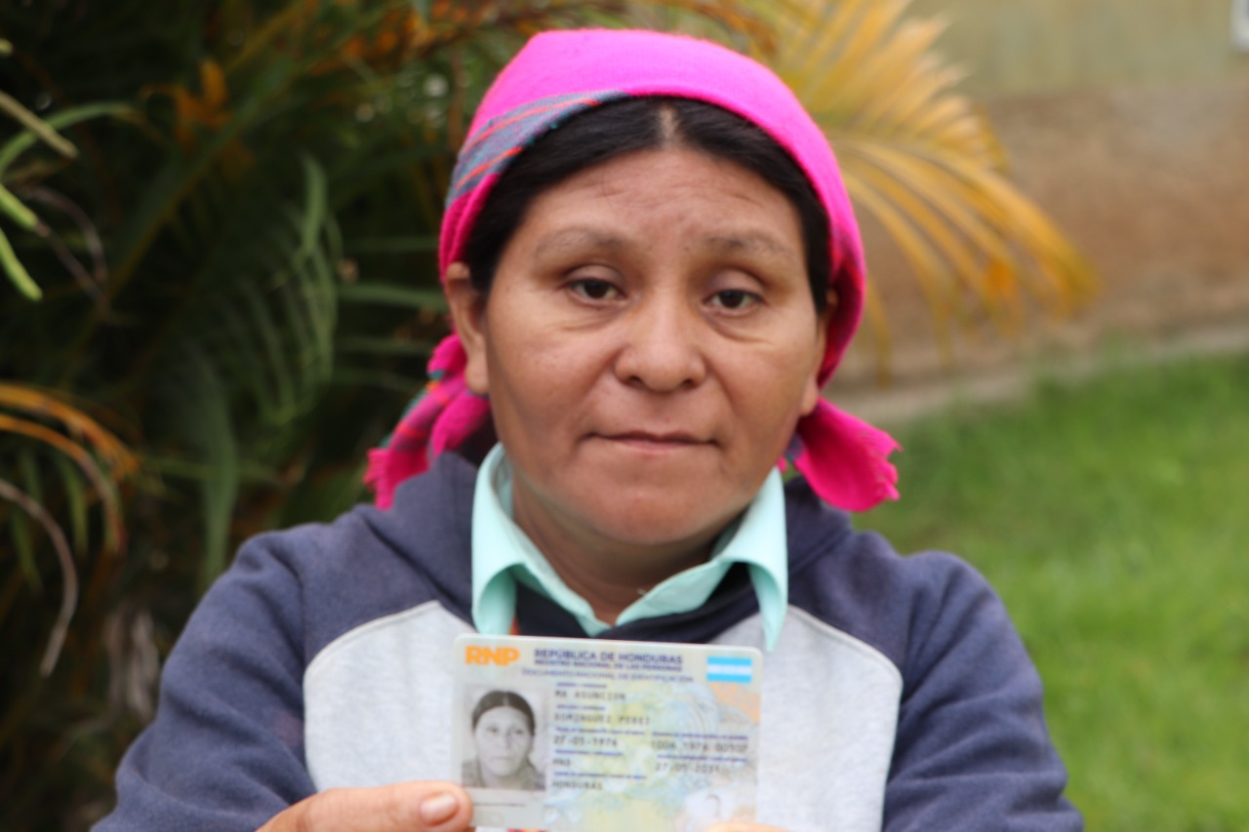
Indigenous Population
HIRED PEOPLE FROM INDIGENOUS POPULATIONS
MATERIALS IN NATIVE LANGUAGES
ENROLLMENT IN NATIVE LANGUAGES

Slide 9
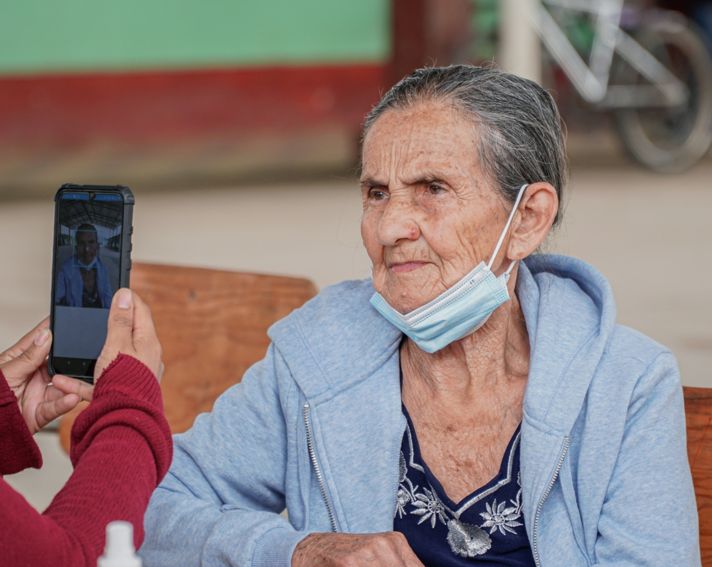
Older adults and people with disabilities
FIRST REGISTRY BASE OF PEOPLE WITH DISABILITIES 18+ YEARS OLD
ENROLLMENT AND FOCUSED DELIVERIES

Slide 10
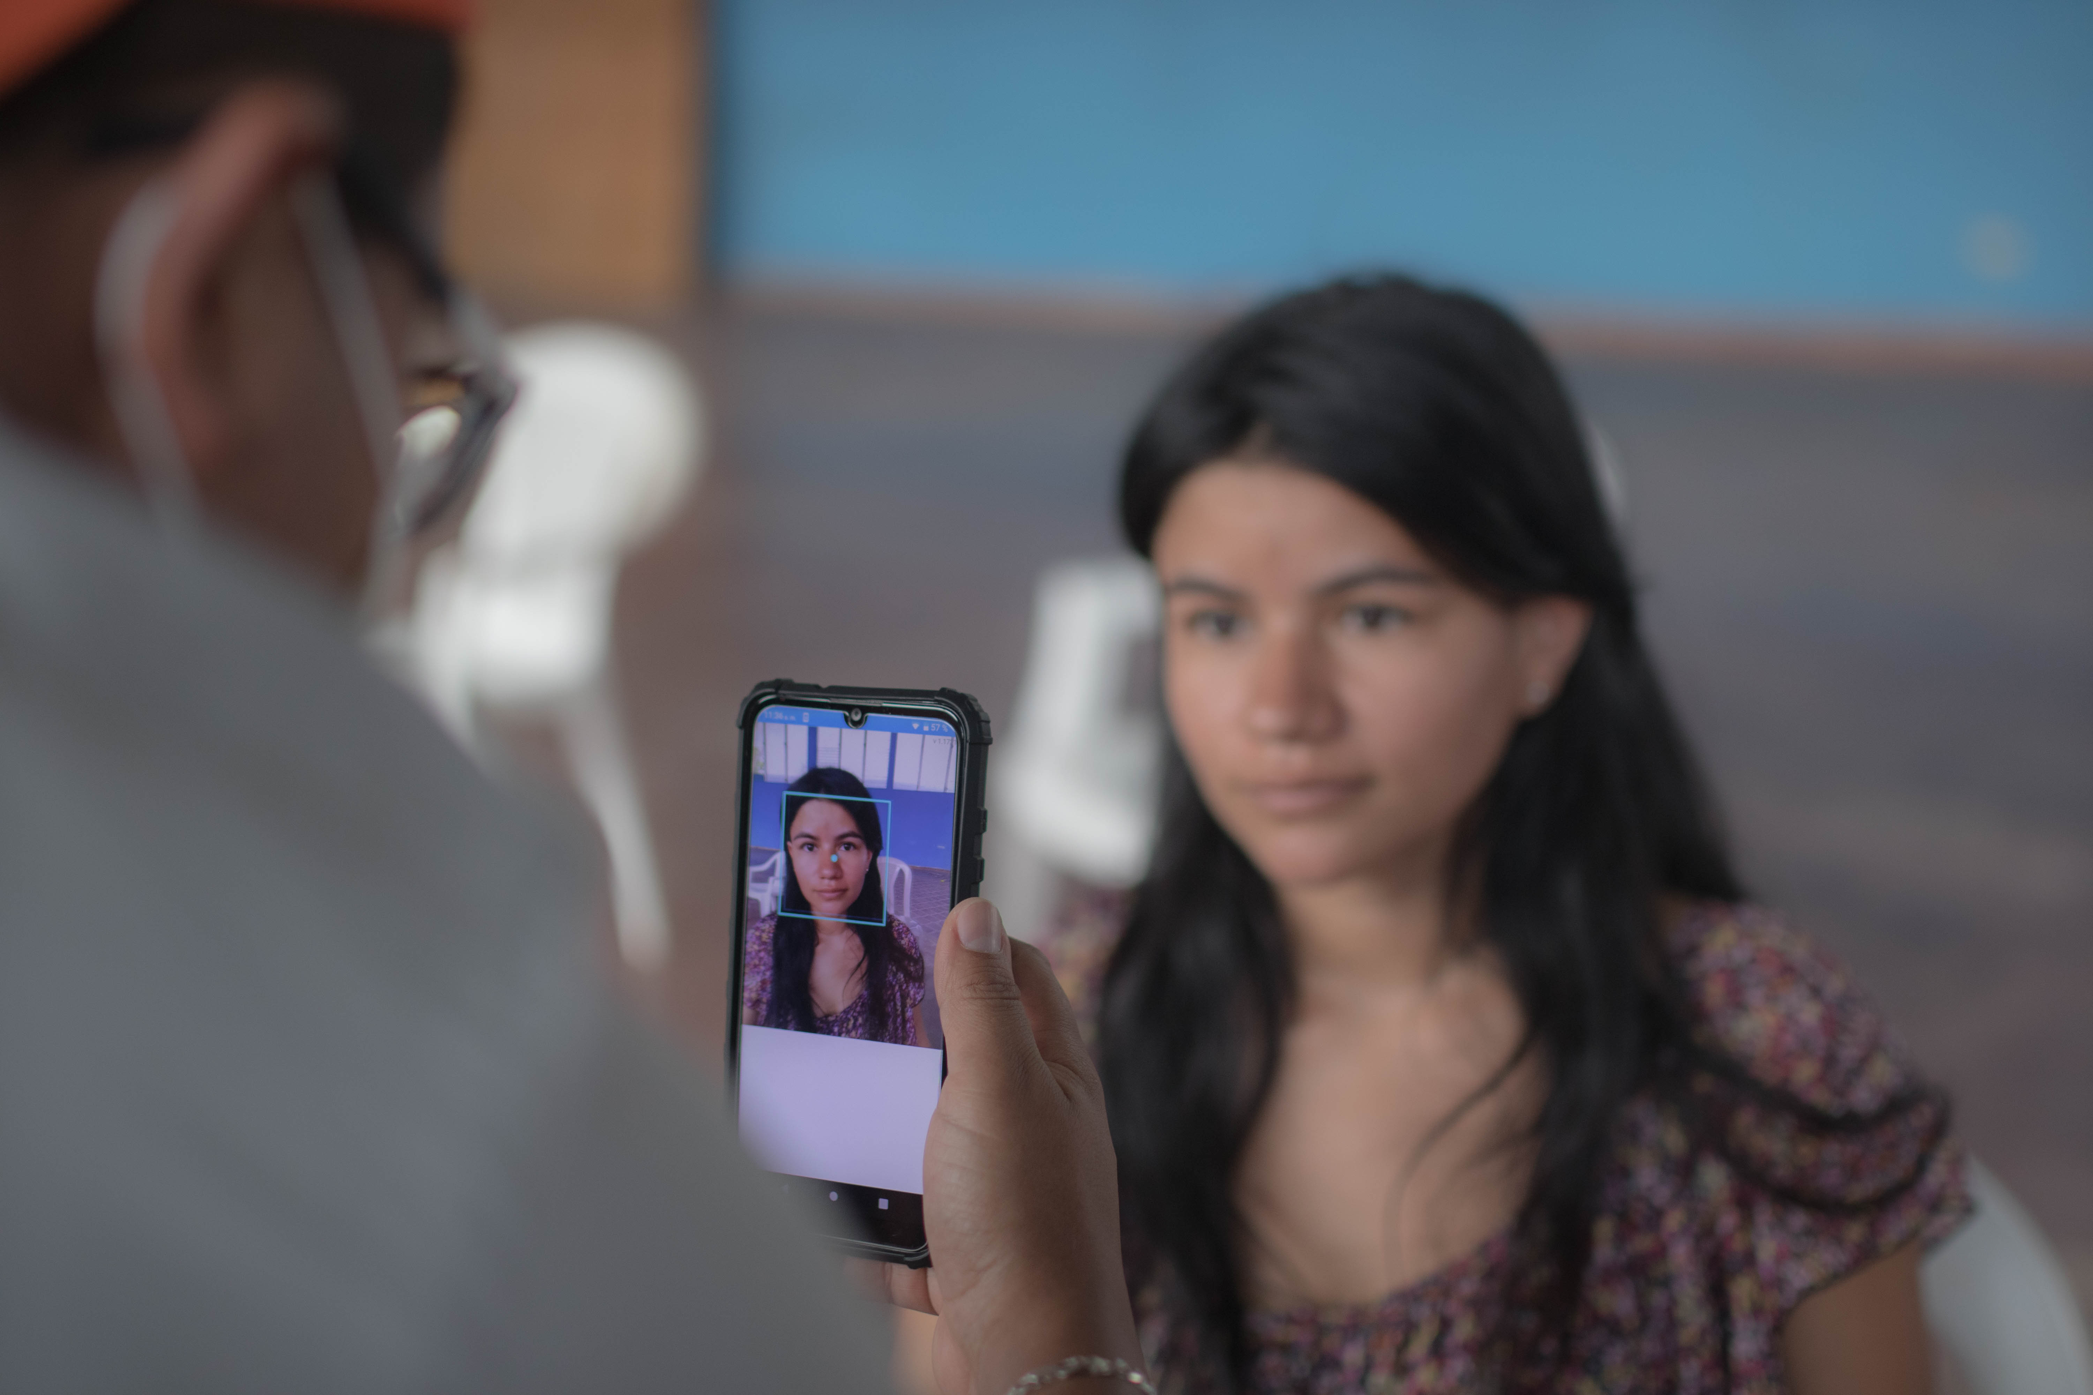
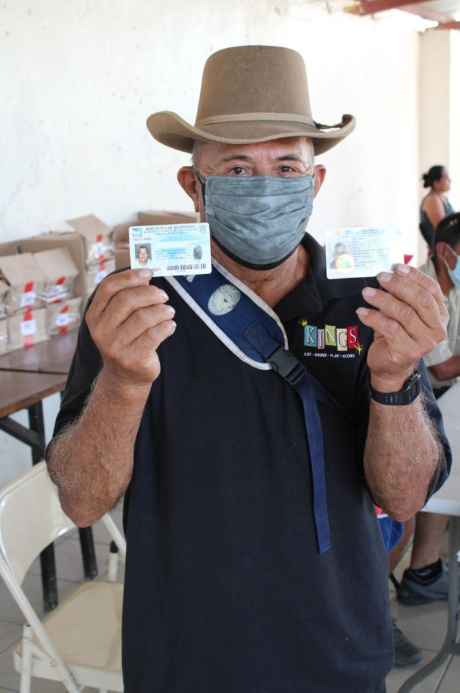

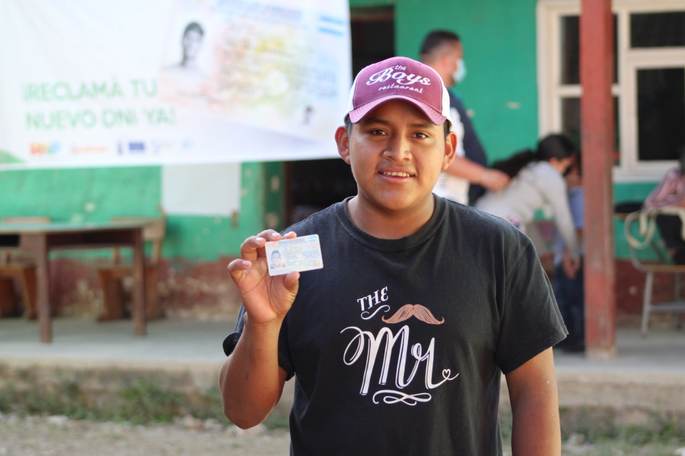
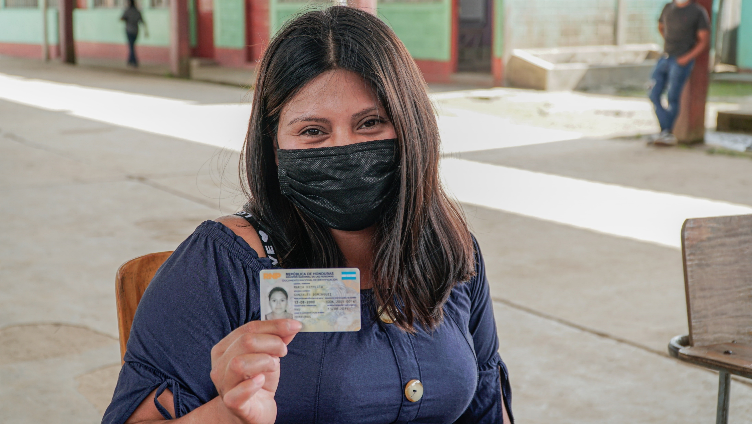
Nationally Enrolled
Participation of Hondurans in the identification process
5,715,641*
men and women with applications for the new DNI
*Data until June 31, 2024

Slide 11
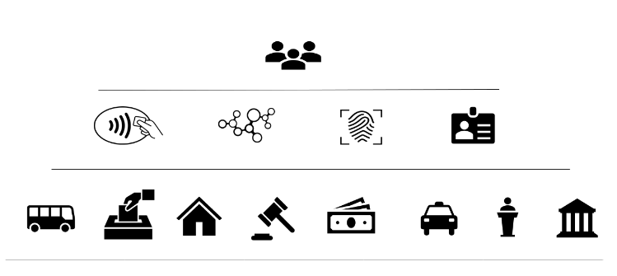
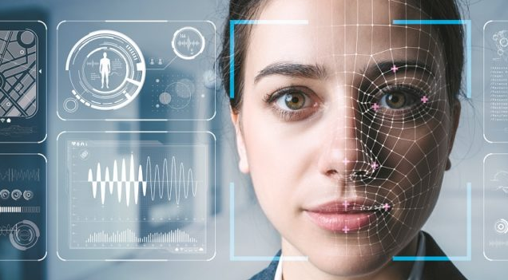
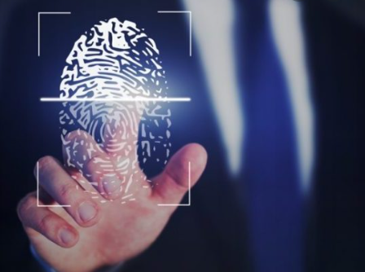

Citizen Authentication
Social Benefits
Electronic Wallets
Elections
Biometric Signature
Health Sector
Education Sector
Notaries
Public Employees
Interoperability
Public Institutions
Banking
Regulated Institutions

Slide 12
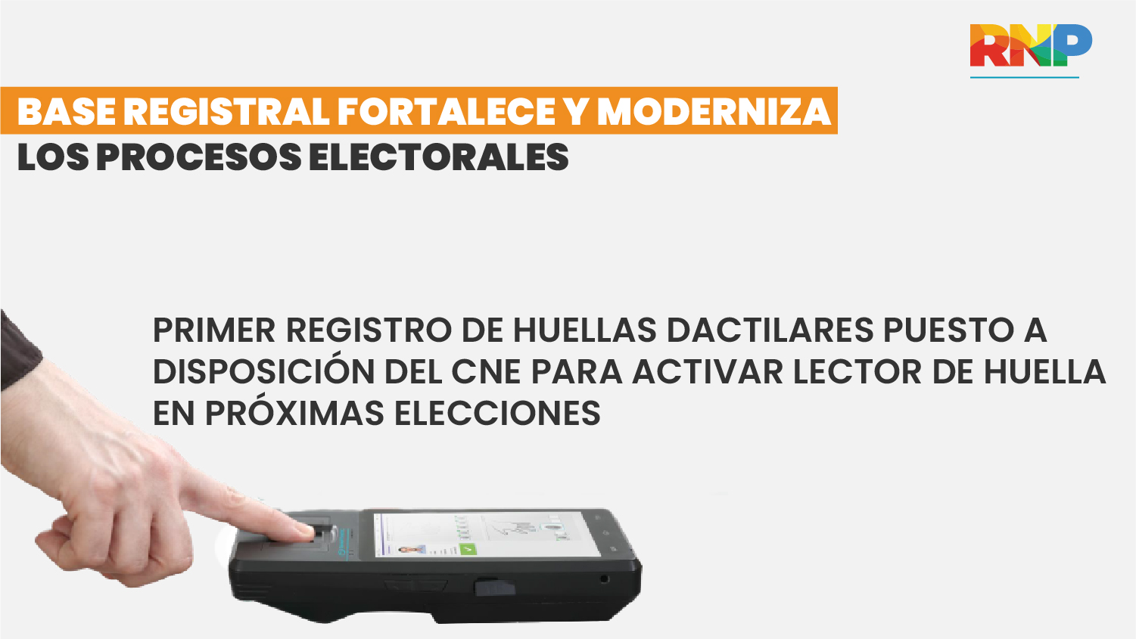
CONTRIBUTION OF THE NATIONAL IDENTIFICATION PROCESS TO THE DEMOCRACY AND GOVERNANCE OF THE COUNTRY
FIRST FINGERPRINT REGISTRY MADE AVAILABLE TO THE ELECTORAL BODY TO ACTIVATE THE FINGERPRINT READER IN THE ELECTIONS

Slide 13
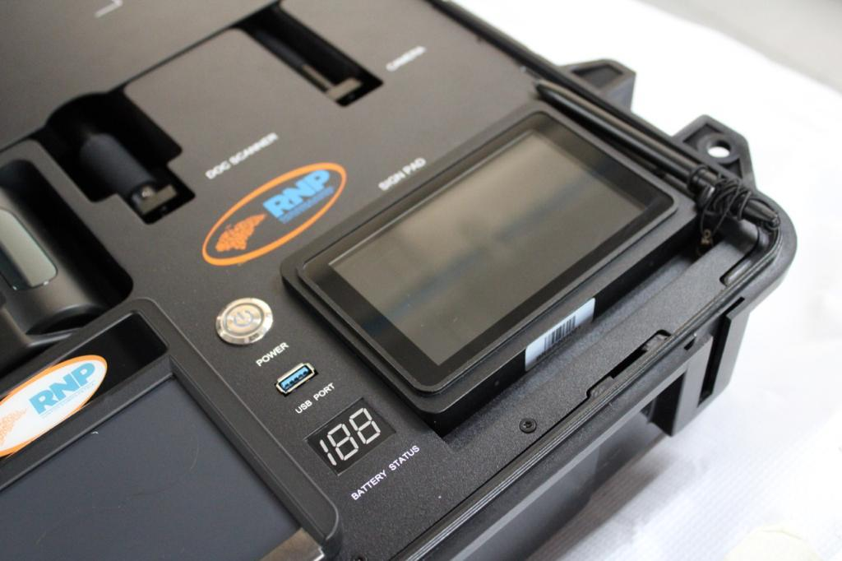
​Contribution of the identification process to the digital transformation of the country

Slide 14
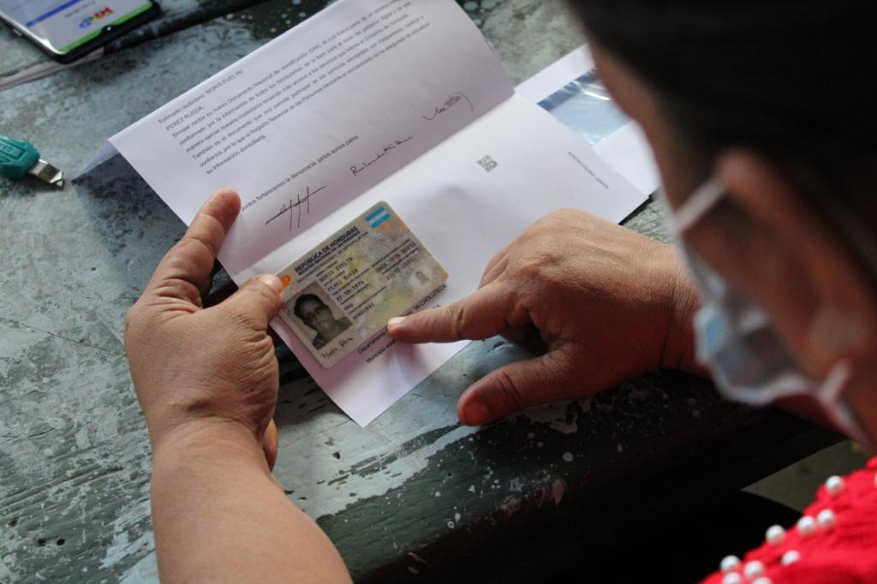
New and modern ID

Slide 15
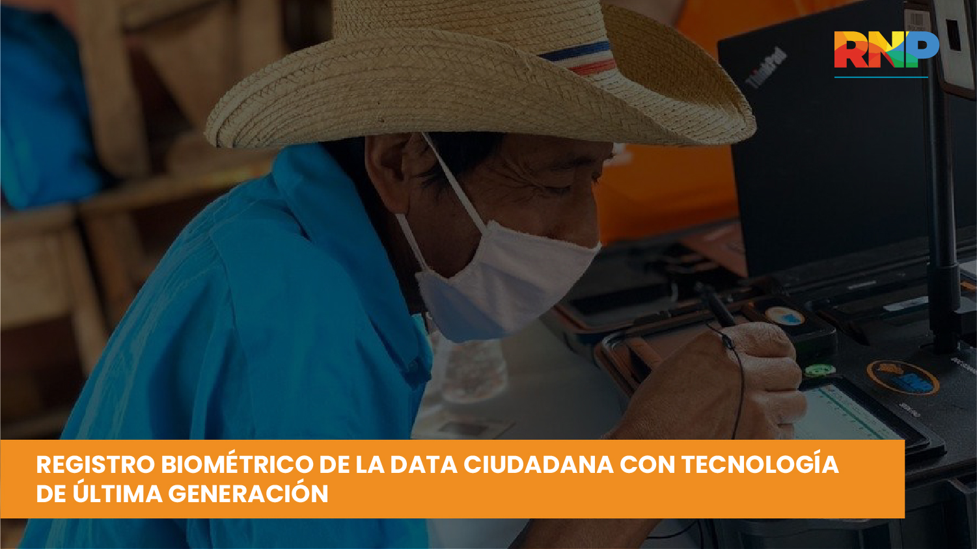
BIOMETRIC REGISTRATION OF CITIZEN DATA WITH LATEST GENERATION TECHNOLOGY

Slide 16
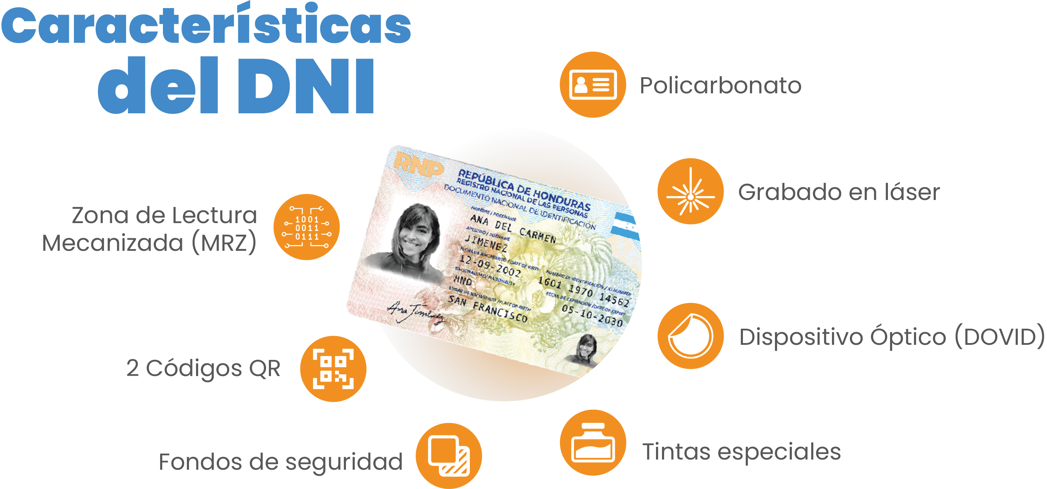
DNI Characteristics
Polycarbonate
Laser engraving
Machine reading zone (MRZ)
Optical device (DOVID)
2 QR codes
Security funds
Special inks

Slide 17
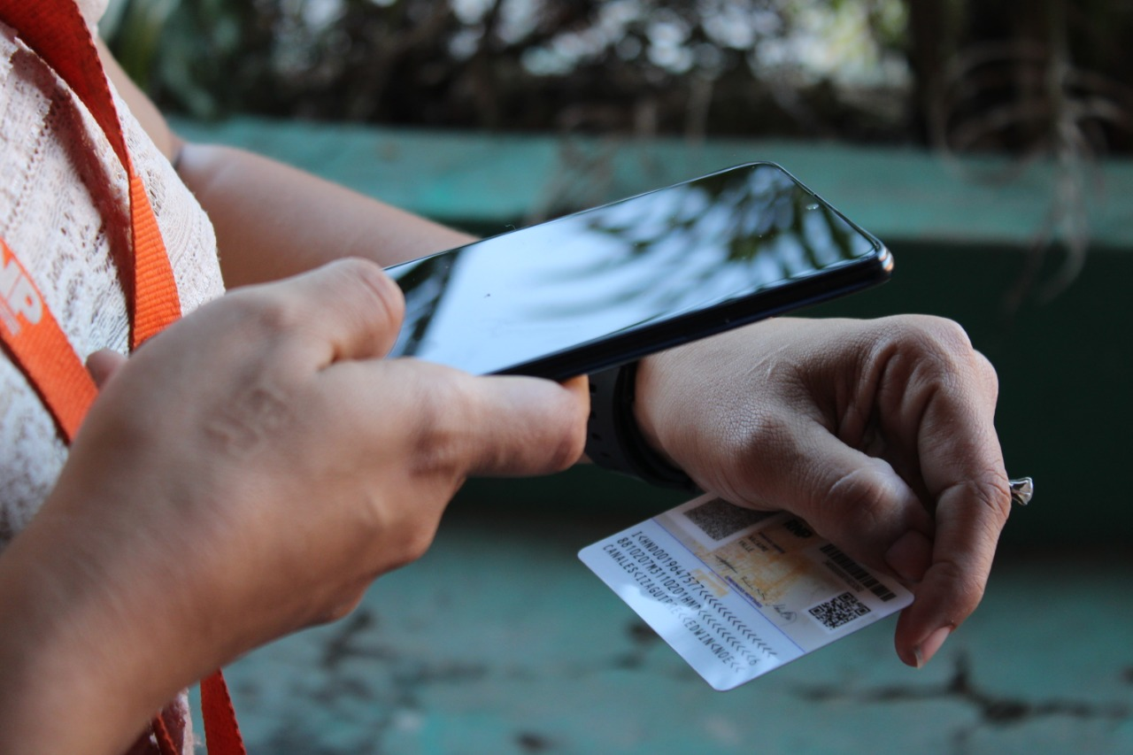
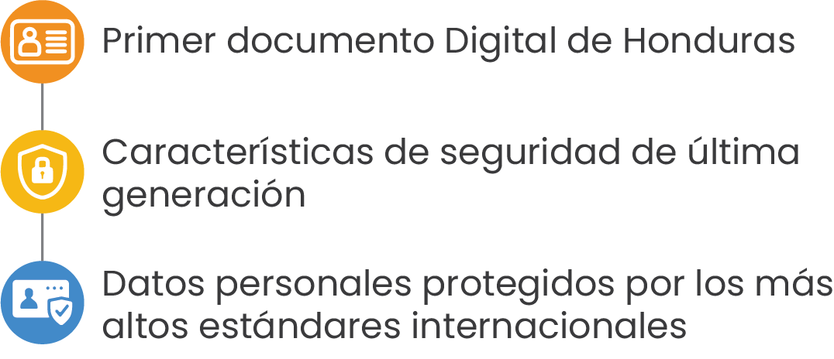
Innovation and security of the DNI
First digital document of Honduras
State-of-the-art security features
Personal data protected by the highest international standards

Slide 18
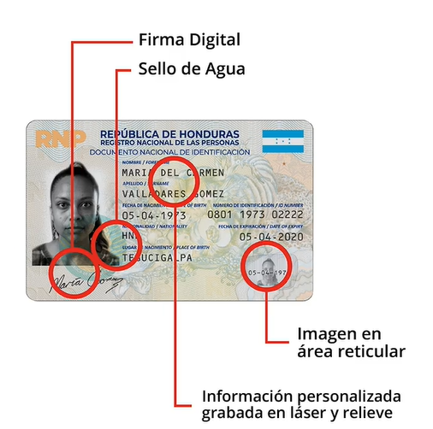
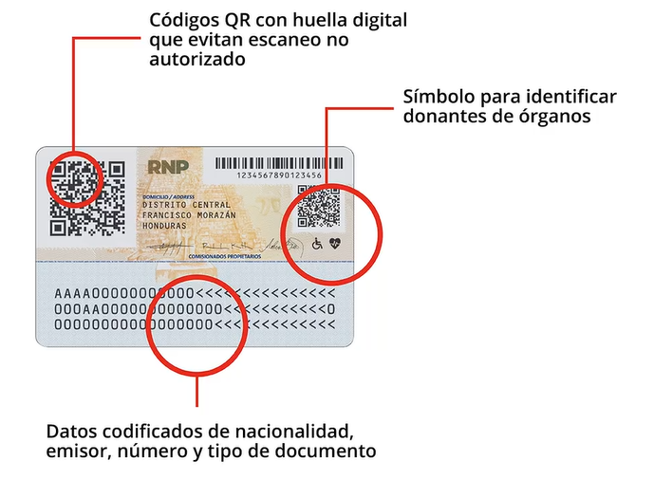
Logros Tecnológicos
Award winning ID card
The new ID card was recognized as the best identity of the Latin American region by ensuring high security through technology and printing features.
QR code with fingerprint that prevents unauthorized scanning
Digital signature
Water mark
Symbol to identify organ donors
Image in reticular area
Personalized information engraved in relief by laser
Encrypted data of nationality, issuer, number and type of document

Slide 19
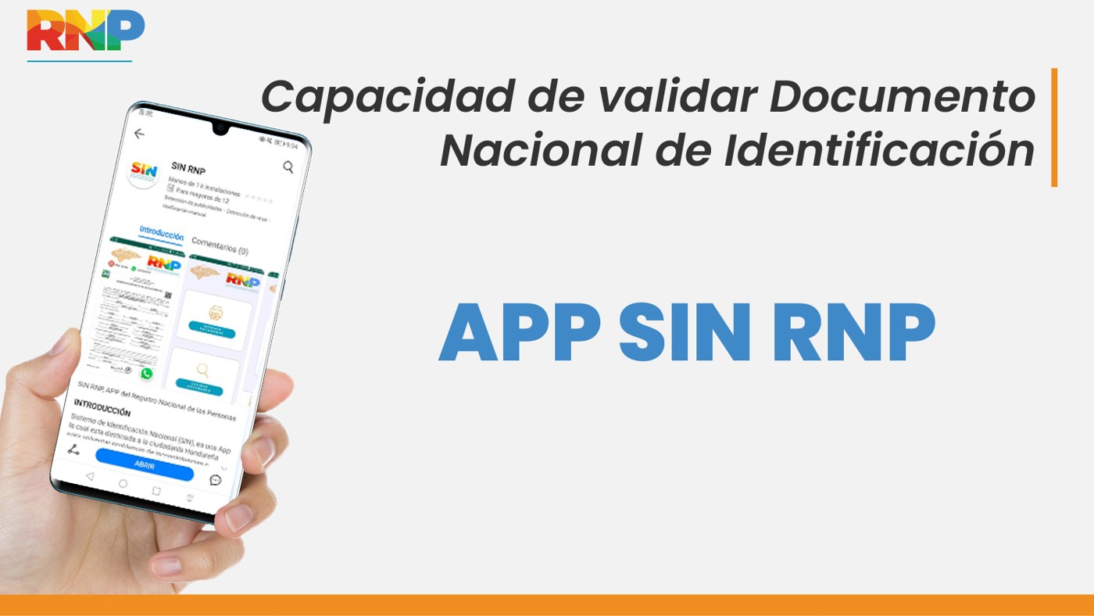
ABILITY TO VALIDATE THE NATIONAL IDENTIFICATION DOCUMENT

Slide 20
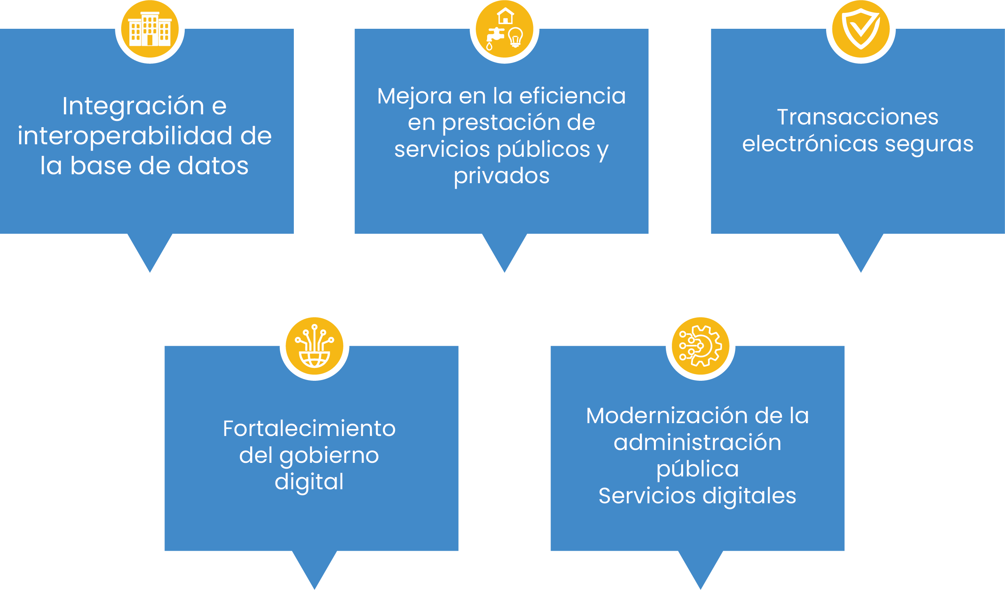
The new DNI will contribute to the digital transformation of the country
Database integration and interoperability
Improved efficiency in the provision of public and private services
Secure Election Transactions
Strengthening of digital government
Modernization of public administration in digital services

Slide 21



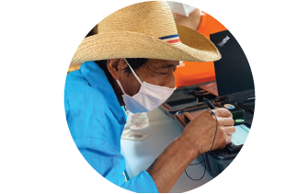




A Strong Partnership: Nationally-Led, UNDP-supported
Technical Assistance
Operations
Digital Transformation
Improved access
to a variety of public and private services
Transparency
Specialized project
organization
Strengthening the National Identification System
Human Resources
Expert Consultants
Low Staff Turnover
UNDP supported the National Registry Office (RNP by its Spanish acronym) to build a robust, modern and inclusive National Identification System.
Logistics

Slide 22
Thank you

