Slide 1
Day 3 | Sunday August 18
Advancing use cases development for national digital ID:
1) Receiving banking services, including receiving mobile money services
2) Registering Sim Cards to receive telecom services
3) Receiving social protection benefits – Baxnaano program as an example
4) IDPs registration and benefits – NIRC
5) Receiving public service - Education and Health Services
6) Receiving passport services – Immigration & Citizenship Agency
Use-case development as part of 3-day consultative session in Mogadishu, August 17-19, 2024
Next pages have the template to fill out together on Day 3
Please bring technical colleague(s) from our organisation tomorrow

Slide 2
Use cases for Somali national digital ID:
Receiving banking services, including receiving mobile money services
Use-case development as part of 3-day consultative session in Mogadishu, August 17-19, 2024
Example

Slide 3
Team: Who’s on your team? What is your use case in 1 paragraph?
Names
Describe the use case in one paragraph
Please remove yellow post-its after finishing
Define the use case together. Have a bias for a concrete and smaller use case, instead of large and broad.
(if you have multiple use cases you want to do, contact NIRA or UNDP)
Bonus for including pictures of each of you
Bonus for including logos of your respective organisations

Slide 4
Challenges: What are the pain points today? Who are experiencing these pains, and in what way?
Challenges:
1.
2.
3.
4.
5.
Bonus, describe the challenges seen from the point of view of different people relevant for your use case (e.g. government employee, user, business owner, etc.)
Name:
Age:
Occupation:
Goals:
Pain Points:
Please insert a real picture to make the use come alive (and delete this post-it afterwards)

Slide 5
Complications: Do you want to expand on the challenges? Why is this a hard problem? What’s the history?
Some questions to start pondering, (please remove after finishing the page)
-------
--------
---------
----------
----------
Is the solution contingent on multiple actors doing things in synchronization?
Are there some actors, “spoilers”, that benefit from status-quo, (e.g. no foundational ID)
Is the use case political to some degree that makes it challenging?
Are there challenges for the business case and financial viability?
Has connectivity and electricity challenges played a role making this challenging?

Slide 6
Map the Current User Journey How do we people get registered, give their info, credentialled and receive the service?
Notes:
Activity 2: This is Mapping the Process As it is now.

Slide 7
Describe the Use Case as-if it was to your leadership team (1 page executive summary)
The use case of remittances for a Legal Digital ID in Somalia involves utilizing the digital identity system to enhance the efficiency and security of money transfers from the Somali diaspora to their families back home. By linking remittances to a verifiable digital identity, the process becomes more streamlined and trustworthy, ensuring that funds reach the correct recipients with reduced risk of fraud or misidentification. This system also simplifies compliance with regulatory frameworks, as financial institutions can easily verify the identities of both senders and receivers, mitigating the risk of money laundering and other financial crimes. Additionally, integrating remittance recipients into the formal financial system through digital IDs can open up access to a broader range of financial services, such as savings accounts, microloans, and insurance, thereby promoting greater financial inclusion and economic stability in Somalia.

Slide 8
Map the Ideal User Journey (with foundational digital ID)
. Collection/Withdrawal
Receiver with Valid ID:
Receiver accesses the funds via mobile money or cash pick-up using their identity documents.
Funds are used, transferred, or withdrawn as needed.
Receiver without Valid ID:
Receiver cannot collect the funds due to the lack of identity documents.
The service provider may hold the funds temporarily and request alternative verification, such as community or local authority identification.
If the receiver cannot provide valid identification, the funds may be returned to the sender or require further intervention.
6. Post-Transaction Experience
Sender and receiver confirm receipt and discuss fund use.
Feedback is provided on the service if necessary.
In cases of unresolved issues:
Customer support may be contacted to resolve identity verification problems or process refunds if the transaction could not be completed.
Do use the NIRA team to understand what will be possible with the digital identity system. Assume you are 12-18 months from now if needed to make your use case come alive
Notes:
Activity 3 : Process to-be, mapping the process with Legal digital Identity.

Slide 9
Impact: How many will be positively affected? How would you convince of the value of the use case with numbers? (Time to find your inner economist!)
For this page, you have to (please delete yellow post-its when done):
For this page, you may want to:
Research and find numbers to back up why this is a valuable use case for foundational digital identity
If no solid number can be found, make estimates based on what you have, and justify your estimates
Bonus for graphs, tables or other illustration that quantitatively explains the benefit of this use case
Just dedicate one analytical team member who is good with numbers to research this during the workshop

Slide 10
Risks: What could go wrong in your use case? Who does it affect and how? How likely is it the risk materializes and how impactful would that be?
Highest Impact
-------
--------
---------
----------
… ----------
Please delete yellow post-its when done:
Bonus, you not only identify the risk, you also prioritize them and map them in a matrix
Lowest likelihood
Highest likelihood
Lowest impact

Slide 11
Partnerships: Who are the key individual experts and organisations for this particular use case? Who could be the organisations required to realize the use case?
Bonus for including logos on organisations
Bonus for suggesting a governance structure (project group, resources required, meeting cadence, responsibilities, etc.) for how the organisations could work together to realize the use case NB: You may need to break down the use case in smaller chunks to do that.
Notes:
Who you recommend as key experts who are highly knowledgeable in the area

Slide 12
Next Steps: What could each of you do next week that would bring this use case closer to fruition?

Slide 13
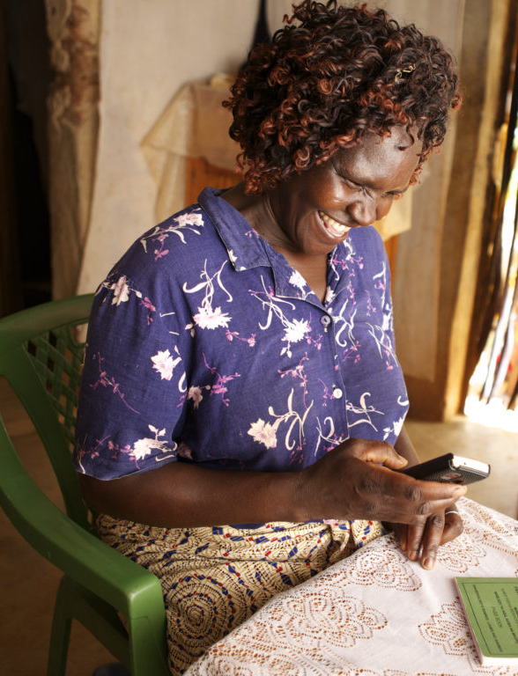
Extra’s for polishing up your use case:
Data flow
Future newspaper article
Use-case development as part of 3-day consultative session in Mogadishu, August 17-19, 2024

Slide 14
SUPER BONUS: What concrete data points are part of this use case (list them)? How does it flow between organisations? Can we minimize the use of personal identifiable information (PII) with foundation ID?
You can also “call a friend” from your organisation to find out these questions
List each data point in a table
If you have the time, you can connect the data to the use-case flow created earlier to create a overview of how the data flows

Slide 15
SUPER BONUS: What would it say in the newspaper if this use case was implemented and worked beyond expectations? Fabricate some results, quotes, find images, and write as if it was in the newspaper 12-18 months from now (Time to find your inner journalist!)
You may want to steal the design from a Somali digital news publication for looks

